Slide 1
THE RESCUE COMPANY 1

Slide 2
Rescue Helicopter Operations

Slide 3
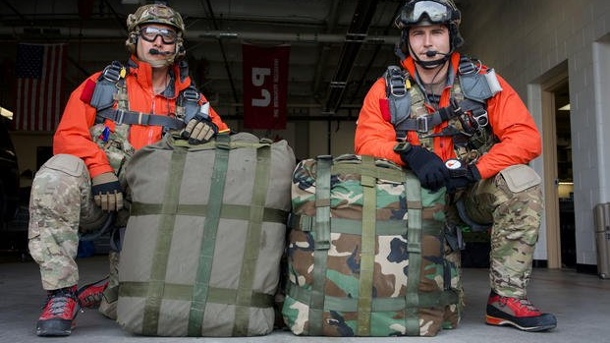
Rescuers aboard Helicopters
Rescuers must board the helicopter fully prepared to hike out.

Slide 4
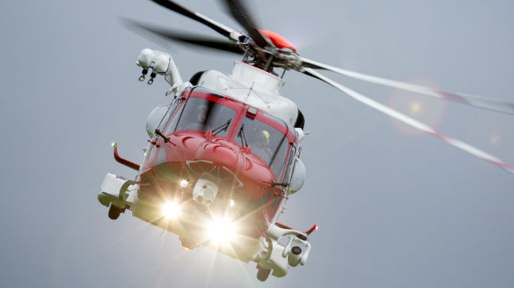
Rescuers aboard Helicopters
Flying conditions can quickly deteriorate, and a flight in does not guarantee a flight out.

Slide 5
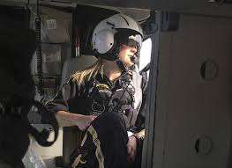
Rescuers aboard Helicopters
Rescuers should study their topographic map carefully before takeoff and look for prominent landmarks as soon as the ship is airborne.

Slide 6
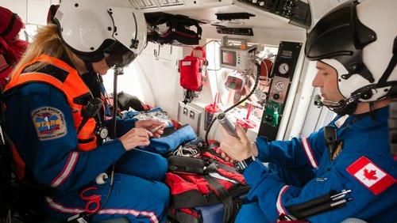
leadership should always choose rescuers experienced with helicopter operations and proven to have stomachs strong enough for helicopter flying.

Slide 7
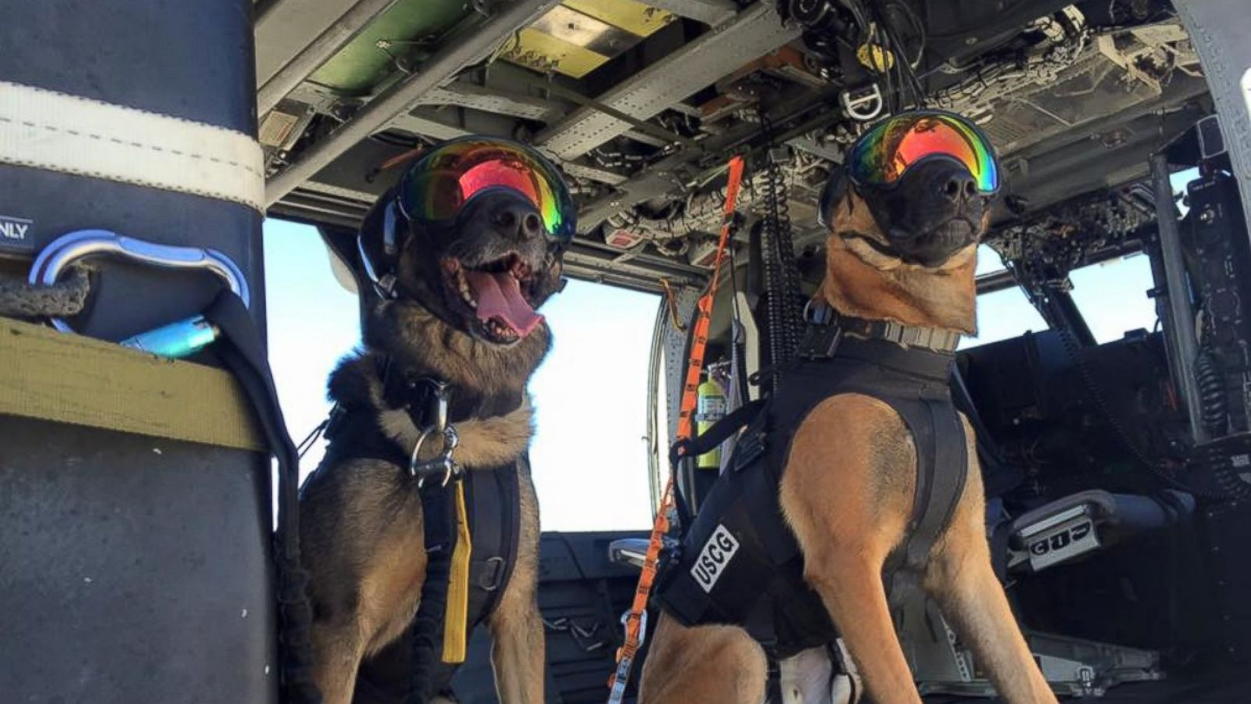
Dogs aboard Helicopters
Search and rescue dogs can be trained to ride in helicopters.
dogs have very sensitive ears and they react to vibrations - especially low frequency vibrations.

Slide 8
Dogs aboard Helicopters
The larger the helicopter, the lower the frequency of vibrations.
Handlers should be prepared to carry dog onboard

Slide 9
Searching From Helicopters
When helicopters are employed during search operations, a rescuer, called a "spotter," will fly with the pilot.
The ideal spotter will have experience with helicopter & rescue operations flight and will not necessarily rely on the pilot to determine which area is best to search.

Slide 10
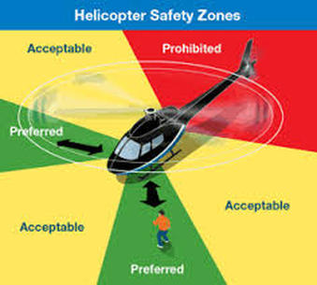
Extrication of Subjects by Helicopter
Ground personnel must ensure that everyone, including rescuers, give wide berth to the tail rotor.

Slide 11
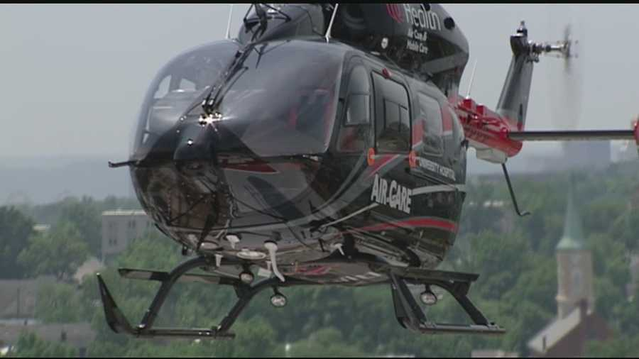
Extricating Uninjured Search Subjects
If the subject of a search is located by helicopter, it may be possible to land, pick up the subject and return to the Incident Command Post.

Slide 12
Extricating Uninjured Search Subjects
Rescuers and pilot must determine if the benefit of immediate evacuation outweighs any risk to aircraft and crew
If the subject is in good physical condition, the rescue team should consider guiding ground teams to the subject

Slide 13
Extricating injured Victims
Circumstances often require loading while the blades are turning, increasing the danger of the work and, consequently, the need for attention while carrying it out.
SAR personnel should seek and accept direction from the flight nurse or pilot, who will choose the path to the loading door of the helicopter.

Slide 14
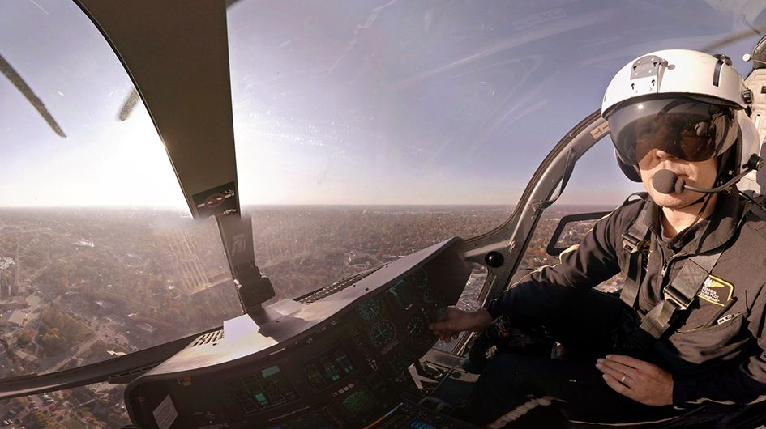
Emergency Procedures
When power to the main rotor is lost, the pilot will put in negative pitch in the main rotor to initiate a controlled descent at the rate of perhaps 1800 feet per minute in a procedure known as Autorotation

Slide 15
Emergency Procedures
As the ship comes within 75-100 feet of the ground, the pilot will add pitch, checking the descent
The pilot often has only 5 or 10 seconds to land an aircraft descending in autorotation.

Slide 16
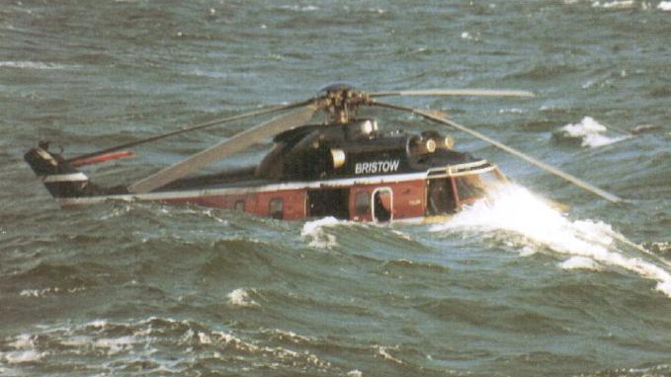
Risk Management Process
Assessing the perceived risk associated with an assi9nment as well as managing that risk to a practical level involves a multi-step process

Slide 17
Risk Management Process
Situational Awareness- knowledge, information, and perception of environment
Hazard Assessment- identification of risk and associated danger
Hazard (Risk) Controls- risk mitigation measures applied
Decision Point- Go/No-Go decision
Evaluate- monitoring

Slide 18
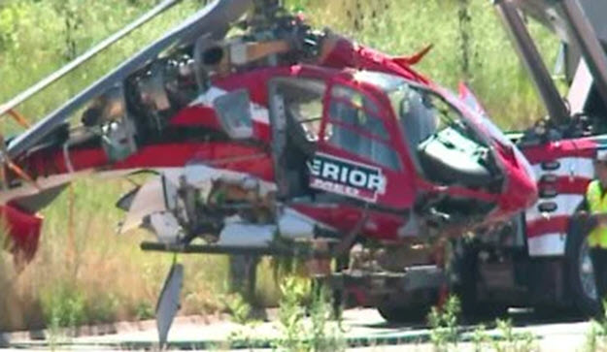
Accept No Unnecessary Risk
SAR operations entail risk. Unnecessary risk conveys no commensurate benefit to safety of a mission. The most logical courses of action for accomplishing a mission are those meeting all mission requirements while exposing personnel and resources to the lowest possible risk.

Slide 19
Accept Necessary Risk When Benefits Outweigh Costs
The process of weighing risks against opportunities and benefits helps to maximize unit capability. Even high-risk endeavors may be undertaken when decision-makers clearly acknowledge the sum of the benefits exceeds the sum of the costs.

Slide 20
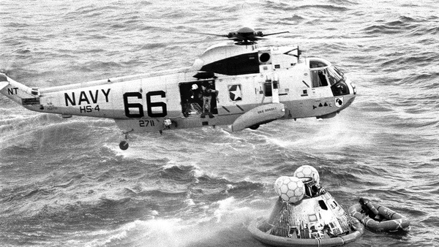
Make Risk Decisions at the Appropriate Level
The appropriate level to make risk decisions is that which most effectively allocates resources to reduce the risk, eliminate the hazard, and implement controls.
This includes ground rescue personnel scrutinizing their own plan to request a helicopter rescue and whether it is truly appropriate

Slide 21
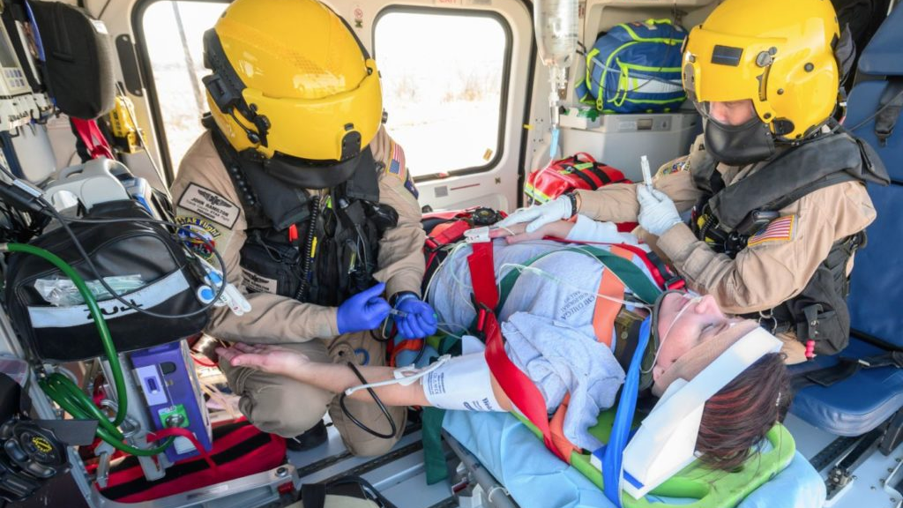
Public Aircraft Regulations- FAA
Helicopter rescue operations are governed by the statutory regulations of the Federal Aviation Administration, which are the Federal Aviation Regulations (FAR) in Title 14 of the Code of Federal Regulations (CFR).

Slide 22
Public Aircraft
Public aircraft are considered by the FM to be those owned or leased by the federal, state, or a local government agency.
The Independent Safety Board Act Amendments of 1994, (Public Law 103-411) clarified the definition of public aircraft and held that one government agency could receive compensation for providing aircraft services to another government agency.
NOT A 135 PROGRAM

Slide 23
Rotorcraft External Load Operations- Public Aircraft
most rescue agencies is FAR Part 133, Rotorcraft External Load Operations, specifically section 133.1, which exempts "a federal, state, or local government conducting operations with public aircraft" from the rotorcraft regulations.

Slide 24
Public Aircraft
According to the FM, "agencies which conduct public aircraft operations are encouraged to comply with the Federal Aviation Regulations (FAR), even when they not required to do so

Slide 25
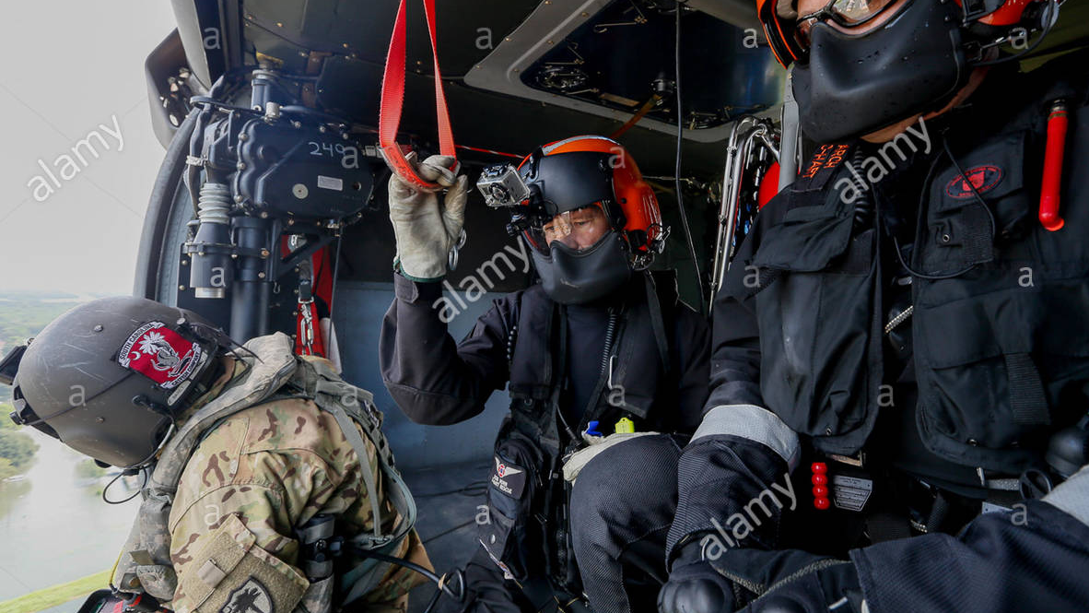
FAR Part 133.31
FAR Part 133.31, Emergency Operations (a), states, "In an emergency involving the safety of persons or property, the certificate holder may deviate from the rules of this part to the extent required to meet that emergency."

