Slide 1
The rescue company 1

Slide 2
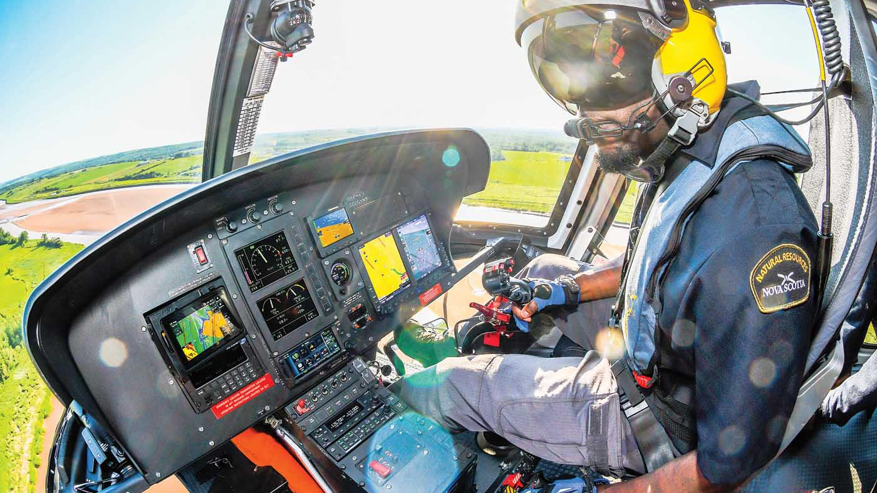
NAVIGATION

Slide 3
Stay or Move Considerations
Leave only when:
Dictated by the threat.
Certain of your location and your destination and you can get there.
Able to reach water, food, shelter, and/or help.
Convinced rescue is not coming.

Slide 4
If you decide to move
Follow
Follow your EPA.
Determine
Determine which direction to travel and why.
Decide
Decide what equipment to take, cache, or destroy.

Slide 5
Other Considerations
Stay in place (e.g., with vehicle).
If you do not stay in place, leave information at your starting point that includes:
Destination and route of travel.
Personal condition.
Supplies available.

Slide 6
Navigation
Determine Navigation and Position
Determine general location.
Note: Determine best guess direction based on previous
knowledge when navigating without a map, global positioning system (GPS), or compass (e.g., movement is east toward the border).

Slide 7
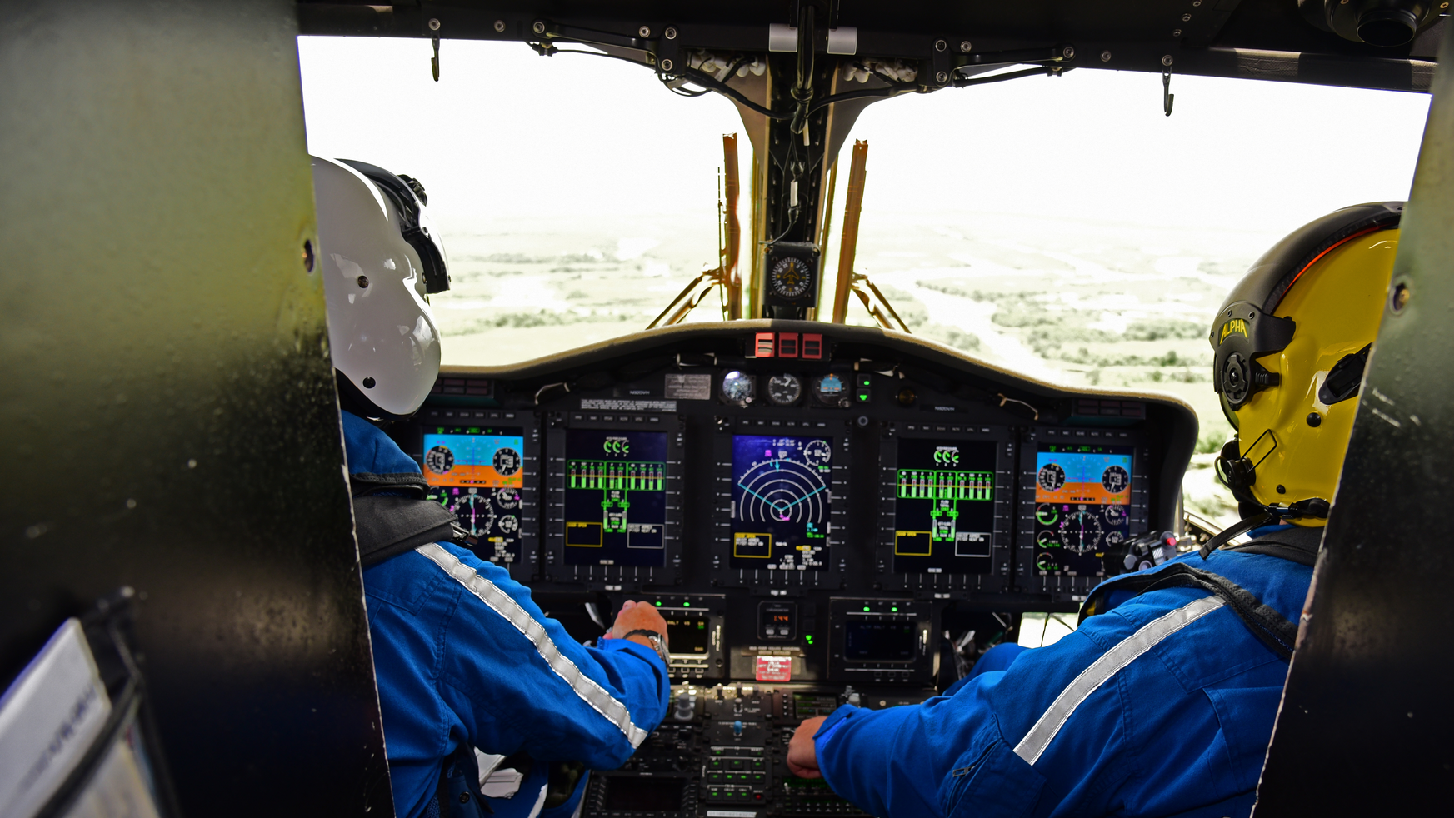
Navigation
Develop working knowledge of operational area.
Geographic checkpoints.
Man-made checkpoints.
Previous knowledge of operational area.

Slide 8
Navigation
Use
Use formula: Rate x Time = Distance.
Use
Use information provided in map legend.
Use
Use prominent landmarks.
Visualize
Visualize map to determine position.

Slide 9
Navigation direction
Determine
Determine cardinal directions (north, south, east, and west).
Use
Use compass.
Use
Use stick and shadow method to determine a true
Remember
Remember the sunrise/moonrise is in the east and sunset/moonset is in the west.

Slide 10
Navigation direction
Use wristwatch to determine general cardinal direction, if current local time is known.
With digital watches, visualize a clock face on the watch.

Slide 11
Stick and Shadow Method to Determine North/South Line

Slide 12
Wristwatch Method to Determine North/South

Slide 13
Celestial Aids (Stars) Method to Determine North/South Line

Slide 14
To orient the map
Use a true north-south line.
Unfold map and place on firm, flat, level nonmetallic surface
Align compass on true north-south line.
Rotate map and compass until stationary index line

Slide 15
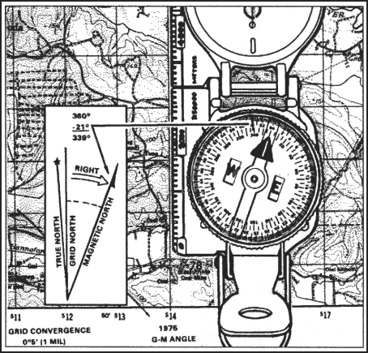

Slide 16
Map Other
Aligns with the magnetic variation indicated in marginal information.
Easterly (subtract variation from 360 degrees).
Westerly (add variation to 360 degrees).

Slide 17
compass rose
Place edge of the compass on magnetic north line of the compass rose closest to your location
Rotate map and compass until compass reads 360 degrees

Slide 18
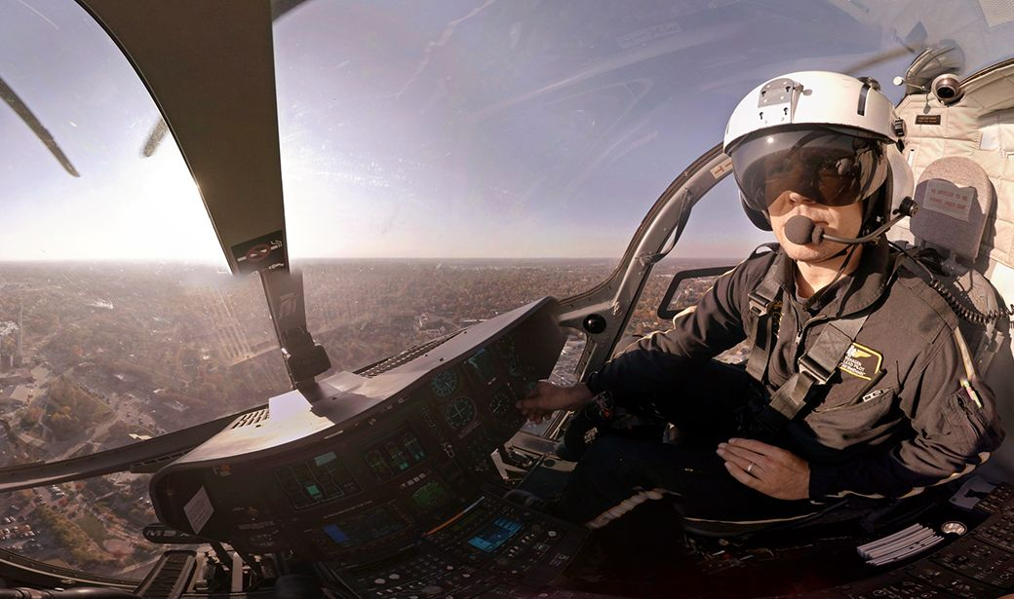
If there is NO compass
Orient map using cardinal direction
Obtained by the stick and shadow method
or the celestial aids (stars) method.

Slide 19
If there is NO compass
Determine specific location (be prepared to give coordinates and datum to rescue forces if asked).
Using GPS and map.
More sky= better accuracy and quicker position acquisition.
More frequent position fixes = shorter time to acquire next position.

Slide 20
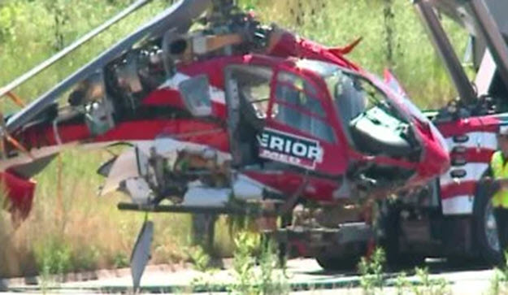
Obviously incorrect position data
you know your rough position
but your GPS receiver shows a location that is significantly and obviously incorrect
(for example you know you are in Iraq, but your receiver shows O degrees latitude and 5 degrees longitude).

Slide 21
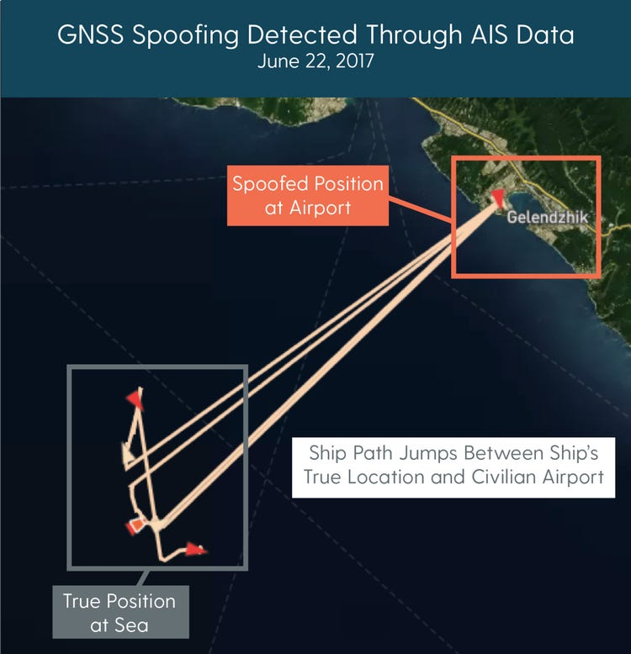
Jumping" position data
receiver position jumps between significantly different positions (for example more than a tenth of a degree at a time).

Slide 22
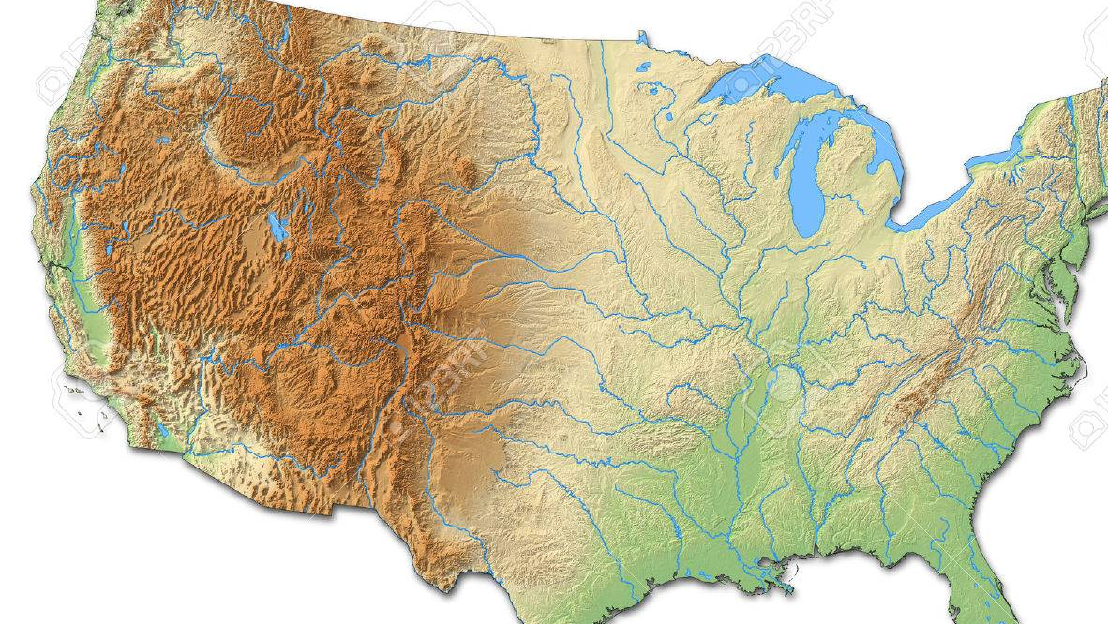
Unexpected loss of position lock
Receiver has good view of the sky and good power supply and is operating normally but cannot maintain position lock or is unexpectedly knocked off a position lock.

Slide 23
Conserve GPS battery life
Triangulation (resection) with a compass.
Try to use three or more azimuths (between 30 and 130 degrees apart).
Positively identify a major land feature and determine a line of position (LOP).

Slide 24
Conserve GPS battery life

Slide 25
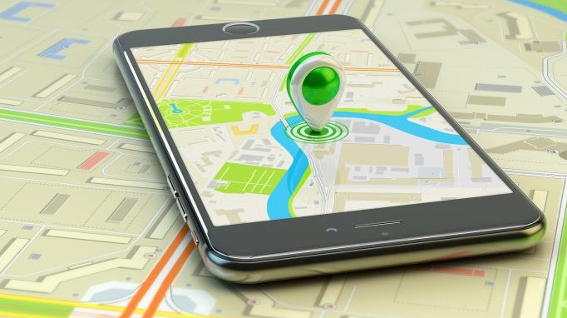
Conserve GPS battery life
Check map orientation each time compass is used.
Plot the LOP using a pencil line.

Slide 26
Use the compass for night navigation
Setting up compass for night navigation
Aligning north-seeking arrow with luminous line and follow front of compass.
Using point-to-point navigation.

Slide 27
Use route selection techniques
Circumnavigation.
Find a prominent landmark on the opposite side of obstacle on current heading.
Contour around obstacle to landmark.
Resume your route of travel.

Slide 28
Dogleg and 90-degree offset

Slide 29
Straight-line heading
Maintain heading until reaching destination.
Track number of paces traveled to monitor progress.

Slide 30
Distances measured by paces
One pace is the distance covered each time the same foot touches the ground.
Distances measured by paces are approximate
Keep track of your pace count (pebbles in pocket or knots in a string per 100 meters).

Slide 31
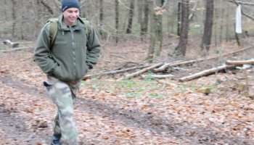
Individual pace
Individual pace varies because of factors such as steep terrain, day/night travel, or injured/uninjured condition.
Adjust estimation of distance traveled against these factors to get relative accuracy when using a pace count.

Slide 32
Point-to-point same as straight line
Pick out landmarks on the heading and walk the trail of least resistance to a point.
On reaching a point, establish another landmark and continue.

Slide 33
Travel Considerations
Maintain
Maintain a realistic pace.
Take
Take rest stops when needed.
Avoid
Avoid overdressing and overheating.
Consider
Consider food and water requirements.

Slide 34
Travel Considerations
Take special care of feet (change socks regularly).
Pack equipment to prevent loss, damage, pack imbalance, and personal safety.

Slide 35
Travel Considerations
Go around
Go around obstacles, not over or through them.
Avoid
Avoid travel on trails, if possible.
Travel in
Travel in forested areas, if possible.

Slide 36
Travel Considerations
Avoid creek bottoms and ravines with NO escape in the event of heavy rains.
Consider the following for swamps, lakes, and unfordable rivers:

Slide 37
Travel Considerations
Circumnavigate swamps, lakes, and bogs, if possible.
Travel downstream to find people and slower water.
Travel upstream to find narrower and shallow water.

