Slide 1
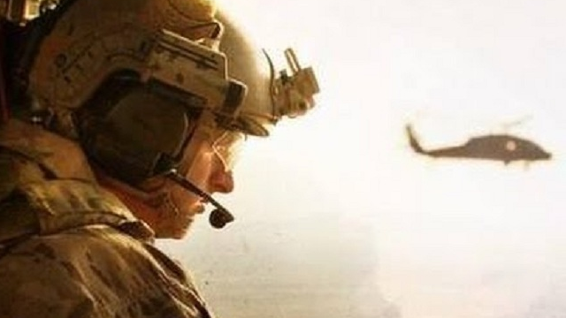
THE RESCUE COMPANY 1

Slide 2
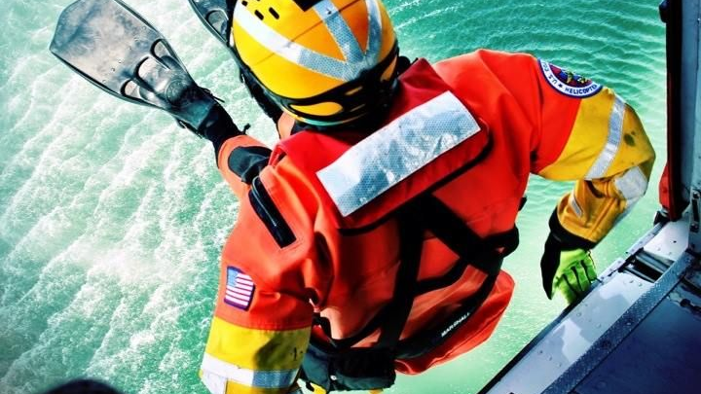
Helicopter rescue swimmer Helicopter Rappel part 3

Slide 3
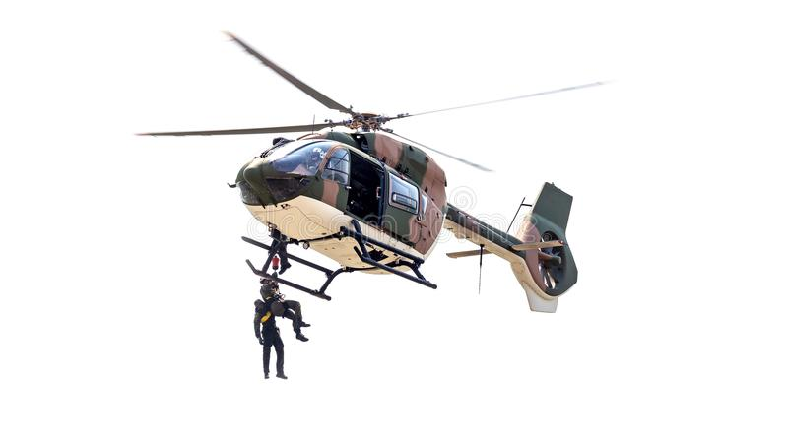
Emergency Procedures

Slide 4
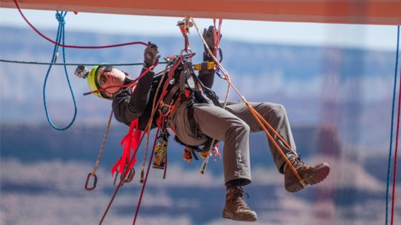
Hung Roper
The HRST master immediately notifies the air­ craft commander.

Slide 5
Hung Roper
The aircraft commander lowers the roper to the ground until the hung roper's feet are on the deck. Once the hung roper's feet are on the ground or he is within 10 feet of the ground, the rope is cut.
However, if the roper is hung more than 10 feet from the helicopter, he is assisted by the belay man and SIO to clear the rope.

Slide 6
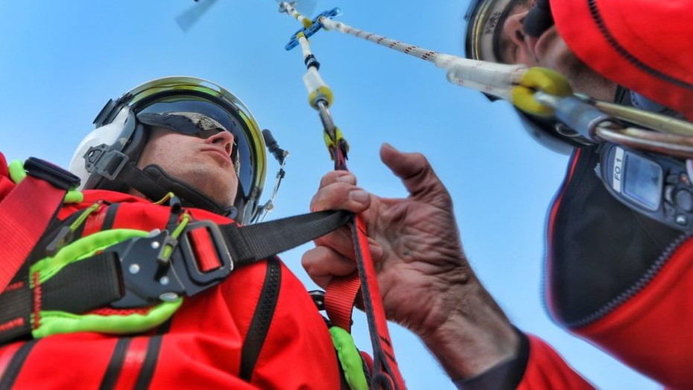
Hung Roper
If the aircraft commander is unable to land and must search for a landing site, the HRST master ties a figure eight loop on the safety line, then attaches a steel locking carabiner.
The safety line is secured to the inside of the helicopter at an anchor point opposite of the fouled rope's anchor points.

Slide 7
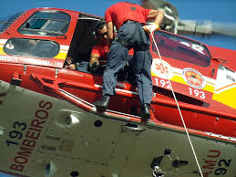
Hung Roper
The carabiner is then connected and lowered on the rappel ropes.
The hung roper disconnects the safety carabiner from the rappel ropes and reconnects the safety carabiner and safety line to his seat carabiner.

Slide 8
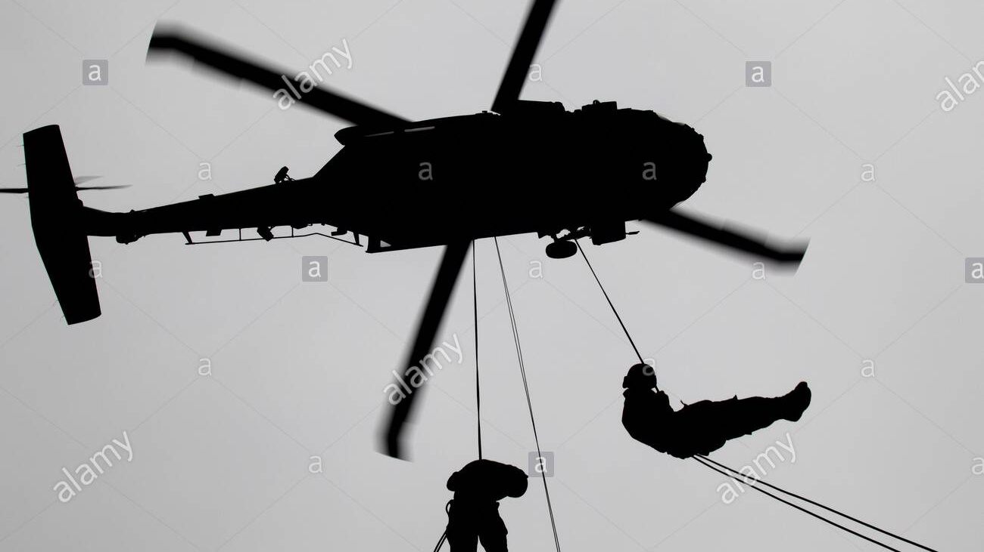
Hung Roper
• If the helicopter cannot descend, a safety line is rigged to establish a belay point. The safety line is rigged to the anchors opposite of the rappel station.

Slide 9
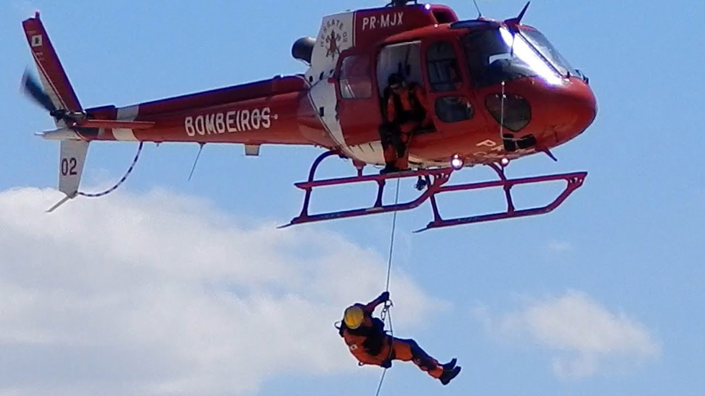
Hung Roper
To rig the belay, the HRST master ties a figure eight loop on one end of the safety line and attaches a steel locking carabiner. The safety line and steel locking carabiner are attached to the rappel ropes and lowered to the hung roper.

Slide 10
Hung Roper
The hung roper disconnects the safety line/carabiner from the rappel ropes and re-attaches them to his rappel seat.

Slide 11
Hung Roper
The HRST master secures the other end of the safety line with a suitable anchor knot to the anchor points oppo­site of the rappel system, leaving the last anchor point or the anchor closest to the ramp vacant.

Slide 12
Hung Roper
On this anchor point, the HRST master attaches a steel locking carabiner. The HRST master then uses a munter hitch to attach the safety line to the same carabiner that is hooked to the anchor point.

Slide 13
Hung Roper
The slack is removed from the safety line and the brake is applied. The rappeller is then instructed to free himself from the fouled rappel system.

Slide 14
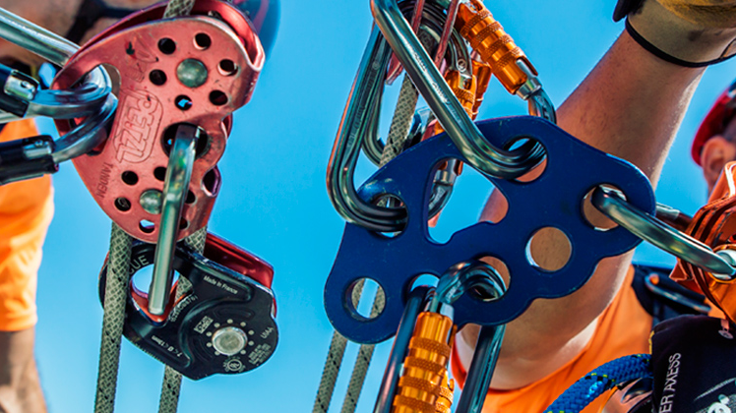
Hung Roper
The rope Master lowers the hung roper to the ground, releasing tension on the safety rope (belay).

Slide 15
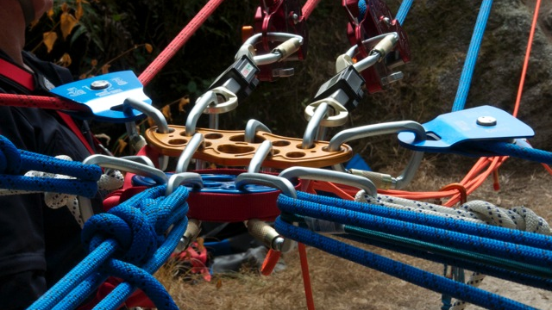
Fouled Rope
A rope may become fouled or entangled on ground obstacles while rappelling. In the event of a fouled rope

Slide 16
Fouled Rope
Ensure all ropers are clear.
If possible, descend or reposition helicopter over target to decrease tension on the rope.
If sufficient tension cannot be released in order to release the rope, the aircraft commander may command, "Cut rope."

