Slide 1
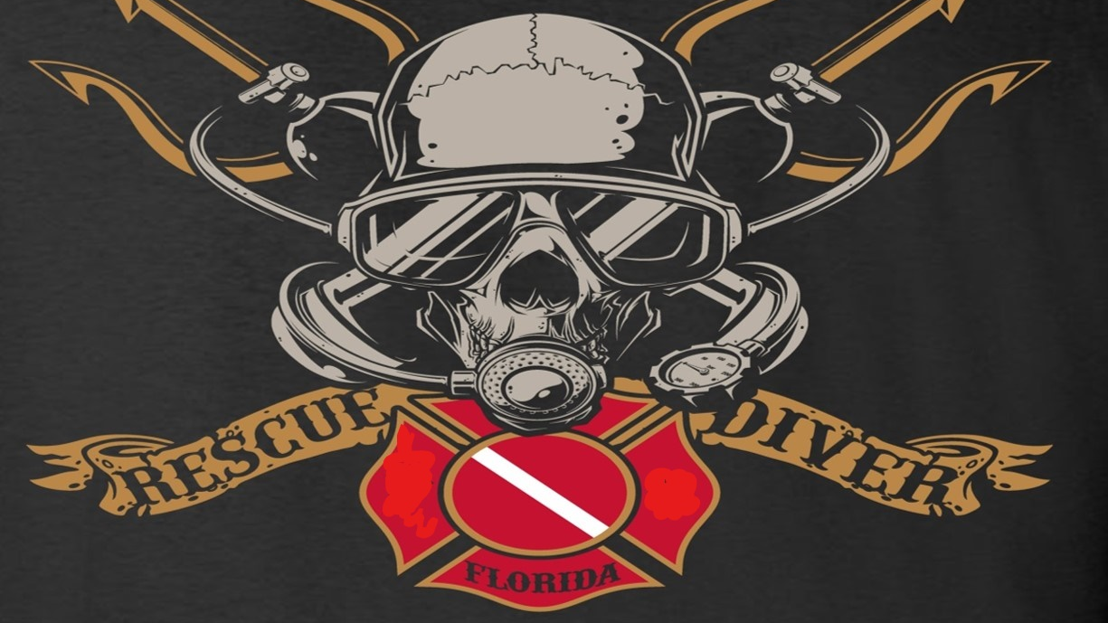
The rescue company 1
Helicopter Swiftwater Rescue

Slide 2
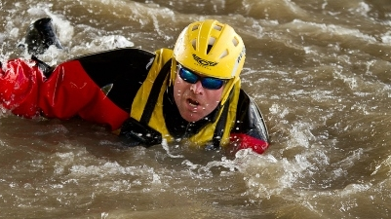
Concepts and Philosophy of Rescue

Slide 3
RESCUE CURVE

Slide 5
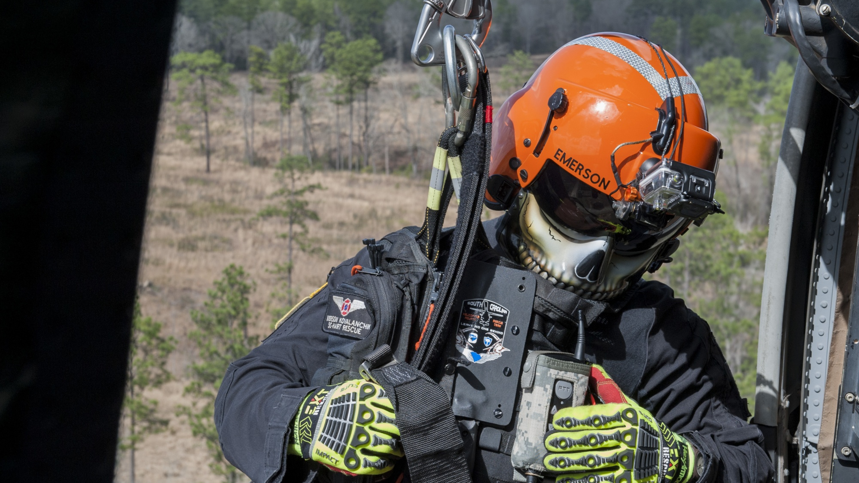
sixteen principles of rescue
They are good thumb rules for practice

Slide 6
sign of a novice
A sign of a novice is that they begin their rescue efforts with rescue by others {i.e. the rescue squad).
In contrast, experienced boaters emphasize safety and self-rescue as their first line of defense.

Slide 7
sign of a novice
This is an application of the Rescue Curve discussed later in this section ( see 911 Syndrome).
If your first line of defense in rescue is rescue by the rescue squad, you next option is a major injury or body recovery.

Slide 8
sign of a novice
In a sense, you have squandered away most of your options.
paddlers increase their options of survival and enjoyment by focusing on safety, prevention and self-rescue as their first lines of defense.

Slide 9
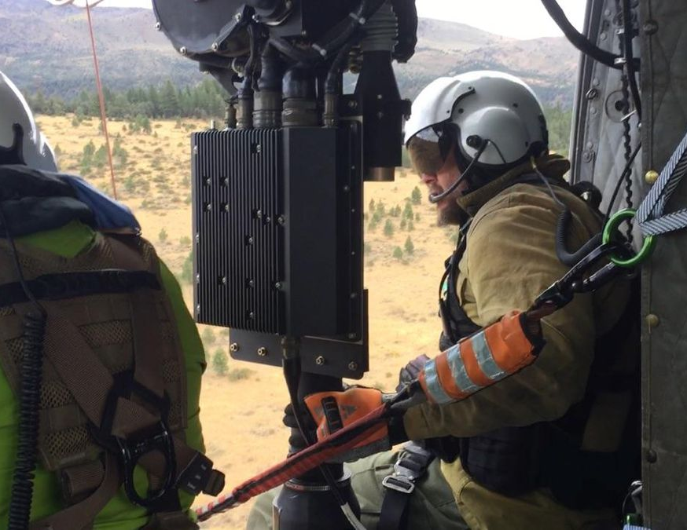
Eliminate the accident/incident before it happens.
Recognize fatigue, hazards, insufficient skills, lack of experience, etc. before it leads to a life-threatening situation.
Choose a trip that is commensurate with the skills and abilities of the participants.

Slide 10
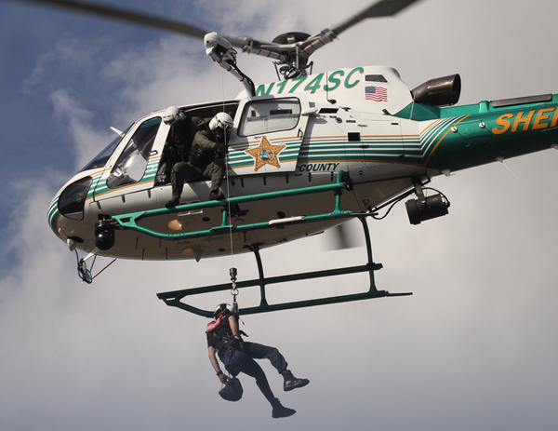
Eliminate the accident/incident before it happens.
Remember, no accident; no rescue. Isn't this what everyone wants? All, this is under the rubric of good trip planning.

Slide 11
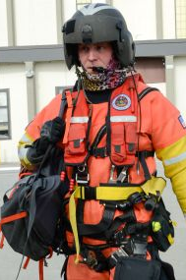
Always wear a life jacket {PFD)
Anyone within 10 feet of the water should be appropriately dressed for being in the water, including wearing a life jacket.

Slide 12
"Caution" is always the sign of a good rescue
Fight adrenalin.
It narrows a person's focus.
It reduces cognitive thought in the frontal lobes.

Slide 13
Caution" is always the sign of a good rescue
This is why training is important.
It counter acts the loss of cognitive thought.
It can lead to a rescuer entering the scene without adequately surveying the scene for the mechanism of injury(MOI). \

Slide 14
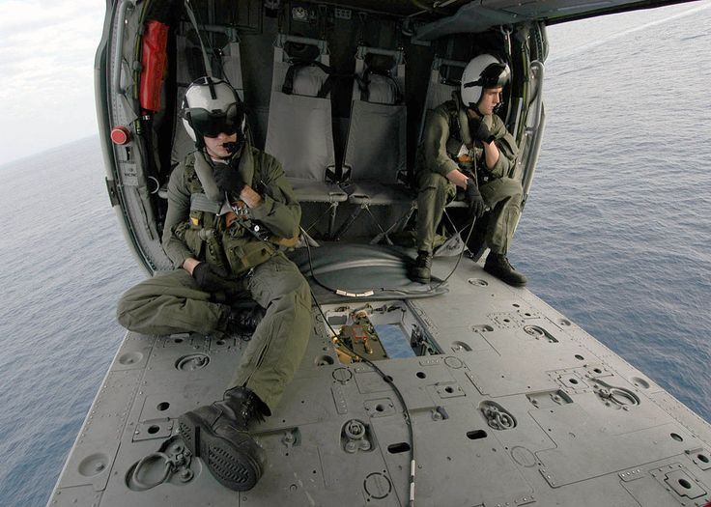
Caution" is always the sign of a good rescue
It can lead to a second victim.
Most manuals recommend that the first step is to "survey the scene.“
Practice STOP.

Slide 15
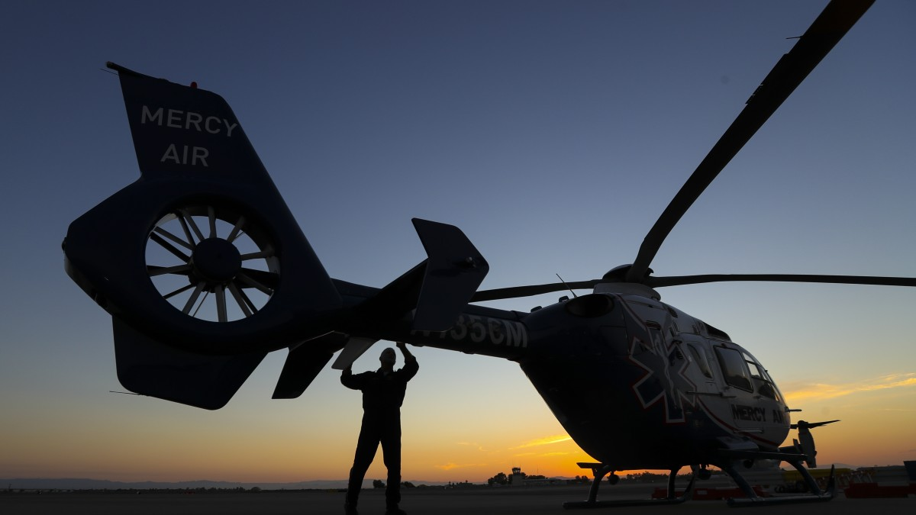
STOP.
When you first come upon scene, stop, think, observe/options, and plan

Slide 16
Never make the situation worse
If a rescuer becomes a victim while performing a rescue, you have made the situation worse.
You now have two victims.
If you dislodge the victim without someone to pull the victim out downstream, you have made the situation worse.

Slide 17
Never tie a rope around the rescuer
If you are tied in, then you are no longer in control of yourself.
Also, don't confuse this point with a self-release system on a rescue harness.
With a rescue harness, you have control and can release the belt.

Slide 18
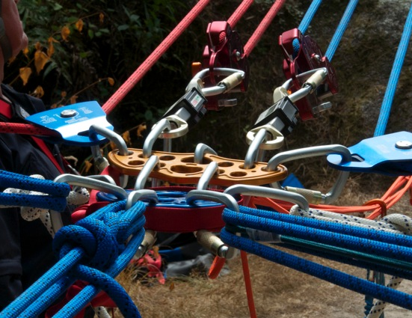
KISS. Keep it simple and safe
Utilize the lowest risk methods first.
Set up the next higher risk method as the next alternative.
To a degree, this principle reflects the underlying changes in swiftwater rescue philosophy.

Slide 19
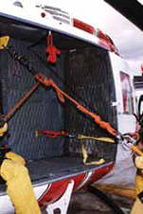
KISS. Keep it simple and safe
It reflects a change in the 1970s when swiftwater rescue morphed many of the more complex climbing rescues (e.g. Tefler lower).
Also, it reflects the amount of equipment swiftwater rescuers must effect a rescue.
Usually, this is a throw rope and two to three carabiners.

Slide 20
Think multiple systems
If one rescue system fails, you should have an alternative approach in the works.
Always use the lowest risk method first.

Slide 21
Think multiple systems
If you have the personnel, use them.
Also, think more than one-way of rescue.

Slide 22
Deploy upstream spotters
You don't need recreational paddlers or rafters interfering with your rescue.
In addition, you want to spot debris before it interferes with the rescue.

Slide 23
Deploy upstream spotters
Normally, this would read always deploy upstream spotters.
A typical group of four or five paddlers may not have the luxury of having a designated spotter. If not, designate someone to assume this role.

