Slide 1

THE RESCUE COMPANY 1

Slide 2
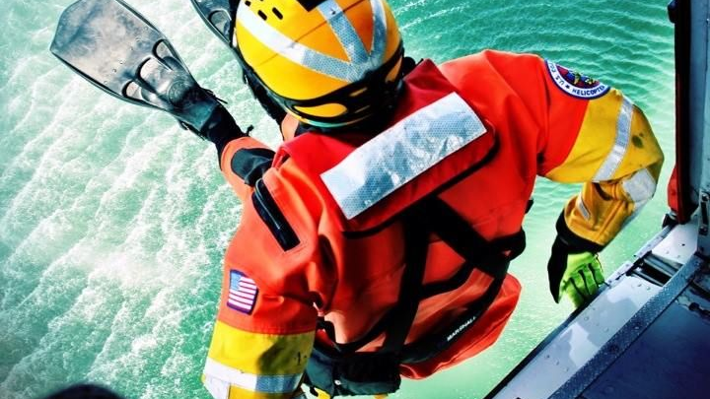
Helicopter rescue swimmer
Helicopter Hoist Rescue

Slide 3
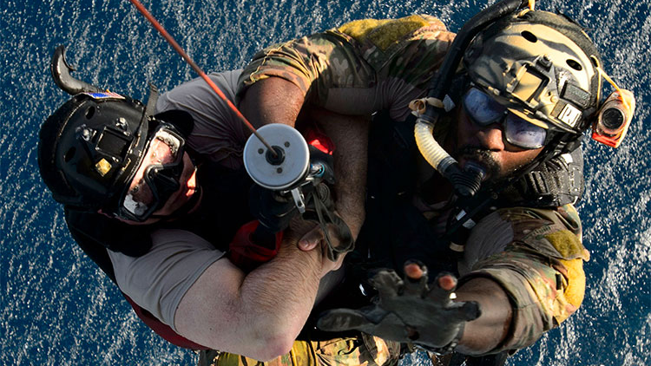
Helicopter Hoist Rescue
The first civilian helicopter hoist rescue was performed by Dimitry "Jimmy" Viner, Chief Test Pilot for Sikorsky, near Fairfield, Connecticut, on November 29, 1945.

Slide 4

The terms hoist and winch are often incorrectly used in referring to rescue hoists. For clarification "hoists" are used for lifting and "winches" are used for pulling.

Slide 5
OPERATIONAL CONSIDERATIONS
hoisting shortens the suspended exposure time of the rescuer beneath the helicopter.
The fixed installation of a rescue hoist on a helicopter increases operational efficiency
Even though the weight of the rescue hoist adds to the overall equipped weight of the helicopter, thus reducing the available payload.

Slide 6
OPERATIONAL CONSIDERATIONS
Other helicopter rescue techniques can require delays for reconfiguring the aircraft for the mission.
The reality of the high cost and maintenance associated with helicopter rescue hoists means that they are primarily available through the military and public safety agencies in larger metropolitan areas.

Slide 7
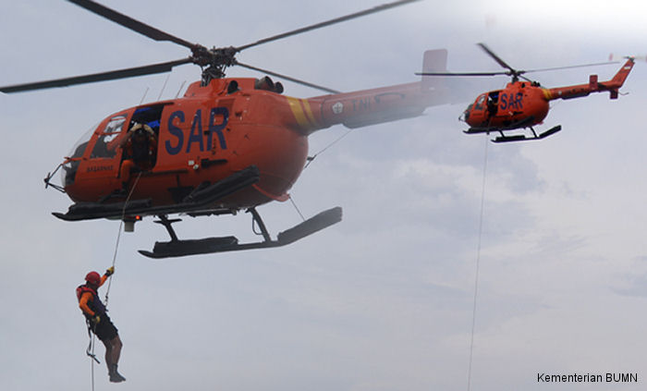
Helicopter rescue hoists
Helicopter rescue hoists are either electrically powered or hydraulically powered.

Slide 8
electrically powered
From the standpoint of power to weight ratio, significant advances in electrical components have lead aircraft manufacturers to increasingly chose electrical (115 volt AC) rescue hoist designs for installations. 3

Slide 9
hydraulically powered
A hydraulic hoist requires an on-board hydraulic pump system, typically found on larger helicopters.

Slide 10
Helicopter Rescue Hoist Designs
Level wind translating cable hoist
Level wind translating drum hoist

Slide 11
Level Wind Translating Drum Hoist

Slide 12
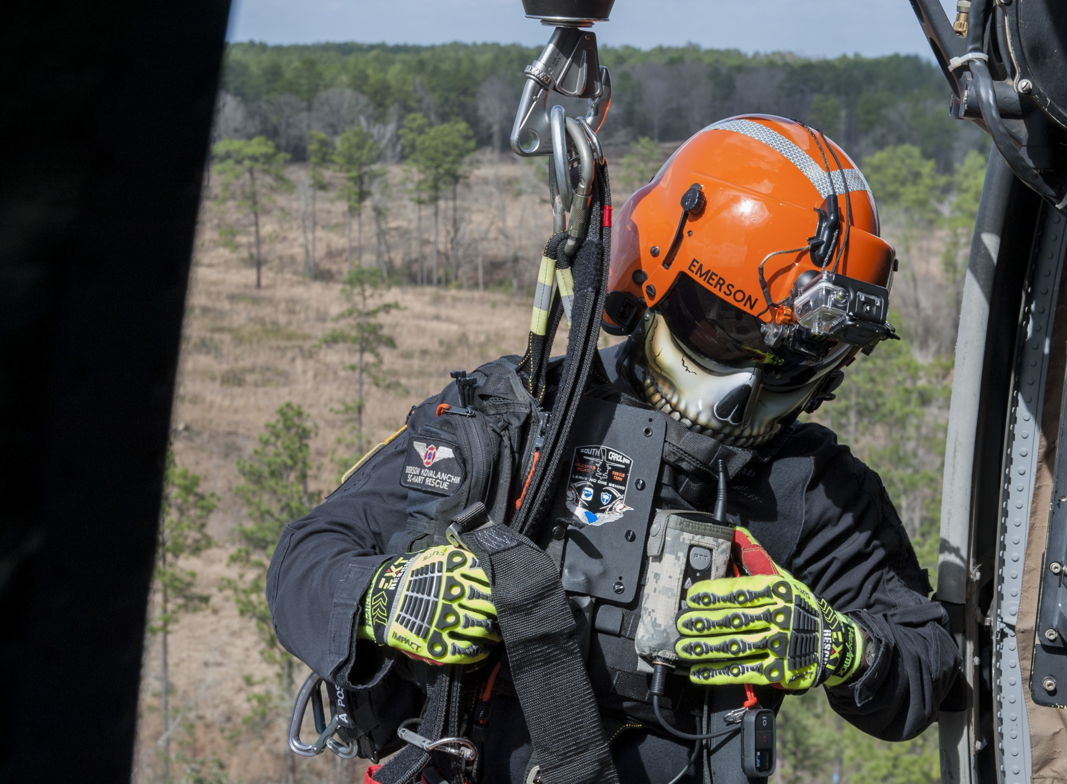
Level Wind Translating Drum Hoist
The translating drum hoist has a cable drum that moves in front of a stationary level wind during spooling and unspooling operations.

Slide 13
Level Wind Translating Cable Hoist

Slide 14
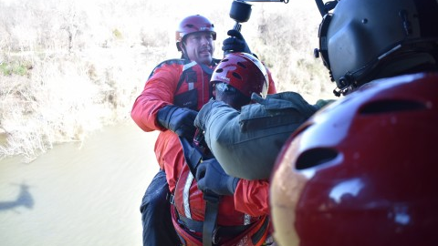
Level Wind Translating Cable Hoist
The "level-wind" mechanism prevents the line from being trapped under itself on the spool during rewinding. The drum of the translating cable hoist remains stationary, while the level wind moves back and forth spooling or unspooling the cable.

Slide 15
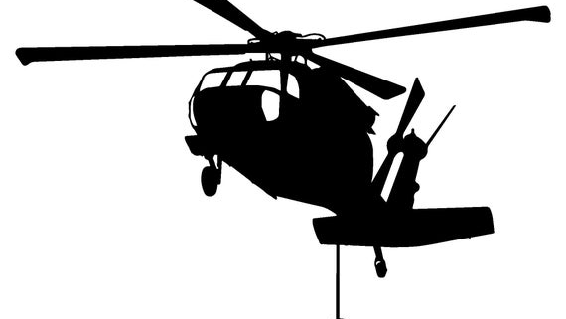
The installation design for the attachment of rescue hoists
Internal mounting styles
External mounting styles

Slide 16
internal mounting styles
Internally mounted rescue hoists are configured on a vertical column extending from the floor structure, which mechanically pivots out the aircraft doorway during deployment. An internal hoist configuration can be changed over quickly to other serviceable aircraft, however it consumes useable space within the aircraft interior.

Slide 17

external mounting styles
Externally mounted hoists can be a fixed installation above the aft doorway or on a moveable boom controlled by the hoist operator, which is stowed against the helicopter fuselage during forward flight.

Slide 18
The hoist operator
works in the open aft doorway, secured by a safety tether strap, or gunner's belt
The hoist operator uses a handheld pendant hoist control, and most styles provide a visual readout display of the amount of cable in use.

Slide 19
Hoist Cable Management
The hoist cable is truly a lifeline and must be treated with respect.
Although it is a rare occurrence, a hoist cable can fail.

Slide 20
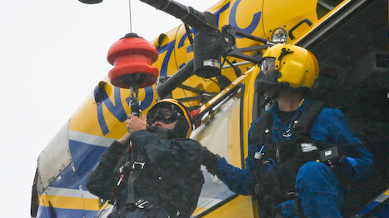
Hoist Cable Management
The factors leading to cable failure include corrosion exposure, mistreatment or poor maintenance, operator inexperience or a dynamic shock force that exceeds the static rated load of the cable.

Slide 21
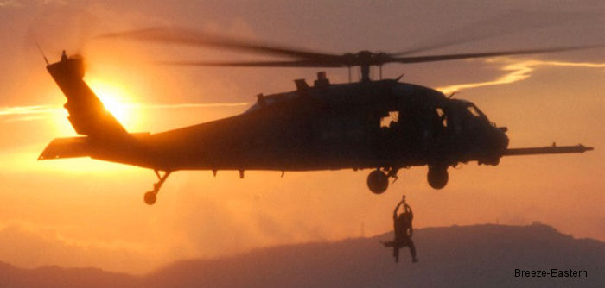
Hoist Cable Construction
Helicopter hoist cables are most commonly 3/16 inch (5 cm) in diameter with a mean breaking strength (MBS) of 3,330 lbs. (1510 kg) and rated working load capacity on the hoist of 600 lbs. (272 kg).

Slide 22
Hoist Cable Construction
Lighter helicopter hoists are produced with a rated working capacity of either 450 lbs. (204 kg) or 300 lbs. (136 kg), which employ 5/32 inch (3.9mm) cable with a 2,160 (979. 7kg) MBS. 3

Slide 23
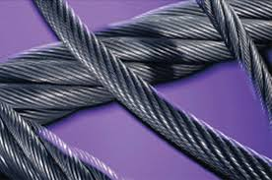
Hoist Cable Construction
The construction of the cable allows for some degree of shock absorbance over the length of the cable. The cable is most vulnerable to a shock force when there is only a few feet of cable spooled out.

Slide 24

Hoist Cable Construction
The stainless steel hoist cable (wire rope) has a spin-resistant feature, which is accomplished through the counter-wrapping of the wire strands.

Slide 25
Hoist Cable Construction
A free-spinning hook at the end of the cable also serves as a swivel between the load and the hoist cable, preventing twisting of the cable. Hoist cable lengths vary considerably, but 245 feet (75 m) of usable cable is a common working length for many rescue helicopters. The initial

Slide 26
Hoist Cable Construction
20 feet (6m) and final 20 feet (6m) of cable may be marked with a high visibilit¥ 6 color to provide a visual warning indicator to the hoist operator of an approaching end.

Slide 27
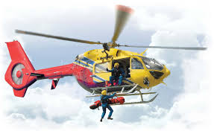
Hoist Cable Construction
20 feet (6m) and final 20 feet (6m) of cable may be marked with a high visibilit¥ 6 color to provide a visual warning indicator to the hoist operator of an approaching end.

Slide 28
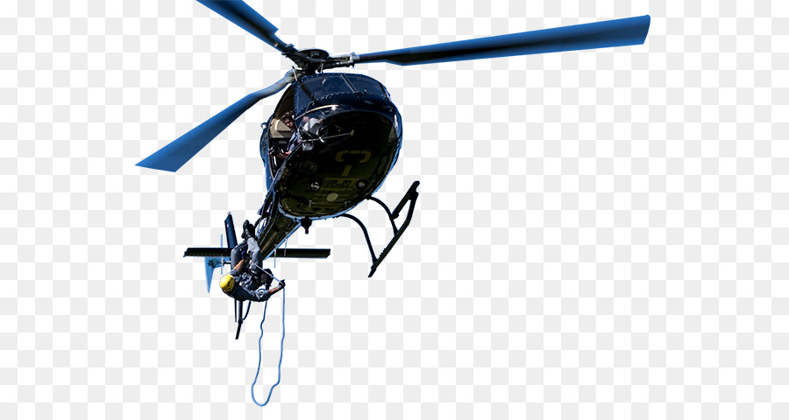
Hoist Cable Construction
The typical 3/16 inch (5 cm) diameter military spec rescue hoist cable is manufactured with austenitic (non-heat treated) stainless steel wires configured in a nineteen by seven strand "non-rotating" construction design, meaning nineteen strands of seven wires each.

Slide 29
Hoist Cable Construction
It is manufactured by covering an inner wire rope of 7 X 7 left lay construction with 12 strands in a right regular lay configuration, which creates a cable constructed of 133 individual wires (Figure 22).

Slide 30
Hoist Cable Construction
The spin-resistant property that characterizes this construction is a result of the counter torques developed by the two layers. 37 This arrangement prevents the cable from unwinding while a load is suspended during use.

Slide 31
Hoist Cable and Rescue Hook Assembly

Slide 32
Rescue Hook Assembly
traditional military style is based upon an older 1963 design, which consists of two gated hooks and an eyelet

Slide 33
Rescue Hook Assembly
The large hook is the only portion of the rescue hook to be used for hoisting personnel. The smaller hook is utilized for handling equipment

Slide 34
Unintentional designment
(Rollout)
The inadvertent release of a load or "rollout" from a hoist hook can occur when a carabiner or attachment D-ring travels upward, through possible load relief, and rides up against the safety latch of the hoist hook.

Slide 35
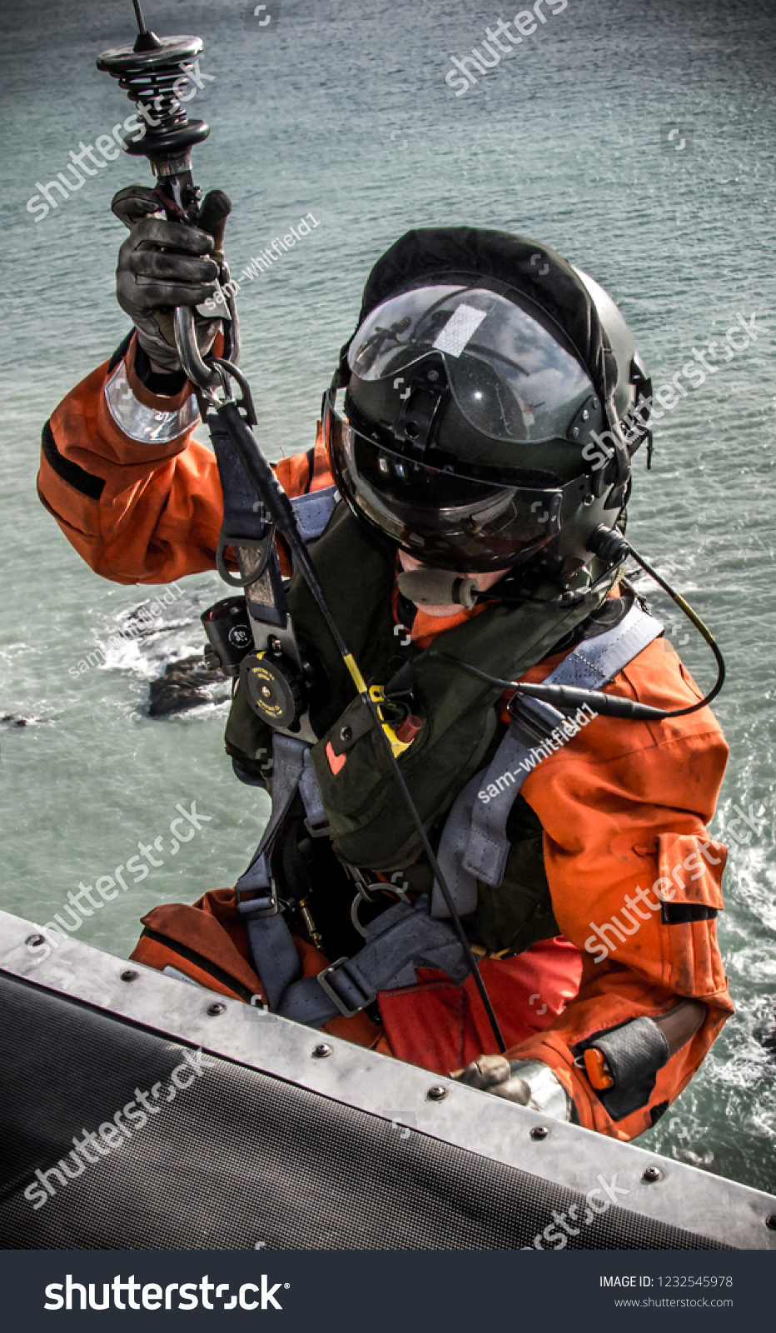
Unintentional designment
The inadvertent release of a load or "rollout" from a hoist hook can occur when a carabiner or attachment D-ring travels upward, through possible load relief, and rides up against the safety latch of the hoist hook.

Slide 36
AUTO-LOCKING HOIST HOOKS

Slide 37
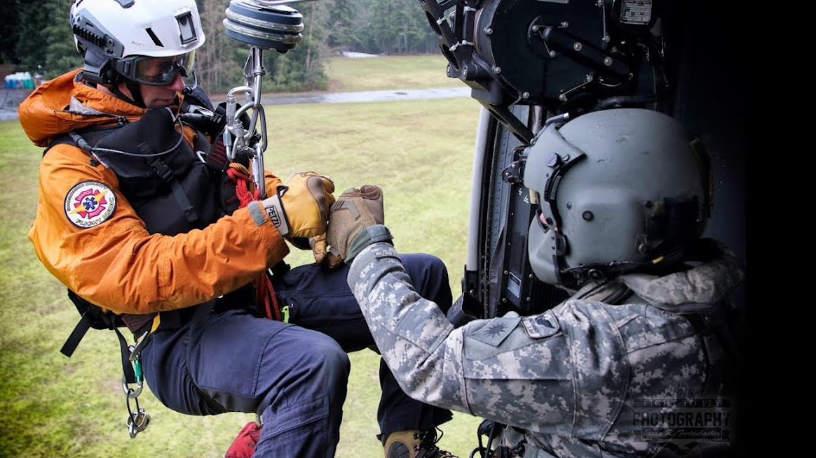
AUTO-LOCKING HOIST HOOKS
A hoist hook with an auto-locking gate provides the greatest amount of security against inadvertent rollout as well as accidental opening leading to entanglement of equipment or lines at a rescue scene.

Slide 38
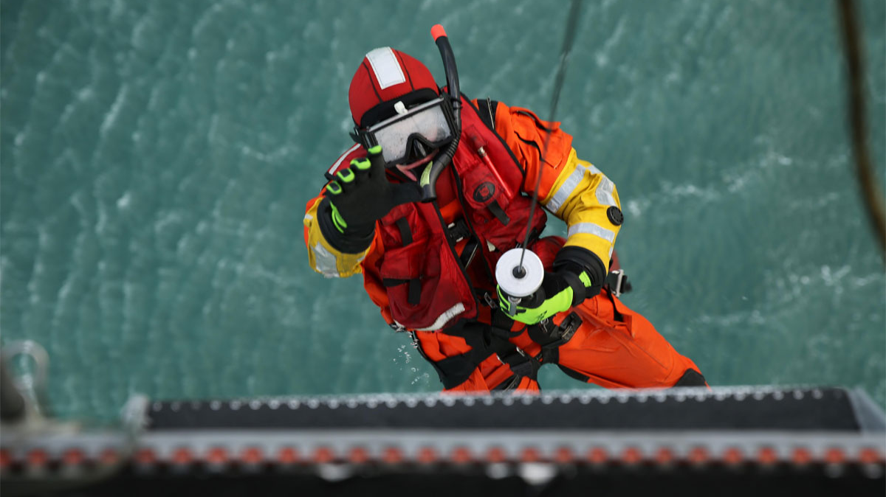
Possible Cable Damage
Visual inspection of a hoist cable is conducted following a mission by running out the full operating length of the cable on the ground. The cable is retracted under a tensioned load to prevent cable fouling on the drum.

Slide 39
Possible Cable Damage
Helicopter hoists have a tensioning system, which maintains approximately 7 to 20 lbs. (3.1-9 kg) of force on the cable, in order to prevent loosening of the wraps on the drum, however this can be defeated during an inspection so a mechanically applied load may be required.

Slide 40
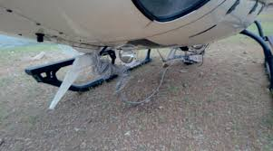
Possible Cable Damage
Hoist cable damage can include a single broken wire strand as well as multiple broken strands within a section of cable, requiring replacement of the cable. Additional problems may include

Slide 41
KINK
A loop in the cable may lead to developing a kink, which may be identified as open or closed. An open kink is caused by pulling a cable loop tight, creating a permanent bend which tends to open the lay of the cable.

Slide 42
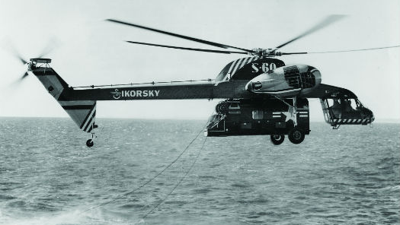
KINK
A closed kink is created in the same manner but creates a sharp permanent bend that tends to close the lay of the cable.
A kink in a cable significantly reduces the load capacity.

Slide 43
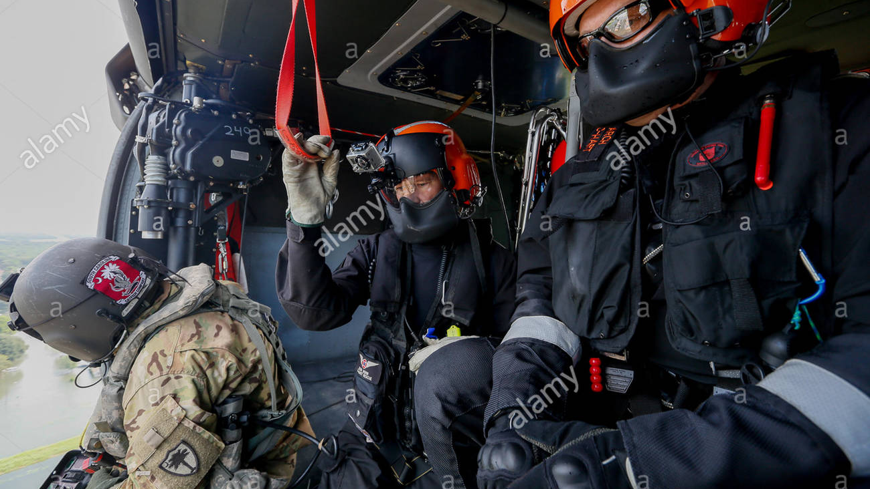
KINK
The continued use of a kinked cable can lead to the kink being caught in the cable guide assembly resulting in cable fouling.
Hoist operations should be terminated when a kinked cable develops.

Slide 44
ABRASION
A cable may develop abrasion if it contacts other material, such as aircraft structural members. Dirt, sand, grit, and other foreign particles can also result in abrasion.

Slide 45
ABRASION
Abrasion weakens the cable by removing metal from the wires in the outer strands. Cables that show signs of excessive abrasion should be removed from service.

Slide 46
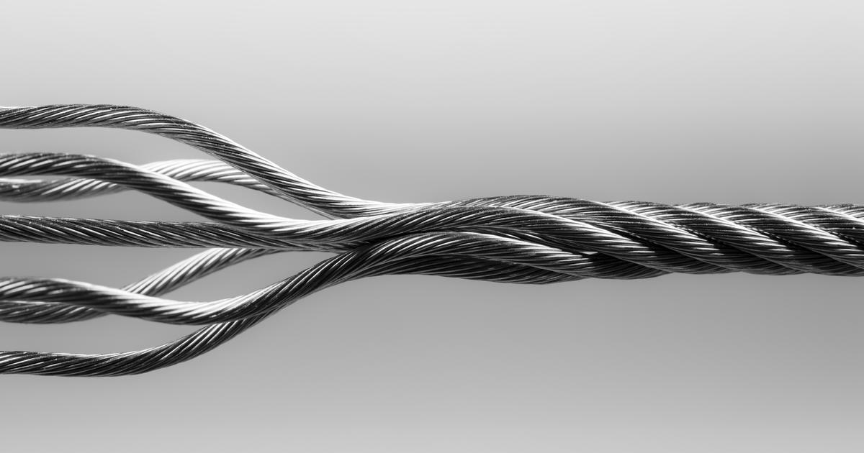
BIRDCAGING
A deformity with a distinctive "birdcage" appearance may develop where a hoist cable has significant stretched open or untwisted outer wraps of wire strands in an uneven or irregular bulging manner.

Slide 47
BIRDCAGING
Birdcaging results from torsional imbalance that occurs because of mistreatments, such as sudden stops, cable being worked through tight sheaves, or a hook bearing that is not rotating freely.
A hoist evolution should be terminated if there is the presence of birdcaging on a cable.

Slide 48
OVERLOAD
A cable that has been severely overloaded may or may not show immediate results of the overload.
Visual broken wires are the most obvious defect; however, overloading can cause broken core wires that are not readily visible.

Slide 49
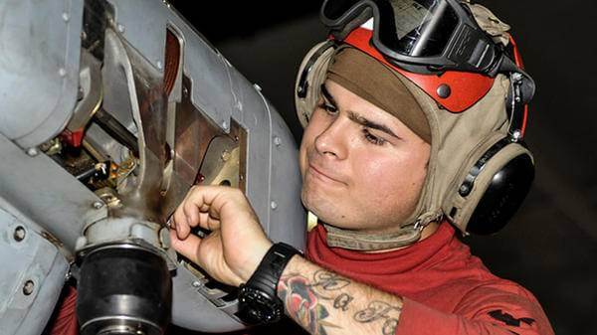
OVERLOAD
Necking-down is a noticeable reduction of cable diameter indicating broken internal core wires. Any cable with necking- down is cause for immediate replacement.

Slide 50
DEFECTIVE BALL FITTING
The terminus of the cable inside the hook has a swaged ball fitting, where broken wires may develop.
This can be prevented by properly seating the hoist cable bumper against the cable guide bell mouth, when the hoist is not in use.

Slide 51
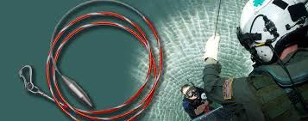
Static Discharge
Helicopters generate static electricity as air particles move over the surface of the fuselage and rotor blades.

Slide 52
Static Discharge
Rescuers can prevent this static shock by always allowing the hoist cable to contact the ground before they touch it.

Slide 53
Line Entanglement
During a helicopter hoist rescue operations this is a very real concern as the cable reaches the ground or structures. During hoist or short-haul rescues, a line or hook has become entangled with rescuer packs, ices axes, harness gear loops, non-locking carabiners, and more. These incidents have included fatal outcomes.

Slide 54
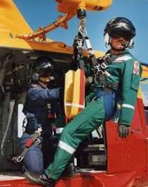
Line Entanglement
All rescue personnel should be well-briefed regarding the danger of line entanglement during helicopter hoist and short-haul operations.

Slide 55
CABLE CUTTER

Slide 56
CABLE CUTTER
If the cable becomes hopelessly entangled or during an aircraft emergency, the hoist operator can activate an emergency cable cutter

Slide 57
CABLE SPLICE
To become operational again, once a cable has been sheered manually (not with use of the hoist-mounted ballistic cutter), it is possible to utilize a cable splice with a spare hoist hook as a backup device

Slide 58

FLEET ANGLES
The lateral center-of-gravity (CG) limits on the helicopter establish the maximum load rating for the hoist, if less than the manufacturer's stated hoist capacity. As excessive loads are placed out away from an imaginary line drawn down through the rotor mast, the helicopter becomes out of balance.

Slide 59
TAG LINE (Trail Line)

Slide 60
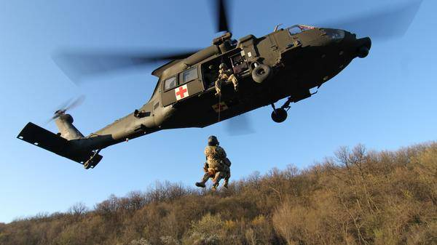
TAG LINE (Trail Line)
A tag line (trail line) may be employed by personnel on the ground or a vessel to assist with hoist hook delivery, however use of such a line to stabilize a litter during a hoisting evolution is very important.

Slide 61
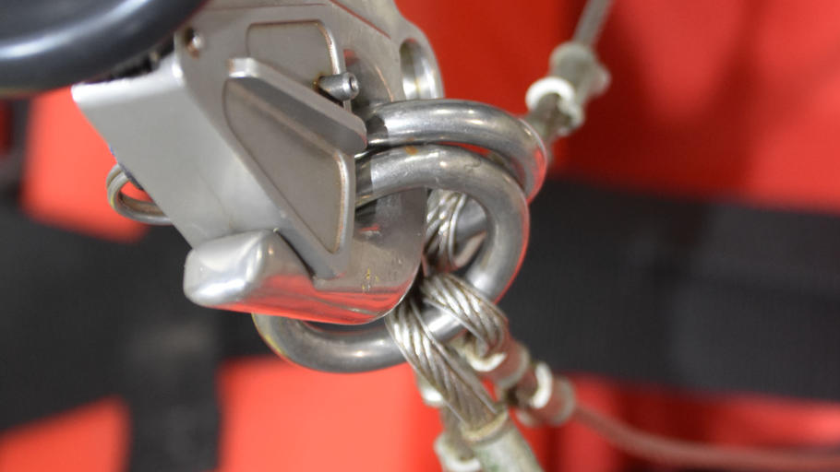
STATIC HOIST TECHNIQUE
Use of a tagline is a standard procedure for a military helicopter "static hoist" evolution, where the aircraft remains stationary in a hover above the rescue scene.

Slide 62
STATIC HOIST TECHNIQUE
Be alert when working beneath heavy-lift (Type 1) helicopters during hoist rescue operations, because the increased rotor wash can easily cause debris from slopes or forest canopy to strike ground rescuers, as well as cause them to lose footing.

Slide 63
DYNAMIC HOIST TECHNIQUE
Another helicopter hoisting method is referred to as a "dynamic hoist." This technique involves lowering a rescuer on the hoist, while the helicopter is on final approach to the scene. The rescuer reaches the ground just as the aircraft is directly above the scene, and the rescuer immediately detaches, permitting the aircraft to depart.

Slide 64
DYNAMIC HOIST TECHNIQUE
When the rescuer is ready for extraction with the patient, the helicopter returns, and following connection to the hoist cable, hoisting of the load is initiated with the aircraft immediately transitioning into forward flight away
No tag line is used

Slide 65
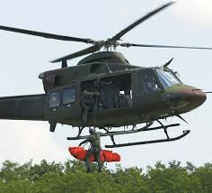
Litter Transfer in Exposed Terrain
During a rescue operation where the stretcher is positioned in hazardously exposed terrain, it needs to be tethered with a dedicated safety line rigged cleanly to an anchor system, until the helicopter extraction is actually occurring.

Slide 66
Litter Transfer in Exposed Terrain
The transfer to the hoist cable needs to occur in a well- coordinated and accurately briefed maneuver. When the hoist hook is delivered to the ground rescuers, a designated team member should physically take control of it and position it within a few inches of the stretcher connection point.

Slide 67
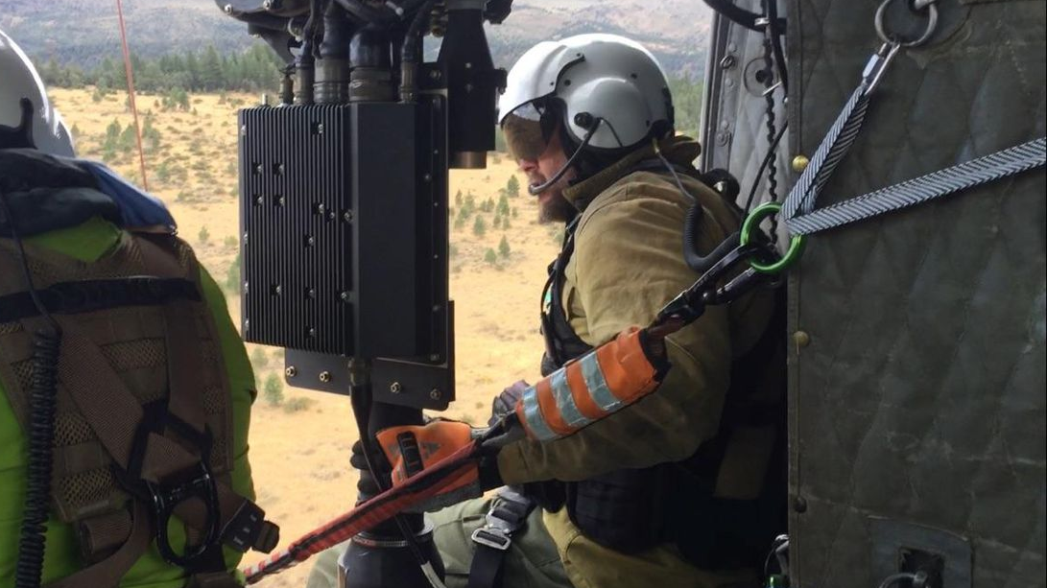
Litter Transfer in Exposed Terrain
When directed, a quick transfer of the stretcher connection point will be made from the safety line to the hoist hook. During this time the stretcher will be momentarily disconnected from the safety line, however the aircraft will not become tethered directly to the ground.

