Slide 1
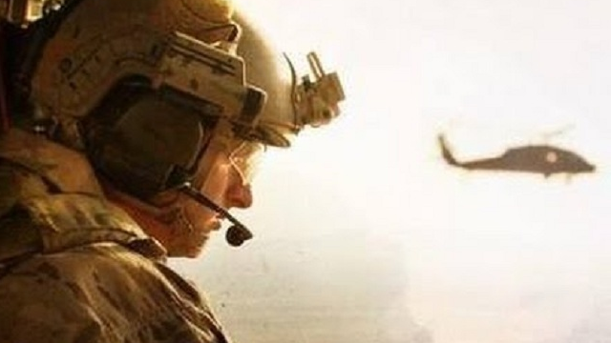
THE RESCUE COMPANY 1

Slide 2
Rescue Helicopter Communications

Slide 3
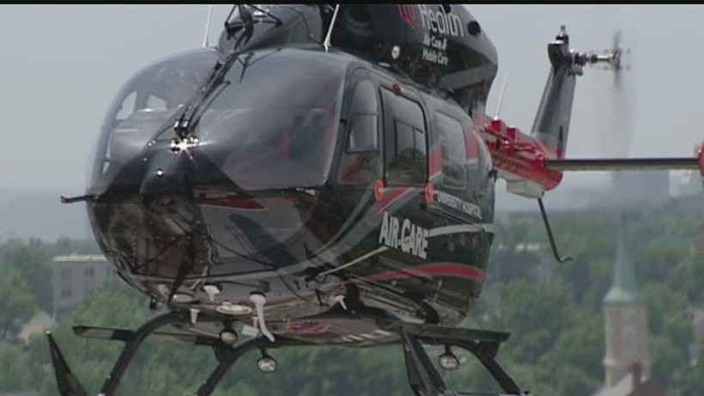
Communications
Clear precise communications eliminates the pitfalls that have jeopardized many missions.
Emergency responders must have reliable communication equipment and possess effective personal communication skills.

Slide 4
Five Communication Responsibilities for All Personnel
Brief Others As Needed
Debrief Your Actions
Communicate Hazards To Others
Acknowledge Messages
Ask, If You Don't Know

Slide 5
Hand Signals
Hand Signals (Ground to Air)
Water aoperations

Slide 6
Deploy LSC Quick Strop Note: May be used to request Helo sling/Cinch Collar if LSC Quick Strop already deployed

Slide 7
Ready for pickup/ ready for extraction Night: red spinning cylume

Slide 8
I need assistance/ emergency Strobe on Night: Waving red cylume

Slide 9
Deploy rescue litter

Slide 10
I am okay

Slide 11
Abort

Slide 12
Monitor radio/lost communication

Slide 13
Hoist Hand Signals

Slide 14
Ready for extraction Night: red cylume extended above head

Slide 15
10 ft from ground

Slide 16
Monitor radio/lost comm

Slide 17
Hoist up Night: red spinning cylume

Slide 18
Hoist down Night: red spinning cylume

Slide 19
Using Direct Statements
Emergency responders often observe operational hazards during an incident; however they fail to speak up
In situations involving critical communication, it is most effective to use direct statements.
Although they appear rude, direct statements are difficult to ignore and are very productive.

Slide 20
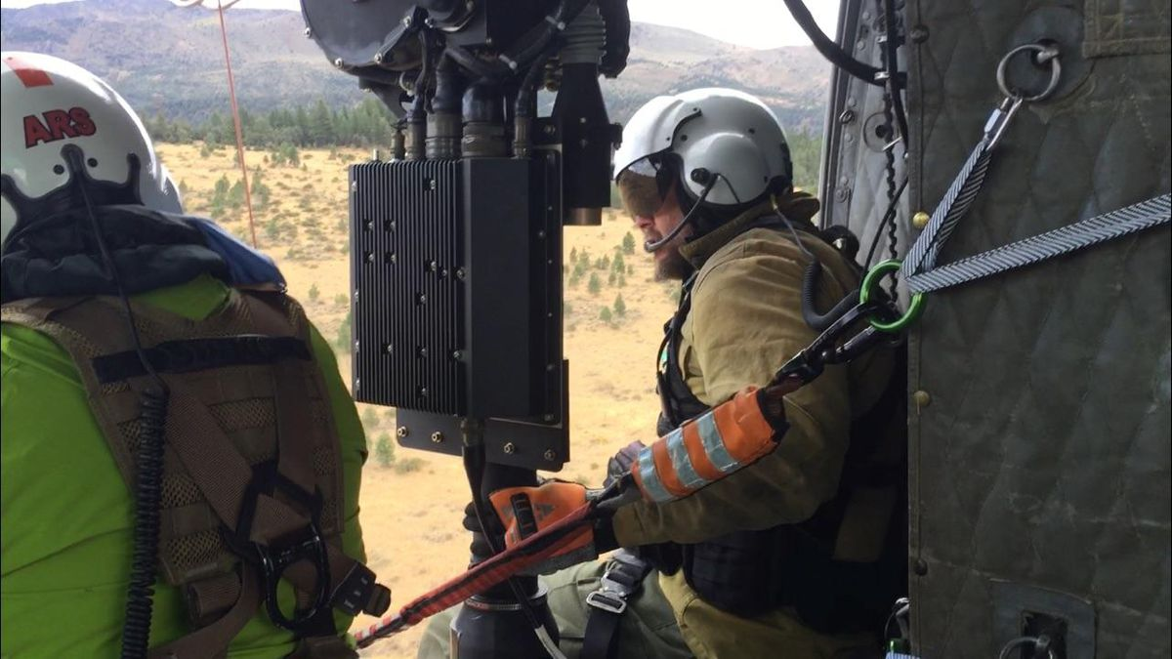
Distractions from a primary task can occur through
Radio traffic
Conflict
Previous errors
Collateral duties
Incident within an incident

Slide 21
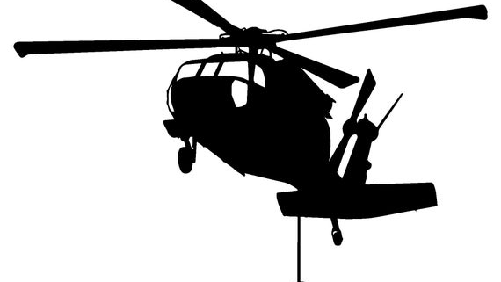
Inattentional blindness
"looking without seeing“
Causes us to fail to notice an unexpected stimulus in our field of vision when other attention­ demanding tasks are being performed.

