Slide 1
Chapter 8: Drowning
Notes:
Identify statistics associated with drowning.
Explain the definition of drowning.
Identify activities associated with drowning.
Describe populations at high risk of drowning.
Describe the stages of drowning.
Describe the pathophysiology of drowning.

Slide 2
Statistics
During 2005-2009 an average of 3,880 died annually from unintentional drowning in the United States
Drowning is a leading cause of accidental death in U.S. and worldwide.
Survivors of drowning incidents are sometimes left with permanent disabilities and can suffer irreparable brain damage
During 2005-2009, an estimated 5,789 people on average were treated annually in the US for nonfatal drowning

Slide 3
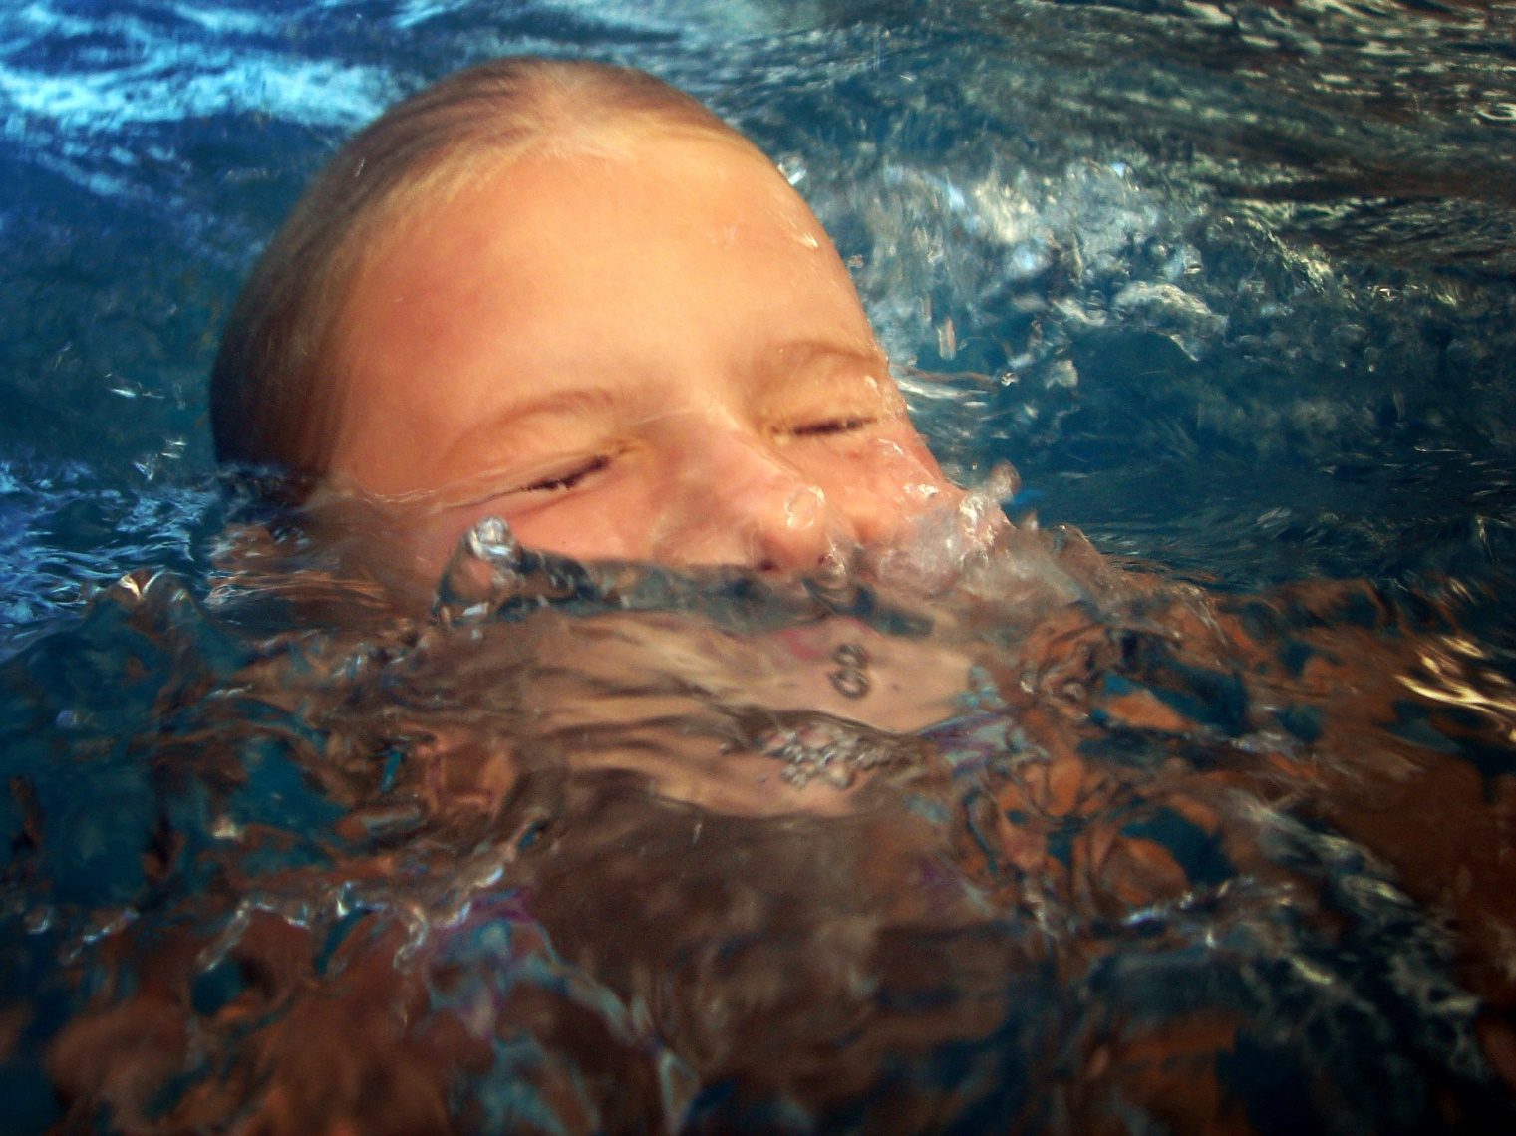
Drowning

Slide 4
Drowning is a process
Drowning may result in death … or not
Drowning can happen anywhere liquid is present
Lifeguards prevent drownings
Notes:
Drowning is a process, not an outcome.
The definition of drowning: “Drowning is the process of experiencing respiratory impairment from submersion/immersion in liquid.”
Drowning may result in death, or may be interrupted by timely rescue or effective medical care.
Drowning takes place in a wide variety of environments.
Wherever there is liquid there is danger of drowning.
Infants have died by drowning in buckets.
“Infants were most likely to drown in bathtubs, young children in swimming pools and older children and adolescents in natural bodies of fresh water.”
Lifeguards have many opportunities to prevent drowning injury and death.

Slide 5
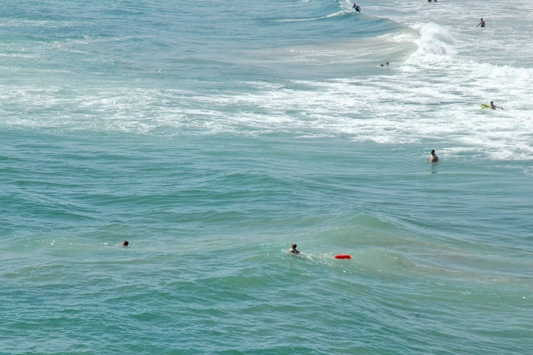
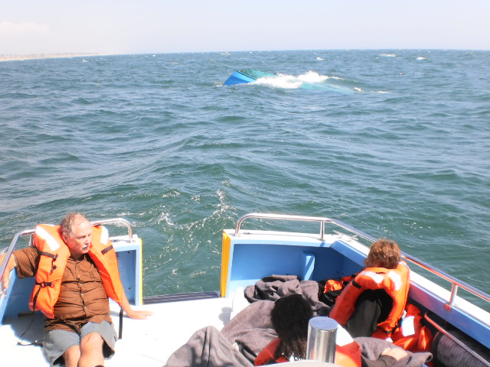
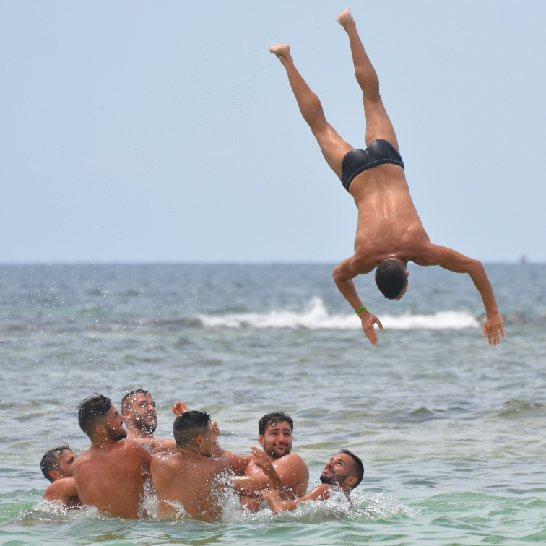
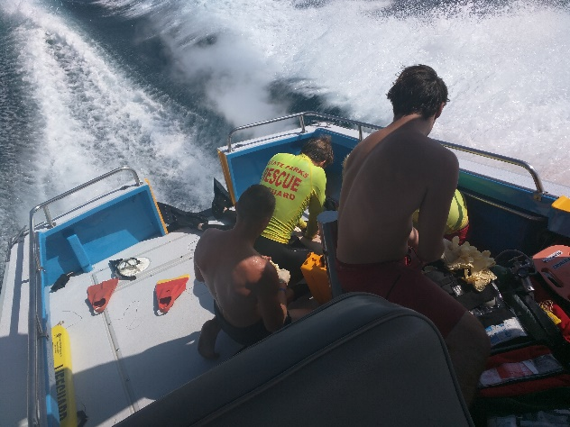
Activities Associated with Drowning
Swimming
Recreational Boating
Diving
Scuba Diving
Notes:
Most deaths from drowning occur in an open water environment.

Slide 6
Swimming
Favorite of kids 7-17
Environmental factors
Non-environmental
Notes:
Most popular recreational activity in the US for ages 7 to 17.
Environmental contributors to drowning include currents, waves, and drop-offs.
Non-environmental factors that contribute to drowning include over-estimating one’s own swimming ability, failing to properly supervise children, swimming in unguarded areas, using drugs, trying to rescue others, and underwater breath holding

Slide 7
Recreational Boating
Popular
Fatalities occur in the hundreds by capsizing and leaving the vessel
Alcohol
Untrained operators
Notes:
Very popular pastime in the U.S.
During 2012 32.3 million US households had at least one member who boated
Boating accidents occur in the thousands each year, with hundreds resulting in fatalities.
Two primary types of fatal boating accidents include falls overboard and capsizing of the vessel.
Alcohol use has been determined to be a significant factor in boating accidents.
The typical boating operator has had no formal boating instruction.
Overall, 70% of all boating fatalities have occurred on boats where the boating operator has not completed a boating safety course.
The USLA encourages all boaters to take a course in safe boating and encourages the wearing of personal flotation devices by all aboard.

Slide 8
Diving
Striking the bottom
Notes:
Striking the bottom or underwater objects when diving causes many injuries and deaths.
Trauma may result directly to the victim’s head, causing concussion, fractured skull or brain hemorrhage.
There were an estimated 1,840 spinal injuries reported in 2014 where diving was the primary cause,
Males are more than three times as likely to be injured in diving accidents compared to females
Alcohol is often a contributing factor.
Body surfing injuries, when surfers strike the bottom headfirst, are similar to diving injuries.
A major problem with diving injuries is that the victim may be improperly removed from the water by those unaware of the possibility of spinal injury.

Slide 9
Alcohol use is involved in up to 70% of adolescent and adult deaths associated with water recreation.

Slide 10
Scuba Diving
Panic
Entanglement
Running out of air
Heart attack
Notes:
Most scuba diving fatalities result from drowning due to panic, entanglement, running out of air or heart attack.

Slide 11
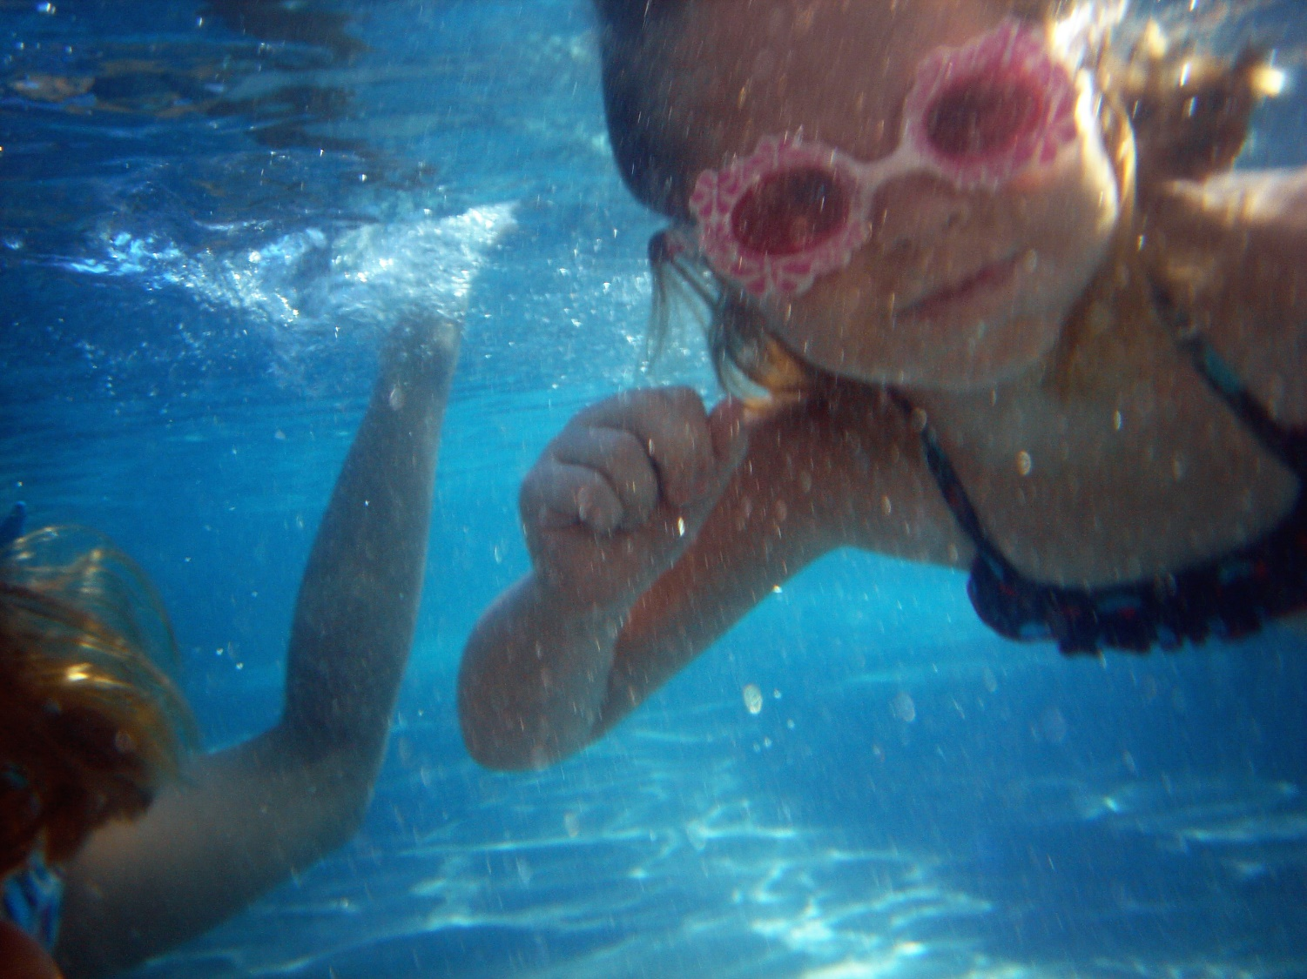
Higher Risk Populations
Notes:
People of all races, ethnicities and ages, both male and female, are susceptible to drowning. No one is immune.

Slide 12
Youth
One in five people who die from drowning are children 14 and younger
Failure to adequately fence off pools and provide adequate and continuous adult supervision are two major factors in backyard pool drownings
Backyard pools should be surrounded by fences with a self-closing, self-locking gate
Young children, especially those unable to swim, should never, ever be left alone anywhere near a pool

Slide 13
Males
Males drown at a rate of 4:1 compared to females
Adolescent males in particular are highly physically active and are known to be frequent risk takers

Slide 14
Race and Ethnicity
U.S. drowning death rates vary on average among racial and ethnic groups.
Since swimmers of all races and ethnicities have competed at the Olympic level, remember that each swimmer at your beach is an individual.
Notes:
Remember: Broad averages are not something that can be applied to individuals. Every person is different in terms of swimming skills and abilities.

Slide 15
Epilepsy
People with epilepsy are disproportionately susceptible to drowning
Victims experiencing a seizure generally are without motor function control
People with epilepsy should be cautioned to advise lifeguards before swimming
Personal flotation devices should be worn by people with epilepsy when around or in the water

Slide 16
Drowning Stages
In the open water environment, the drowning process involves three distinct stages:
distress
panic
submersion

Slide 17
Distress Stage
Victim may be able to call or wave
This stage could end quickly
Victims could be unaware of danger
Leads to panic stage
Notes:
A time of gradually increasing distress, during which the victim may be able to call or wave for help or can move toward a support.
This stage can be as short as a few seconds or may last an extended period of time.
In some instances, victims may not be aware that they are in any danger and may argue with lifeguard assistance.
In the case of a non-swimmer, the victim may completely miss the distress stage and may immediately submerge.
As the strength of the victim ebbs, the distress stage will normally move to the panic stage.

Slide 18
Panic Stage
May stay afloat depending on buoyancy
Can have ineffective kick, head low in water, flailing arms
Focused on getting air
Stroke quality fails
“Climbing”
Notes:
A poor swimmer or a non-swimmer may immediately enter this stage without first experiencing the distress stage.
A person able to stay afloat enters the panic stage as fatigue sets in and the ability to remain buoyant diminishes.
Non-swimmers in this stage have an ineffective kick, head and face low in the water, flailing of arms and all energy focused on grabbing breaths of air.
Persons in this stage of drowning are unlikely able to call for help or alert others nearby.
Lifeguards must stay alert to recognize victims in this stage.
Weak swimmers in the panic state revert to an ineffective stroke similar to a dog paddle.
Lifeguards refer to this stroke as “climbing out of the hole” or “climbing the ladder”.
The panic stage rarely lasts long because of the ineffectual efforts of the victim combined with the consumption of energy.
This is the stage where the victim may grasp for a nearby swimmer.

Slide 19
Submersion
Most victims sink toward bottom
Fresh water victims sink faster
It’s hard to see under the surface of open water
Rescues need to made quickly (under 2 minutes)
Cold water sometimes extends survival
Notes:
Most drowning incidents do not result in the victim floating face-down in the water.
Most people who lose buoyancy and are without a flotation device submerge rapidly and sink to the bottom.
Aspiration of water into the lungs contributes to the lack of buoyancy.
Freshwater provides less buoyancy than salt water.
Submersion in and of itself is not fatal; however, time of rescue and resuscitation must be rapid and can be very difficult in open water.
Open water is often murky and impedes visibility.
Once submersion occurs, the chance of a successful rescue diminishes rapidly.
The USLA believes there is a 2-minute window of enhanced opportunity for successful recovery and resuscitation of a submerged victim.
In colder waters, successful recoveries have been documented (in rare cases) after an hour of submersion.

Slide 20

The Pathophysiology of Drowning
Notes:
Pathophysiology definition: The functional changes that accompany a particular syndrome or disease

Slide 21
Water Aspiration and Water Ingestion
Fitful gasps are attempted on the surface
There may also be coughing and sputtering as water is drawn in with a breath
Water aspiration occurs when water is drawn into the lungs (inhaled)
Water ingestion occurs when water is swallowed
A significant amount of water is often swallowed, in the effort to avoid drawing the water into the lungs

Slide 22
Hypoxia
Hypoxia is the lack of oxygen in the tissues of the body, which leads to unconsciousness
The drowning victim may inhale water when submerged
The larynx will sometimes close reflexively, permitting only a small amount of aspirated water to enter the lungs
When the larynx does not close, victims will aspirate more water
Vomiting may occur secondary to cerebral hypoxia or gastric distension

Slide 23
Hypoxia (cont.)
Without freshly oxygenated blood, the heart will eventually cease functioning
Different from sudden cardiac arrest where heart suddenly stops
Brain death usually begins in five to six minutes after adequately oxygenated blood stops circulating
In extremely cold conditions, the five to six minute timeframe may be greatly extended
Treatment of a recovered drowning victim by lifeguards is always the same, regardless of whether water has been aspirated or not
Notes:
In drowning, lack of oxygen eventually causes a healthy heart to stop beating. This doesn’t occur suddenly

Slide 24
Suffocation
Drowning is not simply a case of suffocation
The lungs are traumatized by aspiration of water
Even if rescued, the traumatized lungs will have difficulty transporting oxygen to the bloodstream and tissues
Immediate resuscitation with 100% oxygen and, if possible, positive pressure ventilation is required

Slide 25
Effects of Freshwater and Seawater Drowning
There are differences, but treatment by lifeguards is the same

Slide 26
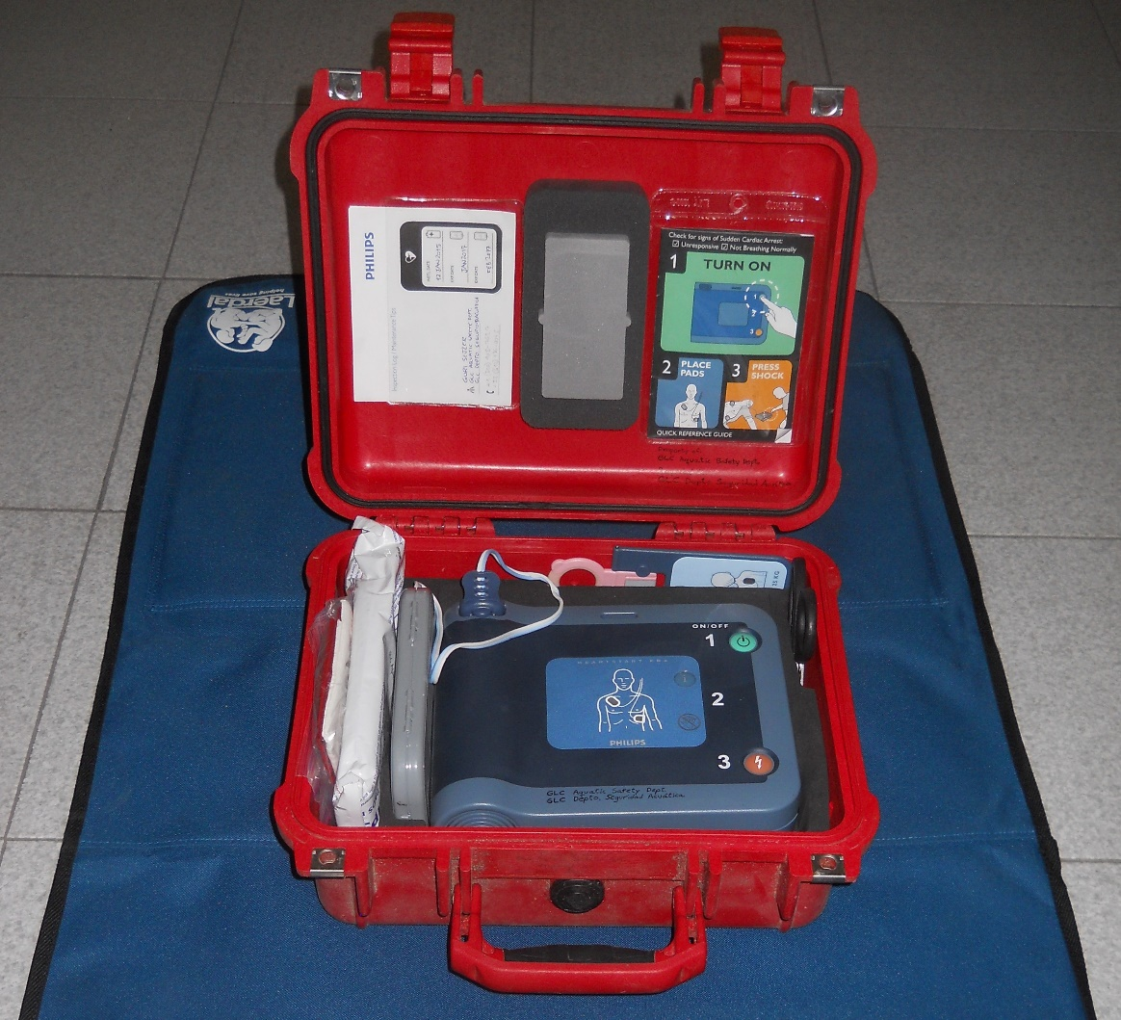
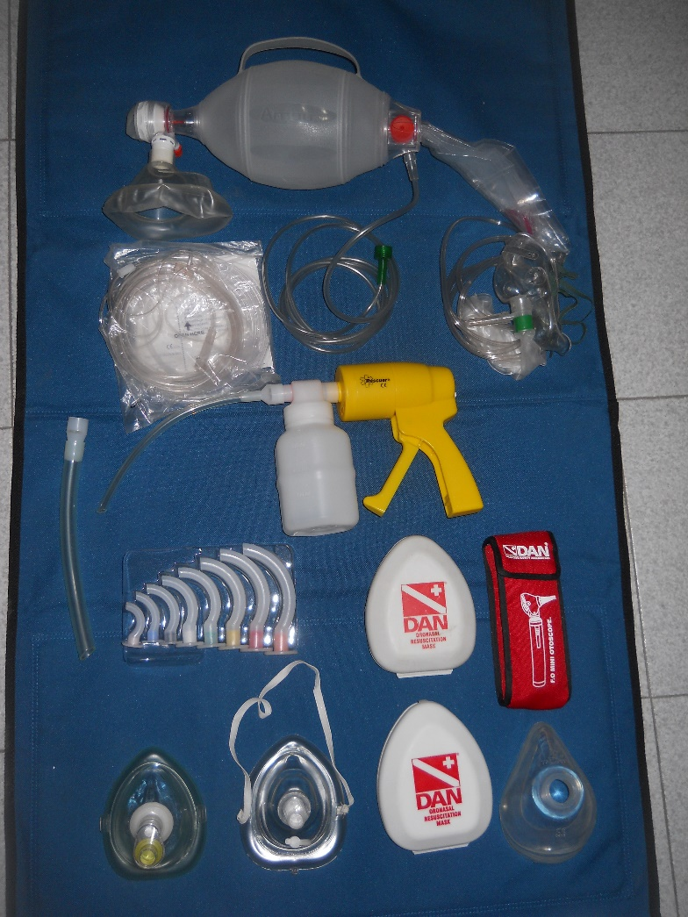
Actions of Lifeguards in Rescue and Resuscitation

Slide 27
The lifeguard is the most important link
The outcome is heavily influenced by the rescue and treatment provided by the lifeguard
Notes:
The outcome of drowning patients is usually more dependent on the timeliness and effectiveness of the initial rescue and resuscitation efforts than on the quality of hospital care.

Slide 28
Abdominal Thrusts
Should not be used in drowning victims
Will not remove water from lungs
Exception: A foreign body other than water (very rare)
Notes:
Should not be used in resuscitation of drowning victims, except in cases that repeated repositioning of the airway suggests a foreign body obstruction (other than water) is present.
This maneuver will not remove significant amounts of water from the lungs, and may instead cause regurgitation of stomach contents and aspiration of stomach contents.

Slide 29
Sudden Submersion Syndrome
Victim submerges without warning
Due to medical issue not swimming issue
Notes:
Occurs when a victim on the surface suddenly submerges due to heart attack, cardiovascular accident (stroke), epileptic seizure, head or neck injury, severe trauma, alcohol/drug use, cold shock or other conditions.
Usually submerges without a struggle.
Very difficult to see even during careful surveillance.
Presents a challenge because it is not preceded by a distress or panic stage.

Slide 30
Hypoxic Blackout
Victim goes unconscious due to breath holding
Lifeguards need to discourage this behavior
Notes:
Swimmers often hold their breath and swim underwater. Sometimes they hyperventilate on the surface in an effort to stay underwater for an extended period of time.
This can lead to unconsciousness and death.
Lifeguards should discourage this behavior as it can be impossible to see a person underwater in distress.

Slide 31
Delayed Effects
When victims are rescued but still aspirated water they can have delayed effects such as ARDS
Notes:
People rescued from drowning may initially appear to be healthy.
They may be embarrassed and want to walk away.
If they have aspirated water or vomitus, they may later suffer serious complications.
This is typically due to damage to the lungs and the ability to exchange oxygen.
ARDS– Adult Respiratory Distress Syndrome is one type of damage that may not result in immediate symptoms.
Children can also suffer from ARDS.
It is always important to monitor victims who may have the potential to suffer from delayed effects

Slide 32
AED’s
Used to correct V-fib
CPR w/ oxygen should be prioritized in drowning victims
Notes:
A common tool of lifeguards.
AED can correct ventricular fibrillation, but this is for sudden cardiac arrest, which is rare in submersion victims.
The best approach in treating a drowning victim is to prioritize immediate CPR measures, ideally with high flow oxygen.
An AED may be used in accordance with manufacturer’s instructions in the relatively unlikely event the drowning victim is experiencing ventricular fibrillation

Slide 33
Notes:
Using the “Discussion Points” at the end of Chapter Nine, divide the class into groups of three. Assign 3 or 4 questions to each group. Ask each group to answer their questions, then share their work with the rest of the group. Finally, link the discussion questions to the lesson objectives as a final check of participant understanding of the chapter.

