Slide 1

THE RESCUE COMPANY 1

Slide 2
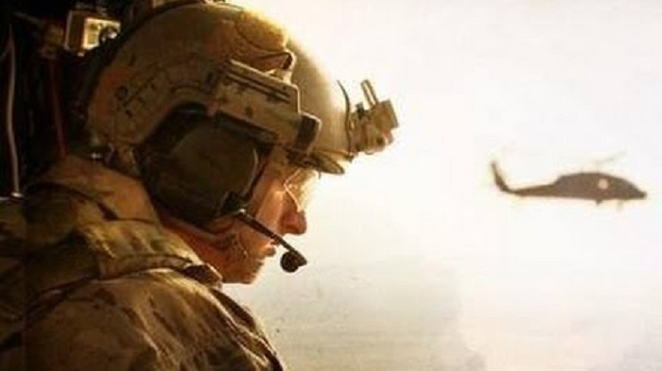
Knots, Hitches, & Bends Part 2

Slide 3
Figure Eight Family
Figure -8 -Figure-eight on a Bight
Figure-eight Follow-through
In-line Figure Eight
Directional Figure Eight Follow-through

Slide 4
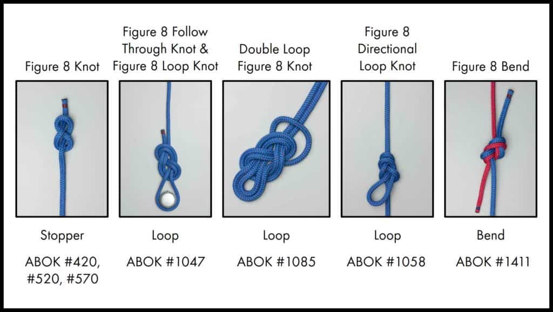

Slide 5
Figure 8 Figure-eight on a Bight
The figure eight on a bight provides a loop in the end of the rope.
The running end of the rope is made into a bight and the bight is tied as if were a simple figure eight.

Slide 6
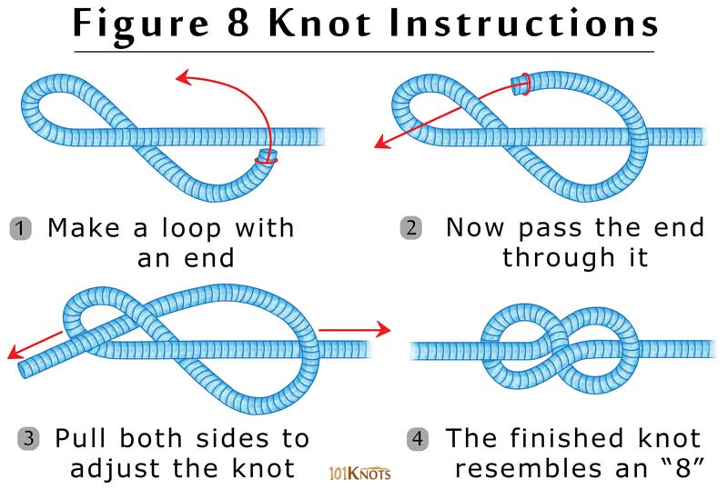

Slide 7
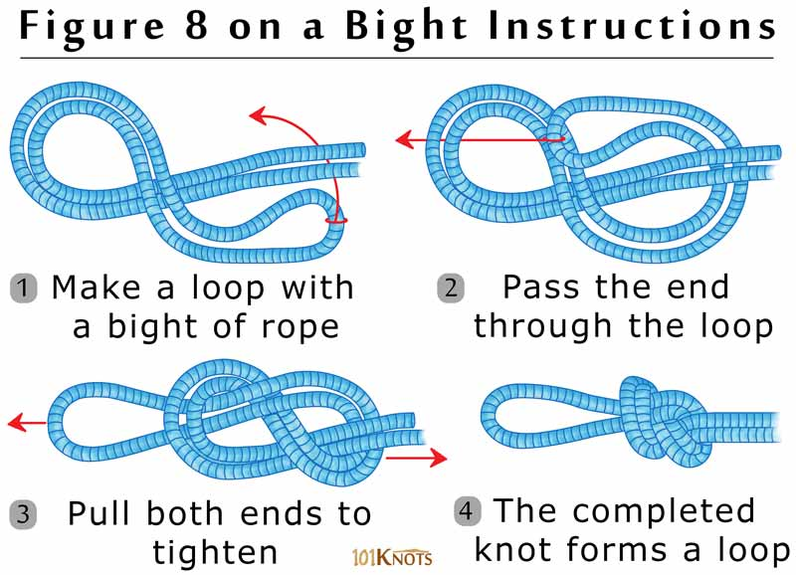

Slide 8
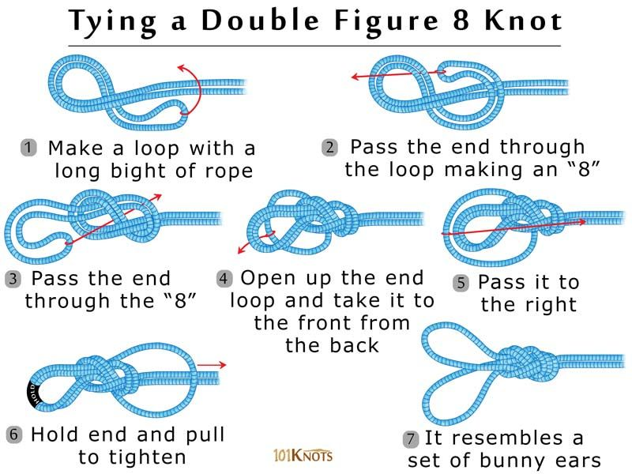

Slide 9
Figure 8 Figure-eight on a Bight
If the person is creating a loop and then clipping it (i.e. carabiner) into something else, this knot is quick to tie and efficient to use.
In contrast, if trying to tie a loop around a person or some other fixed object, the figure eight on a bight becomes less practical to use.

Slide 10
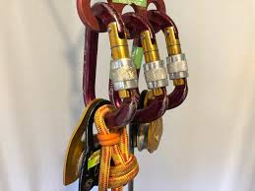
Figure-eight Follow-through
For climbers, this is the knot used to tie into the harness.
It is "bullet proof' in that it won't come undone and it provides maximum protection.

Slide 11
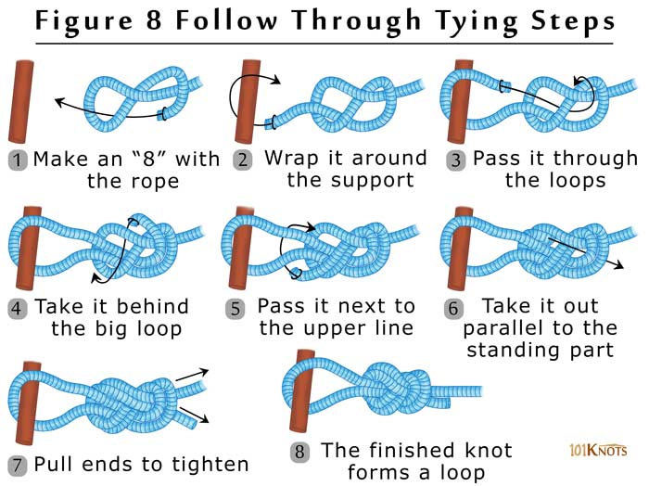

Slide 12
Figure-eight Follow-through
It is designed to create a loop in the rope connected to:
The harness or around the person
Other object that is secure and provides maximum protection.

Slide 13
Figure-eight Follow-through
It is a staple of climbers.
The disadvantage of this knot is that it does take time to tie.
Under normal circumstances this is not a problem.
In an emergency and when time is of the essence, this can become more problematic.

Slide 15
In-line Figure Eight
The in-line figure eight is a figure eight tied onto the middle of the main line.
It is a specialized knot.
It is not difficult to tie and it is relatively easy to untie.

Slide 16
In-line Figure Eight
It is superior to tying a overhand knot on a bight which is virtually impossible to untie once loaded.
It forms the base knot in creating a self-equalizing anchor

Slide 17
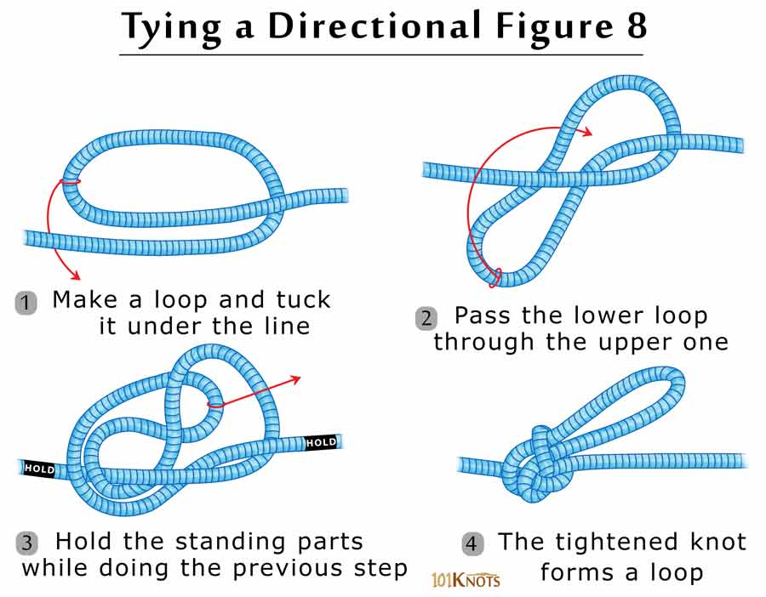

Slide 18
Directional Figure Eight Follow-through
The running end of the in-line figure eight is worked back through the loop and then retraced the knot as diagramed.
The setup is a self equalizing anchor system where the pull on each anchor is the same.

Slide 19
Directional Figure Eight Follow-through
The system can easily incorporate multiple anchor points with the addition of another loop.
If there is an abundance of carabiners, they can be used to clip the loops around the anchors to the loop at the bottom of the figure eight.

Slide 20
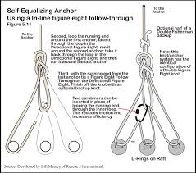

Slide 21
Bowline
The bowline is used to tie a loop in the end of a rope.
The advantage of using the bowline is that it can be tied quickly and easily.
Also, it consumes less rope to tie than a figure eight follow-through.
The knot maintains its integrity under tension.

Slide 22
Bowline
The knot maintains its integrity under tension.
However, it can loosen when placed in continuous tension and compression situations.
In the climbing community the bowline has fallen into disfavor for this reason.

Slide 23
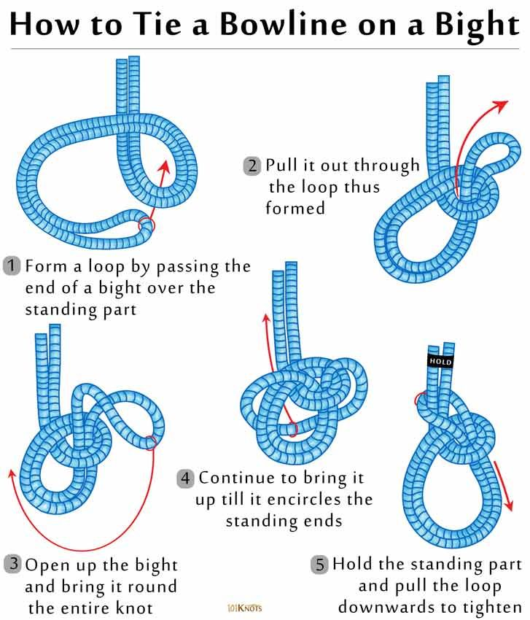

Slide 24
Bowline
When a climber falls, they tend to bounce which can loosen the knot.
If there is any doubt that the bowline could be placed in a tension and compression situation, back it up

Slide 25
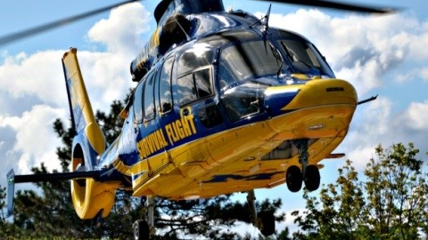
Untying the Bowline
Even after being placed under extreme tension, the bowline is easily untied.
Bend the working end or "neck" forward.
This frees the horse collar which can be flipped over the bent working end (i.e. "neck of the horse"). The knot will easily fall apart.

Slide 26
Yosemite Tie-off
If there is a need for a secure bowline, back it off.
The Yosemite tie-off is one of several acceptable methods.
When tied correctly, the Yosemite tie-off has a figure eight knot look to it.

Slide 27
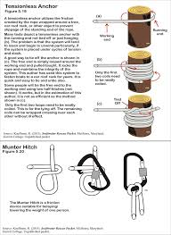
Hitches
Two Half-hitches
Clove Hitch
Prusik
Trucker's (Rigger's) Hitch
Tensionless anchors
Munter hitch

Slide 28
Two Half-hitches
commonly used to tie a loop around an object or another line.
It is useful in tying off the running end in a trucker's knot where it cinches down on the loop
Technically, when tied correctly, the knot has the same configuration as a clove hitch

Slide 29
Two Half-hitches
A common variation is where the loop is looped back against itself
Most people are unaware of the variations and simply tie one or more hitches

Slide 30
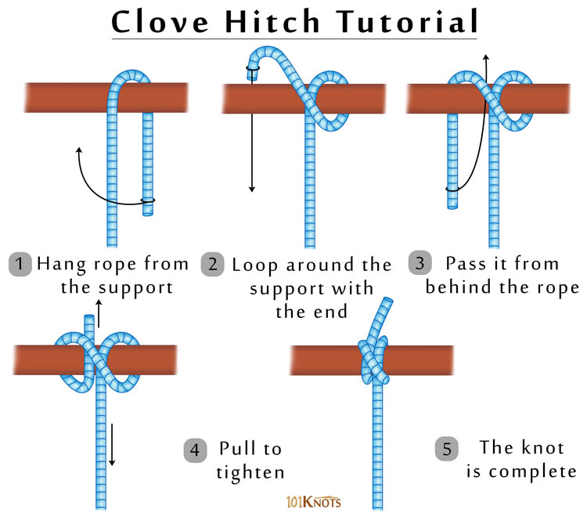

Slide 31
Clove Hitch
The clove hitch is used to tie a line to a post or tent peg.
The knot has the same configuration as two half-hitches.

Slide 32
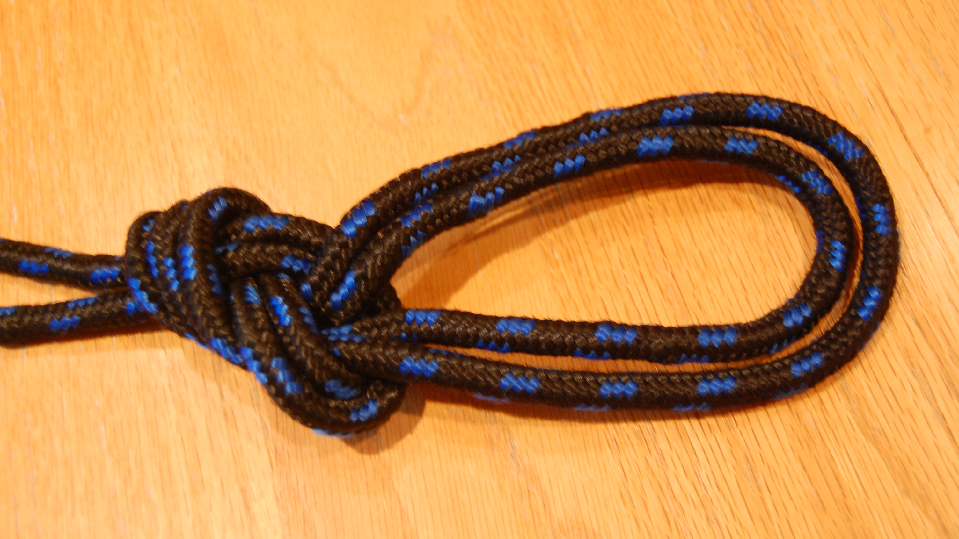
Clove Hitch
The difference is that the clove hitch fastens the running end around a fixed object (e.g. peg, posts), and two half-hitches fasten the line around another line.

Slide 33
Clove Hitch
The clove hitch is a loose knot and in tension and compression situations, it tends to become loose and undone.
This author usually backs up the clove hitch with two half-hitches to maintain its internal integrity

Slide 34
Prusik
The Prusik is a multi-purpose hitch.
It is used in climbing as an ascender and in rescue on hauling systems.
In many circles, it is preferred over mechanical devices because it slips at around 900 lbs of tension.

Slide 35
Prusik
This protects the system from fatiguing elsewhere.
The Prusik is a hitch because without the main line to maintain its integrity, the knot will fall apart.

Slide 36
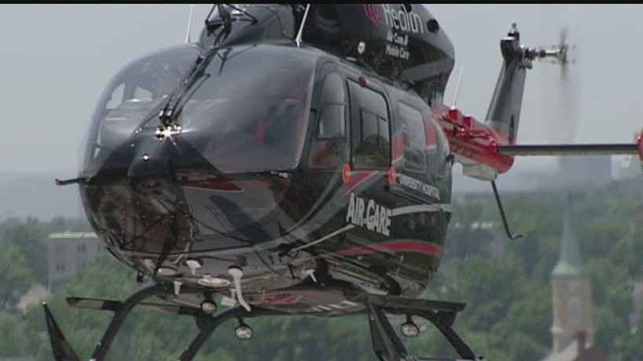
The trucker's hitch
Is used to fasten boats, construction materials, and other items to roof racks on a car, or to fasten lines to tent pegs that are easily adjustable.
Close inspection of the rig reveals that the hitch is the same configuration as a Z-rig and offers a theoretical 3:1 mechanical advantage.

Slide 37
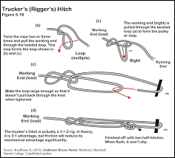

Slide 38
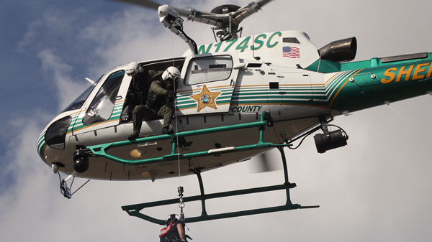
Munter Hitch
Is a friction device that can be used in place of a rappelling device.
The author uses it in place of a clove hitch on a carabiner tied off with two half-hitches (not shown).
Either way works. The advantage of using either a tied off munter hitch or clove hitch is that it prevents the carabiner from rotating.

Slide 39
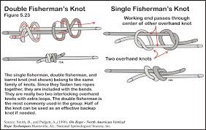

Slide 40
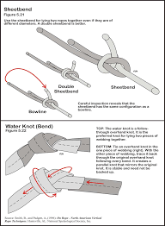
Bends
Bends tie two ropes together.
Three bends are covered, the sheet bend, water knot and double fisherman's knot.
A figure eight follow through is not included.

Slide 41
Sheet bend
Used to tie two ropes together.
Careful inspection of the knot reveals that it has the same configuration as a bowline
Hence, the sheet bend has most of the same attributes as a bowline.
It tends to be a loose knot. Under tension and slack, it will tend to become loose and come apart.

Slide 42
Sheet bend
Like the bowline, it is easy to untie. Simply, break the "horse collar" and the knot falls apart.
For additional strength, consider a double sheet bend with two internal loops.

Slide 43
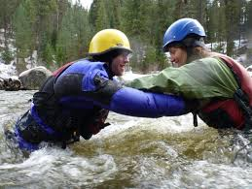
Water Knot
The water knot is used to tie two pieces of webbing together to form a sling.
This is the primary purpose of the knot and no other knot excels like the water knot in this capacity.

Slide 44
Water Knot
It is such a stable and strong knot; it does not need to be backed up.
Normally, it is not used to tie two ropes together.
A sheet bend or figure eight follow through would be preferred.

Slide 45
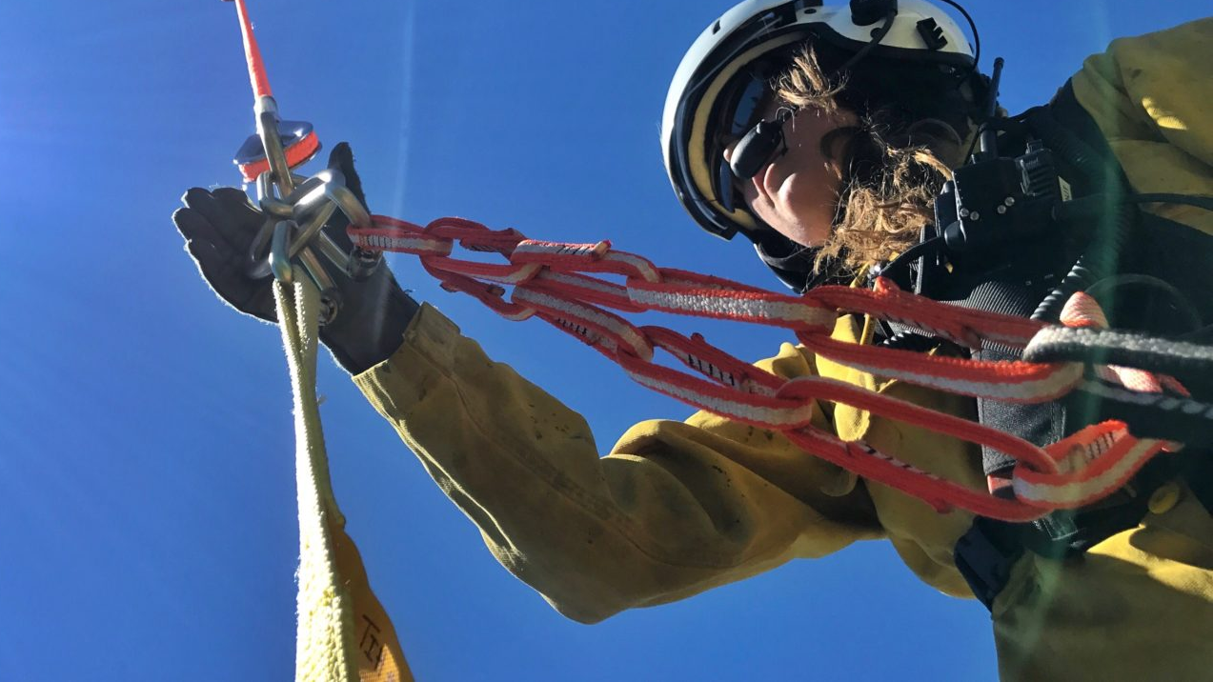
Double Fisherman
Normally, the double fisherman is used to fasten two ends of a rope together to form a loop or sling.
Sometimes, it is called the grapevine knot. It is an integral component in creating a sling and tying the Prusik.
Half of the knot is often used as a backup knot for other knots.

Slide 46
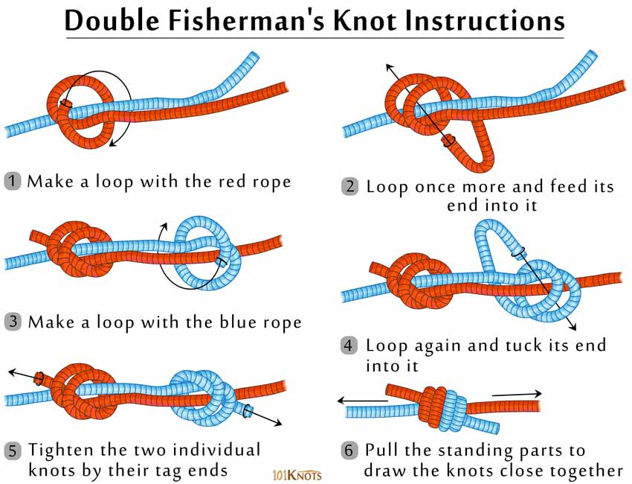

Slide 47
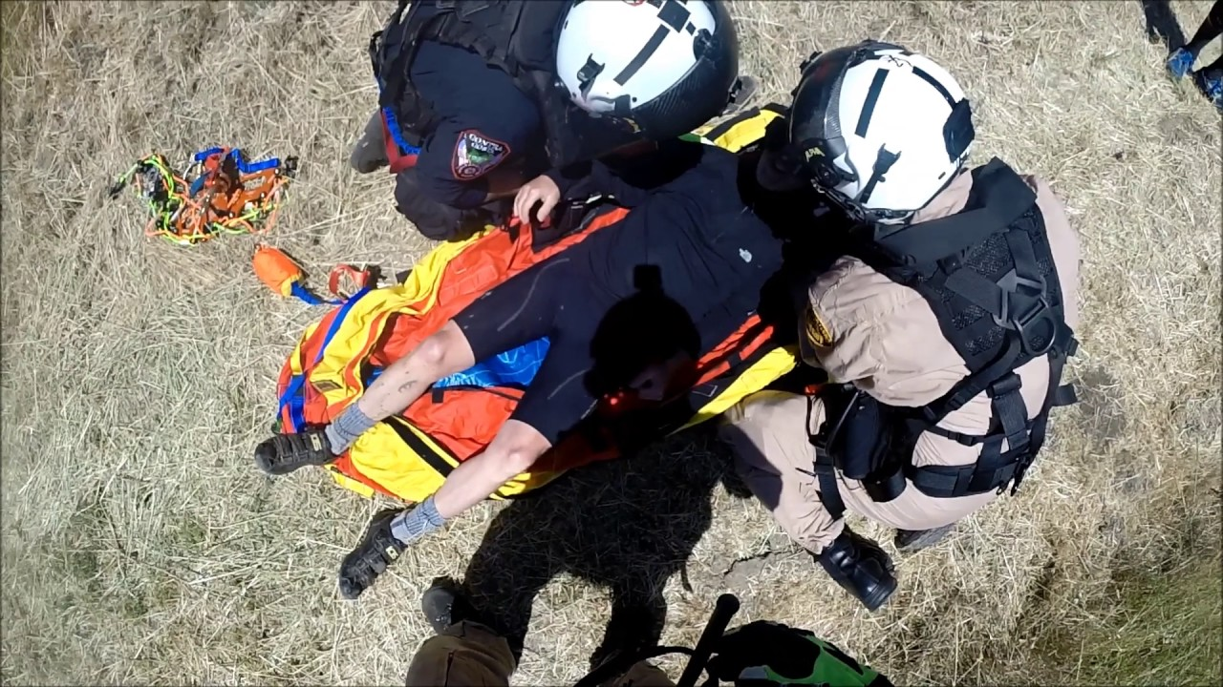
Double Fisherman
The knot cinches on itself making it extremely difficult if not virtually impossible to untie after being loaded.
For this reason, it is used in situations where it won't be untied.
When tying together two separate lines that will eventually be untied, other knots such as the sheet bend or figure-8 follow-through would be preferred.

Slide 48
Cams Straps
Currently, cam straps have not become a staple in the Swiftwater rescue community
However, they are a staple in the rafting and boating communities.
They are used to fasten everything to the raft in both paddle craft and oar rigs.

Slide 49
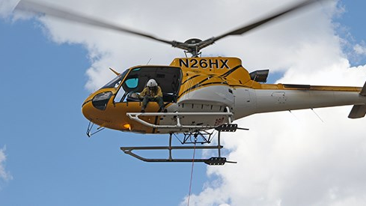
Cams Straps
For this reason they may be available to use in rescue situations where there are limited resources available.
The traditional cam trap is a 1" polypropylene strap with a tensile strength of roughly 1,500 lbs.
They come in a variety of lengths ranging from one foot to 20 feet in length.

Slide 50
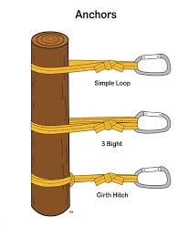

Slide 51
Anchors
In general, an anchor is a rock, tree or other object to which a line can be firmly attached.
A belayer can be considered an anchor.
The tensionless anchor discussed in the hitch section is also used as an anchor.

Slide 52
Anchors
The figure-8 follow through makes an excellent self-equalizing anchor
Usually, webbing is used to wrap around the anchor.
Three anchors are discussed in this section.
They are the simple or single loop, the 3-bight, and the girth hitch.

Slide 53
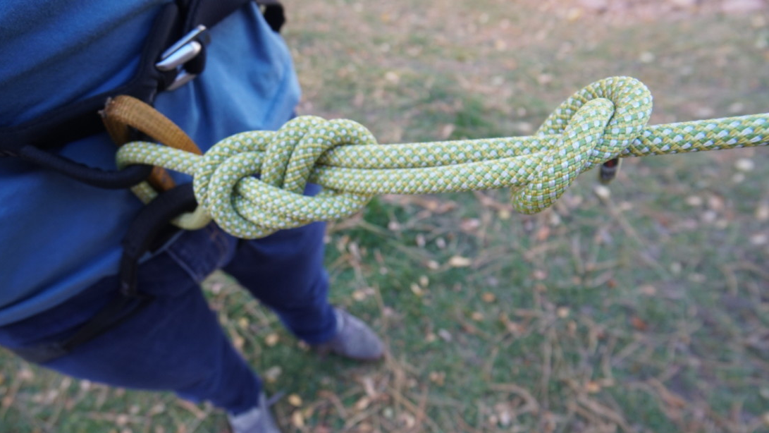
Simple or Single Loop
The webbing is looped around an object or anchor and the water knot is tied connecting the two ends of the webbing together to make a loop.
The downside of this approach is having to tie a water knot when tying the sling around the object.
It takes time.

Slide 54
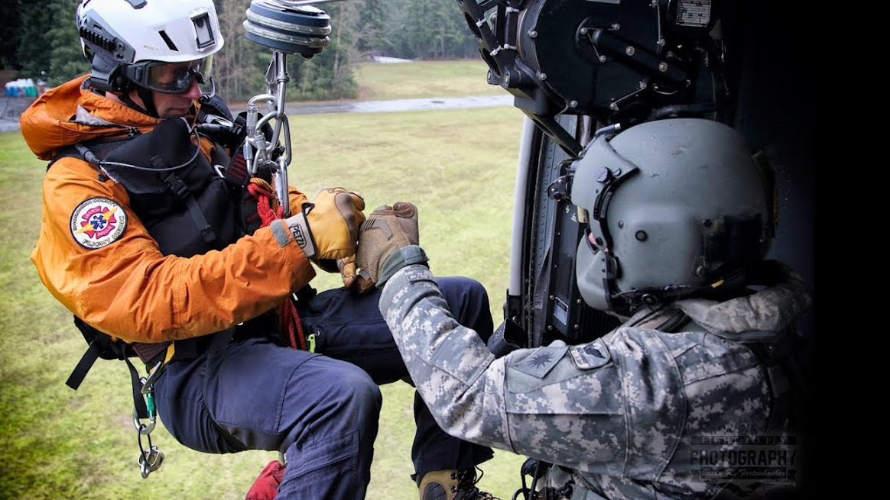
Simple or Single Loop
Second, a pre-tied sling can be slipped or looped around an anchor which is much quicker.
Often, when going around a rock, the extra length of webbing is needed to get around the rock.
The big disadvantage of the single loop is that it can slip down the anchor.

Slide 55
Simple or Single Loop
This is particularly true on tree trunks and other vertical objects.
It is less of a problem going around a rock anchor.
The big advantage of the single loop is that it has twice the length of webbing than in the 3-bight approach which can be useful in going

Slide 56
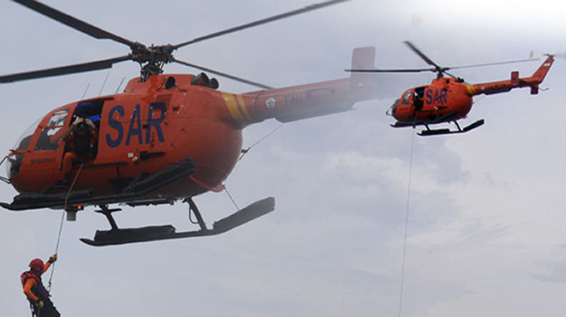
The second version of the simple anchor
It can be used on rocks but not trees.
Most rescuers will take the sling and loop it around the anchor.
This is particularly applicable to wrapping the webbing around a rock or similar anchor.

Slide 57
The second version of the simple anchor
If this doesn't work, the rescuer will often move to the 3-bight approach.
It doesn't require retying the sling.
It reorients the sling.

Slide 58
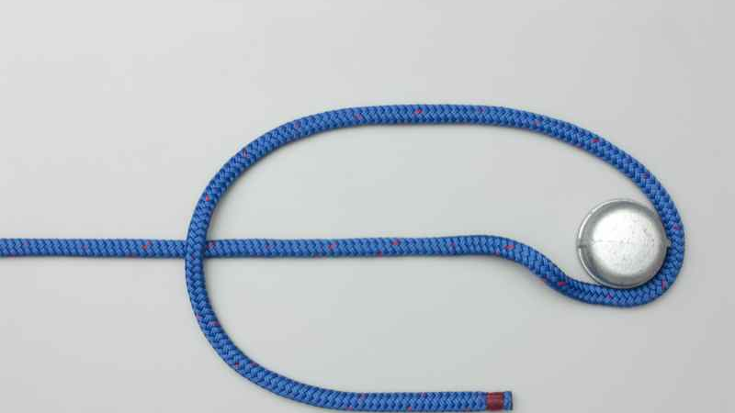
3 Bight
A water knot is pre-tied in the webbing making a sling.
The sling is looped around the anchor and the two ends connected with a carabiner.

Slide 59
3 Bight
An advantage of this system is that it is quick and easy to construct.
Another advantage of this anchor is that it reduces the load on each of the webbing strands by a fourth of the total load.

Slide 60
3 Bight
It is divided by four supporting lines.
As with the simple anchor, a disadvantage of this setup is that it can slip down vertical anchors such as tree trunks.
As noted, a disadvantage is that it takes twice the amount of webbing to go around the

Slide 61
Girth Hitch
In practice, the girth hitch is a practical anchor.
It cinches down on the anchor. It can be tied quickly and easily. It is intuitive and simple to use.
A pre-tied sling is looped around the anchor and then the two loose ends are passed though the loop.

Slide 62
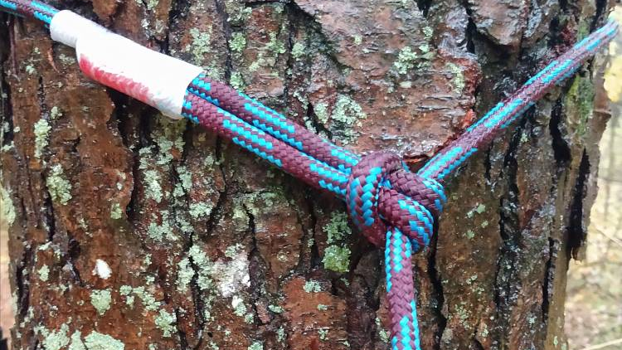
Girth Hitch
An advantage of the girth hitch is that it cinches down on the anchor, making the anchor more effective.
A disadvantage of the girth hitch is that because it cinches down on the anchor, it creates a stress point at the hitch.
Although this is technically true, it rarely presents an actual problem or system failure.

Slide 63
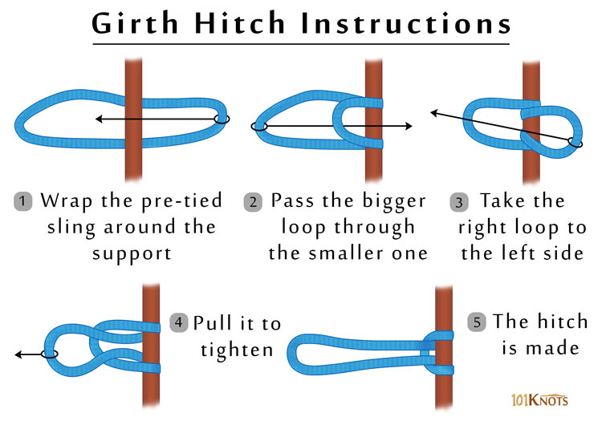

Slide 64
Carabiners
Carabiners are a staple of Swiftwater rescue.
They are used to connect ropes to other ropes or webbing.
They are used in rescue vests to connect the tether to a line in several of the rescues.

Slide 65
Carabiners
Carabiners come in all types of shapes and forms.
Choose a type of carabiner that you will carry with you.
Locking carabiners are recommended. However, if you choose to bring non-locking carabiners with you, they are better than not having any carabiners at all.

Slide 66
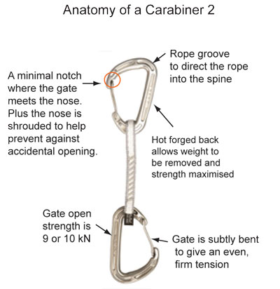

Slide 67
