Slide 1
THE RESCUE COMPANY 1

Slide 2
FEMA HELICOPTER SEARCH AND RESCUE TECHNICIAN

Slide 3
The Helicopter Search and Rescue (SAR) Technician DESCRIPTION
Conducts air SAR, recovery, and evacuation operations from inside and outside the aircraft
Performs air SAR and medical assistance that may include technical rescues using hoist or short-haul techniques
Performs specialized helicopter operations in all water environments, including Swiftwater

Slide 4
The Helicopter Search and Rescue (SAR) Technician DESCRIPTION
Conducts day or night air SAR under Visual Flight Rules (VFR) conditions
Aircraft flight operations may also require flight under Instrument Flight Rules (IFR) and night vision goggles (NVG)
Based on the mission and as the requester specifies when ordering

Slide 5
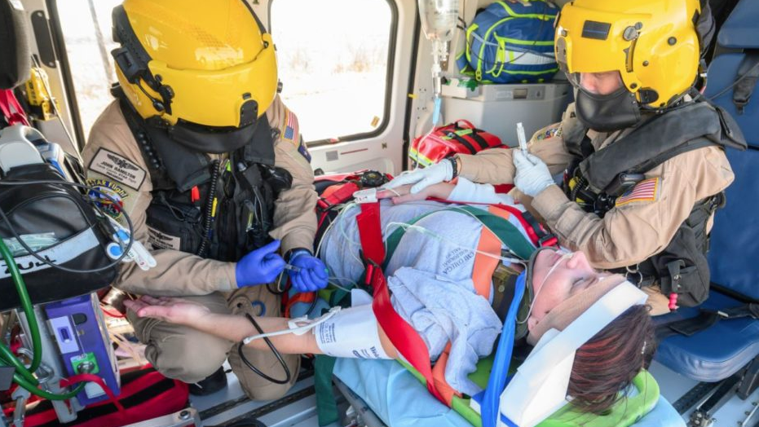
The Helicopter Search and Rescue (SAR) Technician DESCRIPTION
Performs Basic Life Support (BLS)
Reports to the Helicopter SAR Pilot in command or Helicopter SAR Crew Chief
Assists with overall search, rescue tactics, and medical operations

Slide 6
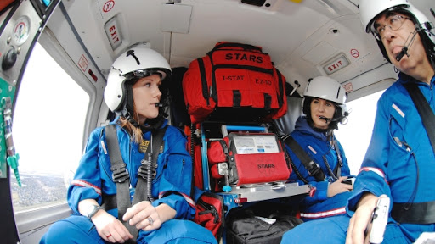
The Helicopter Search and Rescue (SAR) Technician General functions
Safety of self, team members, and operations
Medical care of self, team members, and survivors
Simple decontamination of self and team members

Slide 7
The Helicopter Search and Rescue (SAR) Technician General functions
Basic ground support for helicopter operations
Coordinates with ground vehicles, watercraft, and aircraft for operations and support

Slide 8
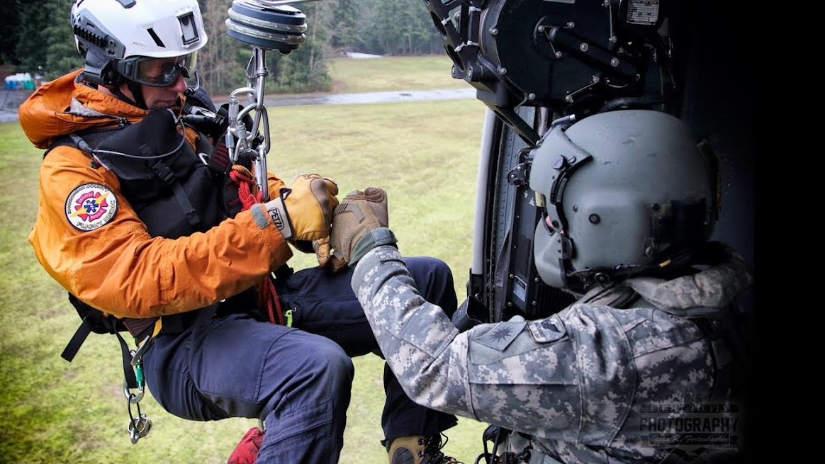
The Helicopter Search and Rescue (SAR) Technician General functions
Operates in environments with and without infrastructure, including those affected by disasters and terrorism; with compromised access to roadways, utilities, and transportation; and with limited availability of shelter, food, and water

Slide 9
TRAINING
IS-100: Introduction to Incident Command System, or ICS-100
IS-200: ICS for Single Resources and Initial Action Incidents
IS-700: National Incident Management System (NIMS) An Introduction
IS-800: National Response Framework (NRF), An Introduction
IS-809: Emergency Support Function (ESF) #9 - Search and Rescue

Slide 10
TRAINING
Following Occupational Safety and Health Administration (OSHA) based coursework:
Annual bloodbome pathogens training or equivalent

Slide 11
TRAINING
Annual hazardous waste operations and emergency response or equivalent
Annual hazardous materials first responder awareness or equivalent
Respiratory protection, including the successful completion of a quantitative respiratory protection fit test and associated currency components, as applicable

Slide 12
EXPERIENCE Knowledge, Skills, and Abilities:
Performs navigation, internal and external loads, rigging, and operation
Provides preventive care and emergency corrective actions for all expected emergencies
Inspects and maintains personal protective equipment (PPE), tools, devices, and equipment specific to this position
Operates aircraft mounted and deployable rescue equipment

Slide 13
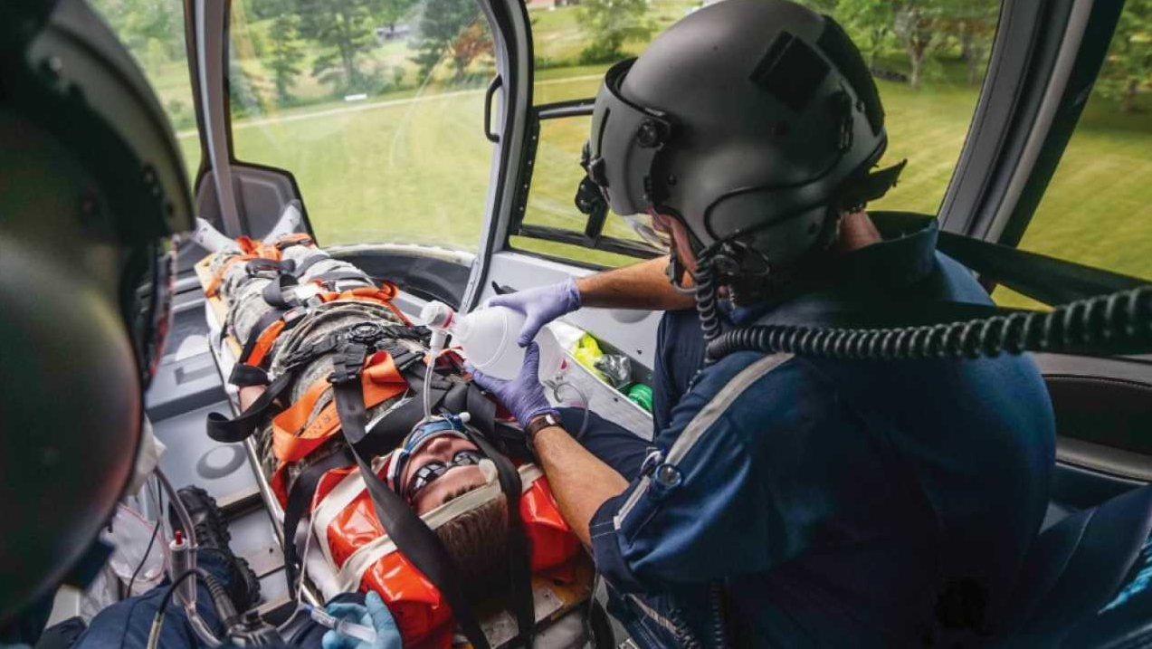
PHYSICAU MEDICAL FITNESS
Performs duties under arduous circumstances characterized by working consecutive 12-hour days under physical and emotional stress for sustained periods of time
Maintains physical fitness and swimming standards, in accordance with the AHJ's Job Related Physical Ability Test (JRPAT)

Slide 14
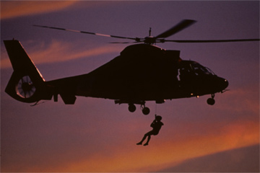
PHYSICAU MEDICAL FITNESS
Maintains immunizations in accordance with the U.S. Department of Health and Human Services Centers for Disease Control and Prevention recommended adult immunization schedule for the United States of America

Slide 15
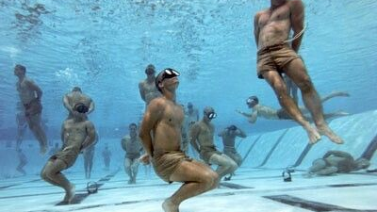
PHYSICAU MEDICAL FITNESS
Arduous fitness or work capacity criteria is consistent with the physical fitness levels the National Wildlife Coordinating Group (NWCG) Wildland Fire
National Fire Protection Association (NFPA) 1582: Standard on Comprehensive Occupational Medical Programs for Fire Departments, or equivalent physical and medical fitness criteria at the AHJ's determination.

Slide 16
CURRENCY
Annual refresher of related skills and emergency procedures in aircraft
Functions in this position during an operational incident, planned event, participation in exercise, drill or simulation at least once every three years
Background checks as applicable law permits or requires

