Slide 1
Fourth Edition
Lesson 8: Pediatric Maltreatment
Notes:
Welcome to Lesson 8: Pediatric Maltreatment.

Slide 2
Learning Objectives
Discuss the epidemiology of maltreatment​.
Describe the different forms of maltreatment.
Identify a possible victim of maltreatment​.
Gather an appropriate history​.
Provide an appropriate level of care​.
Interact professionally with caregivers​.
Notes:
Instructor Notes
Discuss the learning objectives and the importance of thoroughly understanding each one.
Discuss the epidemiology of maltreatment.
Describe the different forms of maltreatment.
Identify a possible victim of maltreatment.
Gather an appropriate history.
Provide an appropriate level of care.
Interact professionally with caregivers.

Slide 3
Introduction
Types of maltreatment
  Physical abuse
  Emotional abuse
  Sexual abuse
  Child neglect
Notes:
Instructor Notes
Types of child maltreatment:
Physical abuse
A person intentionally injures a child or allows an injury to be inflicted in a child younger than 18 years.
Emotional abuse
A consistent pattern of behavior interfering with the social and normal psychological development of a child.
Sexual abuse
Engagement of sexual activities with a dependent or other child for a person’s own excitement or for the enjoyment of others.
Child neglect
Harming a child mentally, physically, or emotionally through a caregiver failing to supply basic needs.
Includes medical neglect, in which a caregiver fails to meet the medical needs of a child (either through not seeking medical care for obvious injuries/illnesses or ignoring medical advice).
The most common form of maltreatment is neglect.
The numbers in the figure add up to more than 100% because a child may have suffered from more than one type of maltreatment.
Most statistics are misleading, because much abuse goes unreported.
The fatalities reported usually do not include co-sleeping deaths, which are more common than one might believe.
Of the children who died, 72.8% suffered neglect and 46.1% suffered physical abuse, either exclusively or in combination with another type of maltreatment.
In 2018, there were 3.5 million reported cases of child abuse.
Approximately 678,000 of these cases were substantiated.
There were 1,738 fatalities from child abuse in 2018.
On average, child fatality rates decrease with increasing age.
The highest occurrence is in children younger than 1 year.
A single maltreatment type was present in 84.5% of reported cases.
15.5% had more than two maltreatment types.
Boys have a slightly higher fatality rate than girls.
The youngest population is the most vulnerable for abuse, and the rates are very similar for boys (48.5 %) and girls (51.2 %).
28.7% of abused children are younger than 3 years of age.
15.3% of abused children are younger than 1 year of age.
In 91.7% of cases, one or both parents were responsible for the abuse.
Nearly 40% of children are maltreated by a mother acting alone
21.5 % are maltreated by a father acting alone.

Slide 4
Risk Factors
Child | Parent/Environment
Age | Single-parent homes
Birth order | Substance abuse in home
Premature infants | Families with low incomes
The “challenging” child | Children of parents who were abused
Stepchildren | Unrealistic parental expectations
Siblings of abused children
Remember: Children of all ages, socioeconomic backgrounds, and family types may be subjects of abuse.
Notes:
Instructor Notes
Child
Some factors make certain children more likely to be the victim of abuse. These are not absolutes; however, they increase the chances of the child being a target of abuse.
Younger children are at greater risk.
Premature infants may require more attention and potentially more medical care.
A medically “complex” child is a lot more challenging than a child without health issues, and some children tend to be more “difficult” than others, which could simply mean that their personality is a little bit more than the parent is able to deal with.
Stepchildren may be a target because they are not the perpetrator’s biological children.
Siblings of abused children also are targets.
Parent/environment
Caregiver risk factors can include the caregiver as well as the environment.
Single-parent homes.
Homes in which there is substance abuse.
Low-income families.
Parents who were abused themselves.
Unrealistic parental expectations can be a factor when either parent expected the “perfect child” and instead ended up with a willful, headstrong, energetic child instead of the “little angel” they were expecting.
Children of all ages and backgrounds and from all family types can be subject to maltreatment.
All socioeconomic backgrounds are included. Although middle- and higher-income families may be better able to conceal what is going on behind closed doors, the fact that a child is growing up in a well-to-do family does not mean they are not subject to maltreatment.

Slide 5

Caregiver Behavior
Apathy
Strange behavior
Little to no concern for the child
Overreact to child’s misconduct
Withholding events surrounding the injury
Intoxication
Overreaction to child’s disorder/injury
© all_about_people/Shutterstock
Notes:
Instructor Notes
Caregiver behavior
When a child is under stress, they seek support and comfort from their caregiver.
The strong bond between a caregiver and child assists in regulating emotions, coping with stress, and providing social support.
Common behavioral characteristics of caregivers of maltreated children include lack of interpersonal skills and parenting knowledge, immaturity, drug use, and poor self-concept.
The list of common caregiver behaviors noted on the slide are not meant as confirmation that a caregiver has abused their child, but should serve as “red flags” for the potential of child maltreatment in the home.
Keep in mind that a caregiver who does not display these common characteristics could still be maltreating the child.
You should never confront a caregiver whom you suspect of causing maltreatment.
Doing so could further endanger the child or create a hostile environment.
The perpetrator may not be present on scene of the suspected abuse.
Including the interactions of caregivers in your documentation is critical but avoid being judgmental.
Document what you see and hear from the caregivers, siblings, and children.
Include the caregiver’s and child’s story of how the injury occurred.

Slide 6

Maltreatment (1 of 10)
Signs of maltreatment
  Behavioral
  Physical
© Mihail Fedorenko/Shutterstock
Notes:
Instructor Notes
Discuss the behavioral and physical signs associated with a child suffering from maltreatment.
Behavioral signs to look for can include:
A child who appears apprehensive around adults.
A child who appears scared when other children cry.
Because they are scared, they will draw attention to themselves and get punished, or they are afraid the other child will get hurt.
Behavioral extremes, either good or bad.
An overly compliant child.
A child who is afraid to go home.
Complaining of soreness, moving awkwardly.
Being destructive to self and others.
Being “accident prone.”
An abusive parent may say that their child is accident prone in order to cover up the abuse. Everyone has heard the old cliché of “He/she fell down the stairs” or “He/she is so clumsy and is always getting hurt.”
Wearing inappropriate clothing to cover the body.
Having a history of running away.
Having an aversion to physical contact or touch.
Physical signs to look for can include:
Human bite marks.
Bald spots.
Unexplained burns.
Rope burns on arms, legs, neck, or torso.
Injuries that do not correspond to the child’s developmental stage.
Example: A 1-month-old does not roll off the bed and sustain a severe head injury.
Multiple bruises or fractures at different stages of healing.
Unexplained lacerations or abrasions should raise suspicion.
Bruises at different stages.
Marks that look like an object, pattern, or geometric shape.
Marks with sharply demarcated borders/transition zones.
Injuries to areas of the body that are unlikely to be injured accidentally.

Slide 7
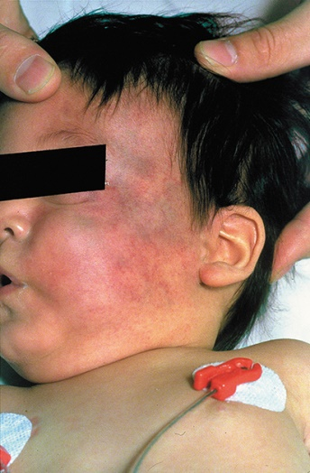
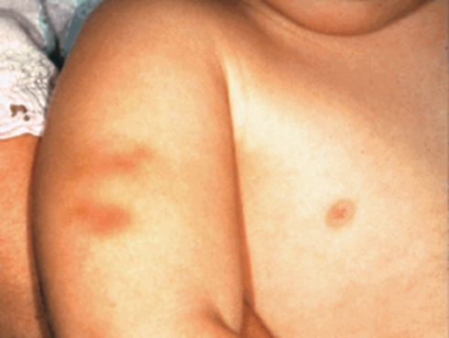
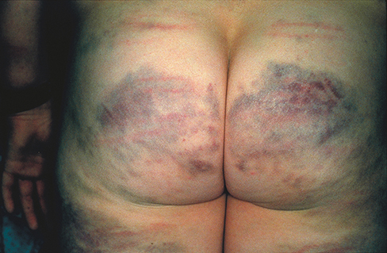
Maltreatment (2 of 10)
Bruising in children
Courtesy of the American Academy of Pediatrics
Courtesy of Ron Deickmann, MD, FAAP.
Courtesy of Ron Deickmann, MD, FAAP.
Notes:
Instructor Notes
Why is there a critical need for prehospital providers to recognize and understand abuse?
Prehospital professionals are more likely going to be dispatched to an “accidental fall” rather than “my boyfriend just hit my child.”
A study determined that bruises where bruising was not expected and had no identified medical cause for the bruising were found in approximately 20% of abused children.
When is bruising normal in children?
Bruises are associated with developmental capabilities.
A child younger than 4 months with a bruise is uncommon.
Bruises become more common in cruisers and walkers as children begin to walk.
Children who are developmentally not able to cruise should not have bruises.
Recognize normal patterns.
Younger children have larger heads.
This means they lead with their head and fall forward (i.e., they have learned how to walk/run, but not how to stop).
Head and face injuries are more common in 10- to 18-month-old children and become less common in children older than 4 years of age.
10- to 18-month-old children have larger heads (relatively) and bad balance, so when they fall, it will more than likely be their head or face that takes the brunt of the injury.
Abusive bruises tend to be away from bony prominences.
Bruising located in the hands, buttocks, and abdomen are not typical and should raise concern.
Abusive bruises tend to be larger and in multiple stages of healing.
They occur in clusters and some carry the imprint of an implement.

Slide 8
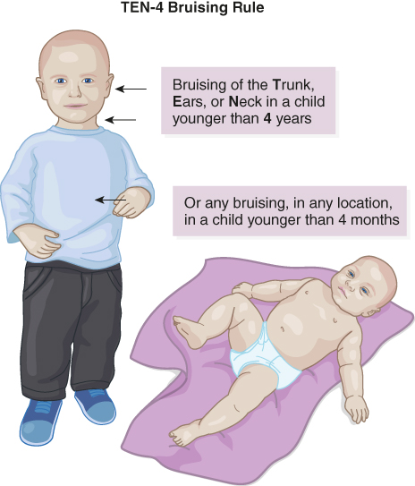
Maltreatment (3 of 10)
Bruising in kids
  TEN-4 bruising rule
Notes:
Instructor Notes
TEN-4 is a tool a provider can use to rule in or rule out child abuse.
In children younger than 4 years of age, bruises on the following parts of the body should be a red flag:
Trunk
Ears
Neck
Any bruises in children younger than 4 months of age should be alarming.
“If they don’t cruise, they shouldn’t bruise.”
Some providers like to add on to TEN-4 by adding FACES P:
Bruises on any of these areas are also a concern:
Frenulum
Auricular area
Cheek
Eyes
Sclera
Bruises that appear in a pattern (P) should quickly raise the prehospital provider’s concern.

Slide 9
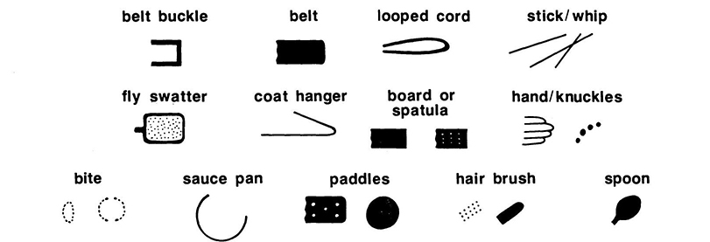
Maltreatment (4 of 10)
Pattern marks
Reproduced from Johnson CF. Inflicted injury versus accidental injury. Pediatr Clin North Am 1990;37:803.
Notes:
Instructor Notes
Discuss how different objects can leave distinguishing marks/imprints.
Injuries inflicted with an object will often leave marks that reflect the outline of that object.
Hand
Can leave a negative imprint
Capillaries break between the fingers as blood is pushed away from the point of impact and into the place of least resistance.
Cords, ropes, shoes, kitchen implements, and belt buckles can leave notable outlines on the skin.
Pulling on kids’ ears can cause bruising.
Some parents will try to explain it away by saying “He/she slept on it wrong.”
Another common injury is the torn frenulum.
These injuries are more than likely caused by a glancing blow to the face or objects shoved violently into the mouth.
Often these may be bottles or pacifiers because the child is crying.
A torn frenulum is easy to miss, if you are not looking for it.

Slide 10
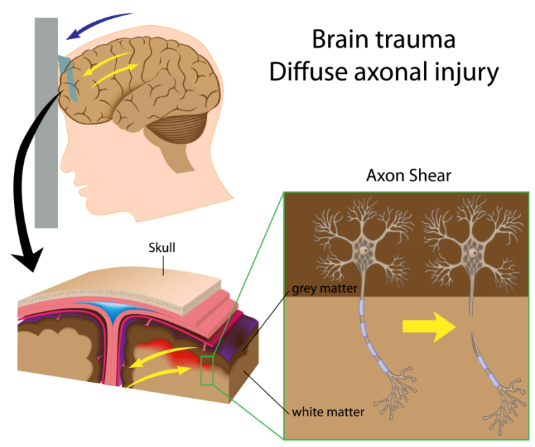
Maltreatment (5 of 10)
Abusive head trauma
  Formerly referred to as “shaken baby syndrome”
© Alila Medical Media/Shutterstock
Notes:
Instructor Notes
“Shaken baby syndrome” is now referred to as abusive head trauma.
Most often occurs when a parent or caregiver is tired or upset because a baby or small child won’t stop crying, is not listening to them, or is “misbehaving.”
The parent may get frustrated and shake the baby to try to get it to stop crying.
The parent might strike the baby against something hard.
It is an acceleration/deceleration injury.
May not be what started the force, but what ultimately ended it.
If patient is slapped and something on the other side stops the acceleration suddenly, injuries can occur.
Abusive head trauma accounts for most deaths associated with children younger than 2 years.
Affects approximately 1000 to 3000 children per year.
Usually caregiver or parent is responsible for the injuries.
65% to 90% of these abusers are male.
80% of survivors suffer some sort of permanent damage.
Signs and symptoms of abusive head trauma include:
Altered mental status
Drowsiness with irritability
Seizures
Decreased appetite
Vomiting
Posturing in which the back is arched and head is bent back
Signs of physical injury outside the body may not be seen, leading to a missed diagnosis.

Slide 11
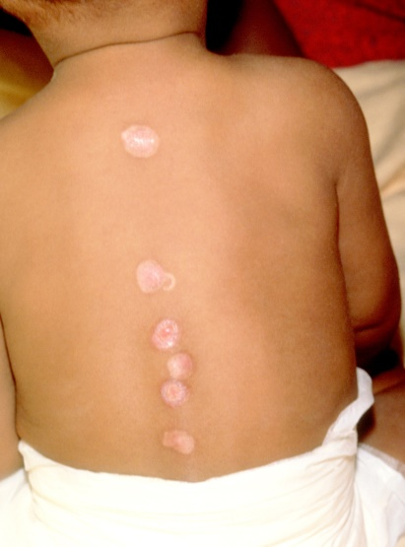
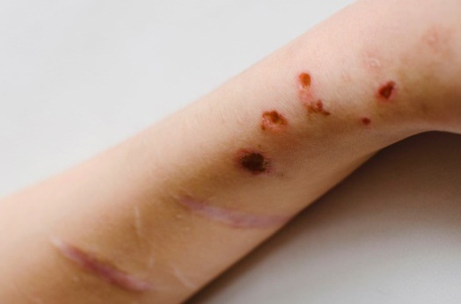
Maltreatment (6 of 10)
Burns
© NataVilman/Shutterstock
© Mediscan/Alamy Stock Photo
Notes:
Instructor Notes
Types of abusive burns:
Contact
Thermal
Electrical
Chemical
Radiation
Abusive burns
Tend to be more common in younger children and in children from single-parent families.
Are generally serious and more likely to be full-thickness burns.
Associated with longer hospital stays than accidental burns.
Contact burns
Inflicted cigarette burns
Circular, uniform-sized, deep
0.75‒1.0 cm in diameter
Often grouped on hands, feet, or back
Accidental contact with cigarettes usually causes brushed lesions, which appear less pristine, and causes superficial burns instead of deep burns.
Lighter burns are more common than cigarette burns.
Hair dryers/other appliances can cause deep pattern burns after just a few seconds of contact with the skin.
In the U.S., burns from tap water are the most common form of abusive burns, and the most common form of all burns.
Account for 50% of child abuse burns.
Usually in children younger than 2 years.
Hot water, tea, microwaved items, ramen.
These injuries are more common in families experiencing high levels of stress.
Single-parent households
Younger families

Slide 12
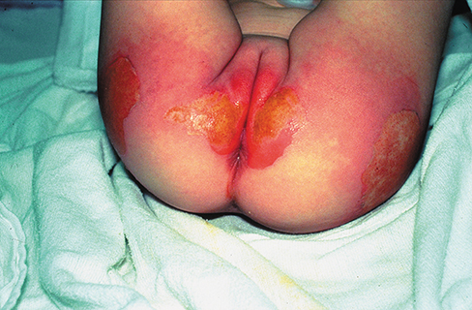
Maltreatment (7 of 10)
Scald burns
Immersion scald burns
Courtesy of Ron Deickmann, MD, FAAP.
Notes:
Instructor Notes
Scald burns
Usually involve the anterior face and head, neck, palmar surfaces of the hand, arms, and anterior shoulder and chest.
Generally become less intense as the liquid runs down the body and dissipates heat.
Area below the initial point of contact tapers down.
“Arrow down” pattern.
Accidental scald burns are typically worse at the top or at point of contact, then lessen as the water runs down and cools.
Rarely full thickness, and the burn margins will be irregular and asymmetric.
Accidental bathtub burns are generally not full thickness or well demarcated.
The child will immediately pull away.
Burns sustained in the kitchen are more likely to be accidental.
Immersion scald burns
Immersion scald burns are the most common inflicted burns.
They usually involve the lower trunk, buttocks, perineum, arms and legs.
Can appear as “stocking and glove” burns involving hands and feet or “donut burns” to the buttocks.
Sometimes it is easy to tell when a child’s hand has been forced into hot water, because he/she will make a fist, sparing the palm.
Note that a child will sustain a much more significant burn than an adult and in a much shorter period of time.
Variables of immersion burns:
Water temperature.
Length of time the child was exposed to the water.
Depth of the burn.
This may not be apparent until several days later.

Slide 13

Maltreatment (8 of 10)
Pediatric human trafficking
© filadendron/iStock/Getty Images Plus/Getty Images
Notes:
Instructor Notes
Pediatric human trafficking
Involves forced labor, domestic servitude, drug running, commercial sex acts, etc.
Examples:
Prostitution
Mail-order bride trade
Child pornography
Online sexual abuse
Performance in sexual venues
More than 21 million victims of human trafficking globally.
26% of them are children.
Average age when a child enters the commercial sex industry in the U.S. is 12 to 14 years.
Minors are easily targeted due to their poor critical-thinking skills and impulse control.
Children with low self-esteem or who experience feelings of worthlessness are considered easy targets.
Researchers have suggested that 9% to 28% of runaway and homeless youth have exchanged sexual activities for items needed to survive.
68% of females who are trafficked, are trafficked for labor.
Discuss common red flags for human trafficking:
Person with child is reluctant to leave them alone
Inconsistent history
May not know address or how to get home
Unexplained absences from class
Sexual behavior
Untreated chronic illness
Chronic lack of care
Sexually transmitted infection or UTI
Trauma to vagina, scrotum, penis, or rectum
Cigarette, iron, or acid burns
Physical injuries
History of abortions or miscarriages
Tattoo or “brand” with man’s initials

Slide 14
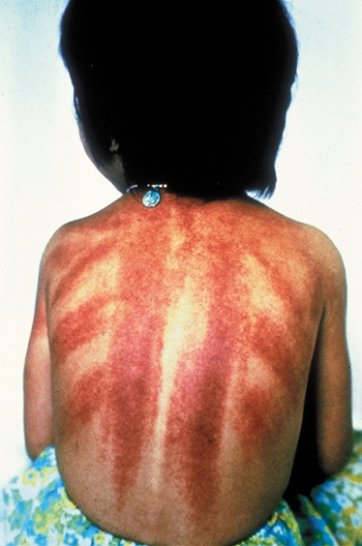
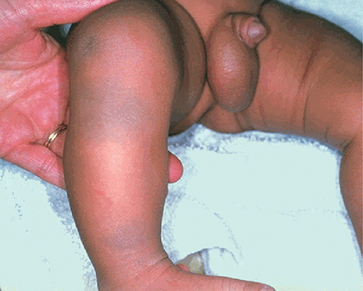
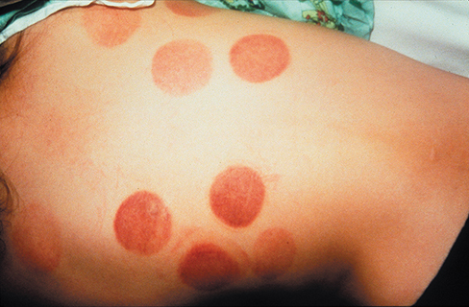
Maltreatment (9 of 10)
Signs mistaken for abuse
  Mongolian spots
  Cao Gio (“catch the wind”)/Gua Sha/Kerikan
  Cupping
  Phytophotodermatitis
Courtesy of the American Academy of Pediatrics
Courtesy of the American Academy of Pediatrics
Courtesy of the American Academy of Pediatrics.
Notes:
Instructor Notes
Mongolian spots are often mistaken for child abuse.
Blue-gray patches usually found in the lumbosacral area, but can be found on back, shoulders, or extremities.
Result from deposition of melanin in the dermis.
Present at birth and tend to fade over several years.
At least 2% of newborns are born with some type of birthmark, including Mongolian spots.
Always document presence and location.
The spots are harmless, but in a small number of children have been associated with rare metabolic diseases.
Distinguishing factors of Mongolian spots are:
Presence at birth and failure to manifest color progression.
Mongolian spots will blanch; bruises will not.
Some cultures, when treating illnesses, use practices that can be mistaken for signs of abuse.
Cao Gio is also referred to as Gua Sha or Kerikan, depending on which ethnicity/nationality is practicing it.
It is a dermabrasion therapy.
Asian practice of rubbing skin with coin or spoon to alleviate “bad winds” presumed to cause illness.
The coining will bring the blood to the surface, where the negative energy can then be released.
Cupping
The process of attaching cups to the skin to create suction.
Often used to treat sore muscles and is supposed to promote healing by removing negative forces and promoting circulation.
People have been using cupping for centuries, but there is not much research available.
Michael Phelps was seen with cupping marks at the 2016 Summer Olympics.
Phytophotodermatitis
Dermatitis caused by contact of the skin with photosensitizing compounds in plants.
When the skin is then exposed to sunlight, it reacts with an inflammatory eruption.
Can resemble a severe sunburn.
Usually well-demarcated, irregular patterns.

Slide 15

Maltreatment (10 of 10)
Reporting
  History taking
  Mandated reporting
© twomeows/Moment/Getty Images
Notes:
Instructor Notes
History taking
The initial history can be the most important piece of evidence a healthcare provider can collect in a child maltreatment case.
Both the history from the caregiver and the child are important.
Rarely does a family disclose concern for abuse.
The child’s history will more than likely be in verbal form.
However, children younger than 3 years of age are at high risk for abuse because they are unable to tell their story.
Giving open-ended prompts to obtain the history is the best way to get detailed answers.
Absolute privacy should be provided when obtaining history from a suspected maltreated child.
All information should be documented verbatim.
Mandated reporting
A mandated reporter is one who is required by law to report reasonable suspicions of abuse.
Most state laws only require reasonable suspicion that abuse is occurring.
The job of EMS is to consider whether the injury/symptoms might have been caused by abuse rather than the story as told. If we do not think about abuse, we will miss it.
Participant engagement:
Are you liable if you make a report and it is not substantiated?
No, those persons making a report in good faith are protected from liability.
You do not need to have proof of abuse to make a good faith report.
What should I do if a child discloses abuse to me?
Listen without expressing anger or disbelief.
Ask open-ended questions like “then what happened?”
Do not ask leading questions (may retraumatize child and contaminate investigation).
If possible, determine what, where, when, and by whom (minimal fact interview).
Do not attempt further investigation on your own; especially do not investigate physical signs.
Report any relevant findings immediately to law enforcement, Child Protective Services, or both.

Slide 16
Case Study 1
Dispatch
  You are dispatched to a private residence for a 3-month-old unresponsive female. It is a cool fall afternoon with an outside temperature of 56°F (13.3°C).
Notes:
Instructor Notes
For students other than prehospital practitioners, dispatch information can be modified.
What are your initial concerns and possible differential diagnosis from the dispatch information?
Initial concerns
Unresponsive
Differential diagnosis
Accidental ingestion
Trauma
Hypothermia
Sudden death
Child abuse
Discuss the importance of scene assessment and awareness.
Expand on how it applies to this case.
Ask the students: What goes through your mind?
Did the parents just panic, and the child is not truly unresponsive?
Is this the “real deal”?
If so, is the child still unresponsive?
Case Study 1 involves a 3-month-old unresponsive female.
Diagnosis: Multiple subdural hematomas (nonaccidental trauma).

Slide 17
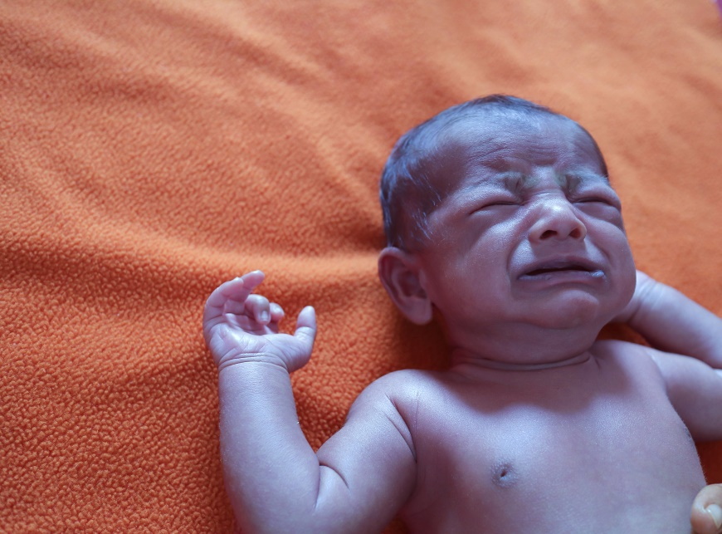
Initial Observations
© Master the moment/Shutterstock
Used with permission of the American Academy of Pediatrics, Pediatric Education for Prehospital Professionals, © American Academy of Pediatrics, 2000
Notes:
Instructor Notes
Discuss the following initial findings at the scene and PAT findings:
As you arrive on scene, a frantic couple rushes out to meet you, carrying a 3-month-old girl in their arms.
They are yelling at you to help the child, saying she is not breathing.
The child appears limp and floppy.
PAT
Appearance: Unresponsive
Work of breathing: Agonal
Circulation: Cyanotic
The couple tells you that they are the girl’s aunt and uncle and that they have custody of her due to concern for parental methamphetamine abuse.
They appear appropriately concerned and tell you that the child fell out of her portable playpen (pack ‘n play).
They say she cried immediately, then vomited and went limp, which is when they called 911.
Discuss additional precautions or concerns that may be warranted based on initial observations.
Is this patient “Quick” or “Not Quick”?
The patient is “Quick.”
How was this determination made?
Have you identified any possible red flags?
Implausible story

Slide 18
Discussion
Does the couple’s story sound credible?
What are risk factors for child abuse?
Notes:
Instructor Notes
Does the couple’s story sound credible?
Identify pediatric milestones and whether this is a plausible story.
A 2-month-old is not physically capable of falling out of a portable playpen.
Falls
The likelihood of a child getting hurt from a fall of less than 3 feet is very slim.
This includes a fall from a bed, couch, chair, or coffee table.
At 3 to 6 feet, injuries are not expected, but possible.
For instance, a fall from a kitchen counter, changing table, bunk bed, or the stairs.
At falls from heights of over 6 feet, injuries can be reasonably expected.
These include falls from a deck or the top of a slide.
Recall risk factors with the students.
Does it sound as if this child might have been in a less-than-ideal environment to begin with?
In foster care, coming from a house in which parents were convicted of methamphetamine use.
Foster parents are related to the child’s parents.
Participant engagement:
Remind participants that completing a thorough assessment and history in pediatrics is of utmost importance.

Slide 19
Primary Survey
    Primary survey
      X ‒ No bleeding found.
      A ‒ Patent
      B ‒ Agonal
      C ‒ Brachial pulses are absent. Skin is cyanotic.
      D ‒ Unresponsive; GCS = 3 (E1, V1, M1)
      E ‒ In uncle’s arms.
Notes:
Instructor Notes
Discuss the primary survey.
Note that the PAT is completed prior to the primary survey (XABCDE).
Ask participants to explain any abnormal findings of their patient(s), whether physical and/or developmental, and why.
Discuss any life threats identified in this case.
Unresponsive, cyanotic female with absent pulse.
Primary survey
X ‒ No bleeding found.
A ‒ Patent.
B ‒ Agonal.
C ‒ Brachial pulses are absent. Skin is cyanotic. (The cardiac monitor represents asystole if applied.)
D – Unresponsive; GCS = 3 (E1, V1, M1).
E – In uncle’s arms.
What would your initial treatment be?
Discuss treatment options per local guidelines and policy.
Treatment should focus on cardiopulmonary support.
Immediately begin chest compressions and ventilate with an appropriately sized bag-valve mask.
Discuss local guidelines on pediatric cardiac arrest in the field.
After 10 minutes of CPR, ROSC was obtained.
The child is intubated with a 3.5-mm endotracheal tube.

Slide 20
Detailed Assessment
History taking
  O – Sudden
  P – Unclear
  Q – Unable to assess
  R – Unable to assess
  S – Unknown
  T – 10 minutes
Notes:
Instructor Notes
Review history taking using the OPQRST mnemonic.
O – Sudden
P – Unclear
Q – Unable to assess
R – Unable to assess
S – Unknown
T – 10 minutes

Slide 21
Detailed Assessment
History taking
    S ‒ Unresponsive, cyanotic, pulseless.
    A ‒ No known allergies.
    M ‒ None.
    P ‒ Full-term infant. Resolved upper respiratory infection several weeks ago.
    L ‒ Bottle this morning.
    E ‒ Child was in her portable playpen when they heard a loud thump and found her lying on the bedroom floor.
    R – Age.
Notes:
Instructor Notes
Review history taking using SAMPLER.
S ‒ Unresponsive, cyanotic, pulseless.
A ‒ No known allergies.
M ‒ None.
P ‒ Full-term infant. Resolved upper respiratory infection several weeks ago.
L ‒ Bottle this morning.
E ‒ Child was in her portable playpen when they heard a loud thump and found her lying on the bedroom floor.
R – Age.

Slide 22
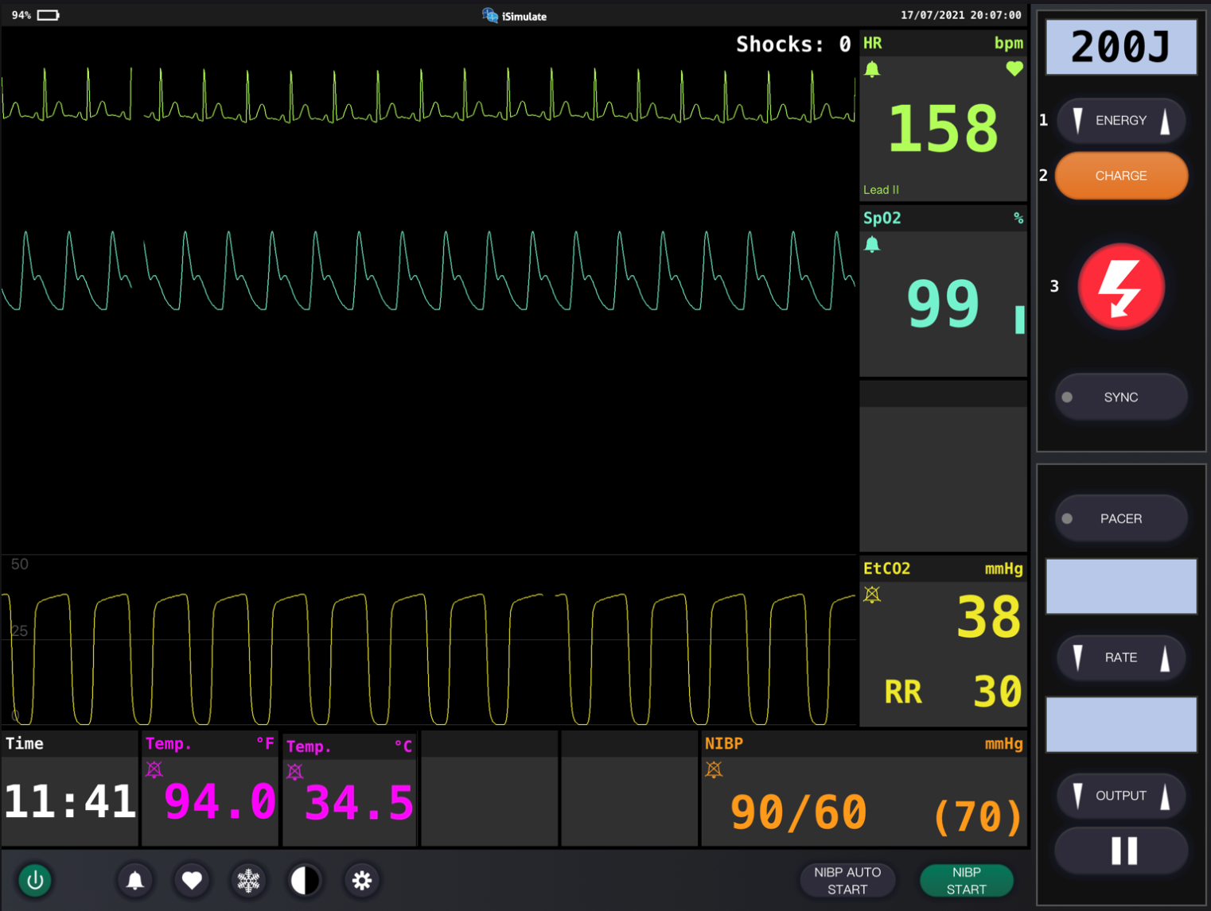
Vital Signs
4
Notes:
Instructor Notes
Discuss what the vital signs show about the patient:
SpO₂: 99% on oxygen via endotracheal tube.
ETCO₂ is 38.
Respiratory rate is ventilatory rate via bag-valve mask.
Blood pressure is 90/60.
Blood glucose is 178 mg/dL (9.9 mmol/L).
Weight is 6 kg per length-based tape.
Diagnostics indicate sinus rhythm.
Participant engagement:
The patient begins having a generalized seizure as you complete your vital signs.
Discuss treatment in your region for seizure.
0.6 mg Lorazepam was given in this case.

Slide 23
Detailed Assessment
Notes:
Instructor Notes
*Ask students: Given the age of this child, would you perform a head-to-toe or toe-to-head assessment?
HEENT
Head: No external evidence of bruising or trauma noted. Soft, nonbulging fontanelle.
Eyes: PERRL
Ears: Unremarkable
Nose: Mucus present
Throat: Unremarkable
Heart and lungs
Lung sounds, clear bilaterally. Heart sounds are normal, no murmur.
No external trauma noted.
Neuro
Unresponsive
Abdomen and pelvis
Soft, nontender
Upper extremities
Nickel-sized bruise to her right upper arm
Lower extremities
Unremarkable

Slide 24
Treatment
BLS
  Maintain patent airway
  CPR
  Oxygen
  Ventilatory support
  Oral adjunct
ALS
  BLS care
  Warm fluids via IV/IO
Critical care
  BLS/ALS care
  ET intubation
  Benzodiazepine for seizure
  ROSC management
Notes:
Instructor Notes
Ask students how they would treat this patient according to their local protocols and scope of practice.
Patient management:
What are your goals for this patient?
Discuss treatment options for this patient.
The patient should be treated with cardiopulmonary support and monitored for continued seizures.
Be prepared for rapid deterioration.
What conditions are part of your potential differential diagnosis?
Accidental ingestion
Trauma
Hypothermia
Sudden death
Child abuse
Abusive head trauma/concussion

Slide 25
Ongoing Management
Reassess the patient.
Where is the most appropriate treatment destination and why?
Can you safely transport this child in your ambulance?
Will you allow the aunt and uncle to ride in the ambulance?
Notes:
Instructor Notes
Discuss the ongoing management options based on scope of practice and local protocols.
Warm fluid administration of 20 mL/kg.
Continue rewarming measures.
The child remains unresponsive without any need for sedation or paralytic meds.
Prepare for further seizure management.
What is the most appropriate treatment destination and why?
Discuss transportation destination options for pediatrics in your region for this patient.
This child should be transported to the closest appropriate facility.
Advise students they can mention any suspicions they may have to ED personnel, who will take the necessary steps of ensuring nothing is missed.
How would you safely transport this child in your ambulance?
Discuss policies and procedures for transporting pediatrics in your region.
Will you allow aunt and uncle to ride in the ambulance?
Family-centered care is a priority, so we recommend allowing one of the family members to ride in the ambulance with the EMS crew if safety allows.
The uncle rode with EMS crew and was restrained in the front passenger seat.

Slide 26
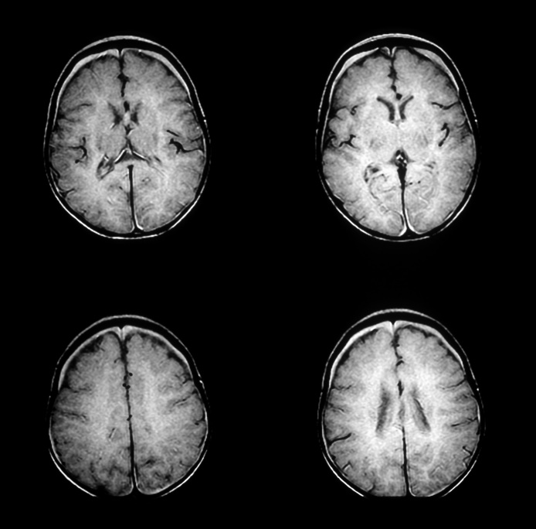
Case Wrap-Up
Diagnosis: Multiple subdural hematomas (nonaccidental trauma)
© Living Art Enterprises, LLC/Science Source
Notes:
Instructor Notes
The US Department of Health and Human Services (DHHS) reported that in 2018 there were 678,000 validated cases of child abuse, and the numbers are increasing each year.
This doesn’t include the cases that receive a CPS response but are then deemed to deserve an “alternative response,” which could mean any number of things.
Case wrap-up:
At the hospital, the patient is still hypothermic but otherwise remained stable from a hemodynamic and respiratory deterioration.
CT revealed multiple subdural hematomas, which immediately raised a concern for nonaccidental trauma, as did the mechanism of injury and the story told.
At discharge 26 days later, she was discharged into state care and transferred to a long-term pediatric facility for care.
She had some improvement in her neurologic exam and was moving all extremities spontaneously.
She was opening her eyes spontaneously but did not fix or track.
She does not have a cough or gag reflex, and thus had a G-tube placed while in the hospital.

Slide 27
Lesson Wrap-Up
A significant number of the permanent disabilities sustained by children are the result of injuries from child abuse and neglect.
The disabilities inflicted on victims are not always the physical ones that we can see.
The youngest victims often are subjected to traumatic injuries.
It is important to take down the history from both the caregiver and the child.
Notes:
Instructor Notes
A significant number of the permanent disabilities sustained by children are the result of injuries from child abuse and neglect.
The disabilities inflicted on victims are not always the physical ones that we can see.
The youngest victims often are subjected to traumatic injuries, such as: shaken baby syndrome and various other head traumas, causing mental retardation, learning and cognitive delays, as well as other brain and central nervous system disorders.
It is important to take down the history from both the caregiver and the child.
Coming Up, Lesson 9: Obstetric, Newborn Care, and Congenital Defects.

Slide 28

Questions?
© Nujumuddin Mohamad Yaman/EyeEm/Getty Images
Notes:
Instructor Notes
Allow time for a question-and answer-session about the topics presented in the lesson.

