Slide 1
THE RESCUE COMPANY 1

Slide 2
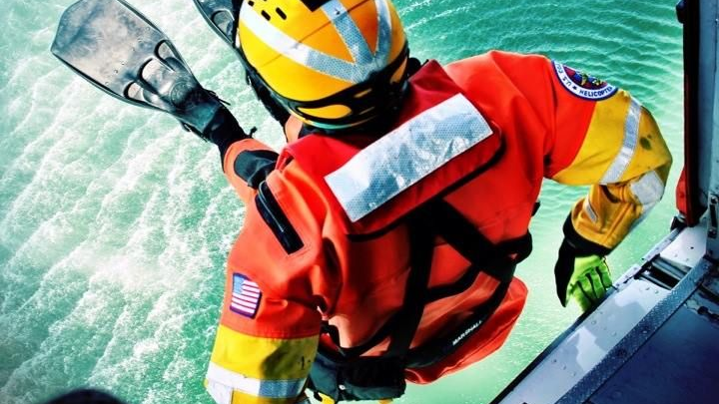
Helicopter rescue swimmer ROPE RESCUE

Slide 3
Knot
Over hand loop
Figure 8 loop
Double 1-8 loop
Double fisherman knots
Middle of the line prusick
Tape/water knot

Slide 4
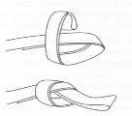
Overhand knot
Overhand knot: Used as a stopper knot or to form a loop in the end of rope, webbing or cordage. When making a loop out of webbing, watch for twists

Slide 5
Double fisherman's knot
Double fisherman's knot: Used to tie two ropes of equal or unequal diameter together or connect two ends of a rope to make a loop. \
It is a strong joining knot but is difficult to untie once loaded with weight. Used for rope and accessory cord, not for webbing.

Slide 6
Double fisherman's knot

Slide 7
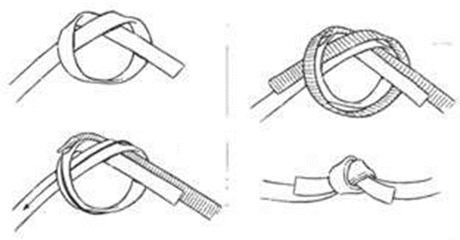
Tape-Water knot
Tape-Water knot: Used to secure two ends of webbing together.

Slide 8
Figure 8 loop
Figure 8 loop: This knot forms a single bight and is used to form an anchor point in the middle of a rope.

Slide 9
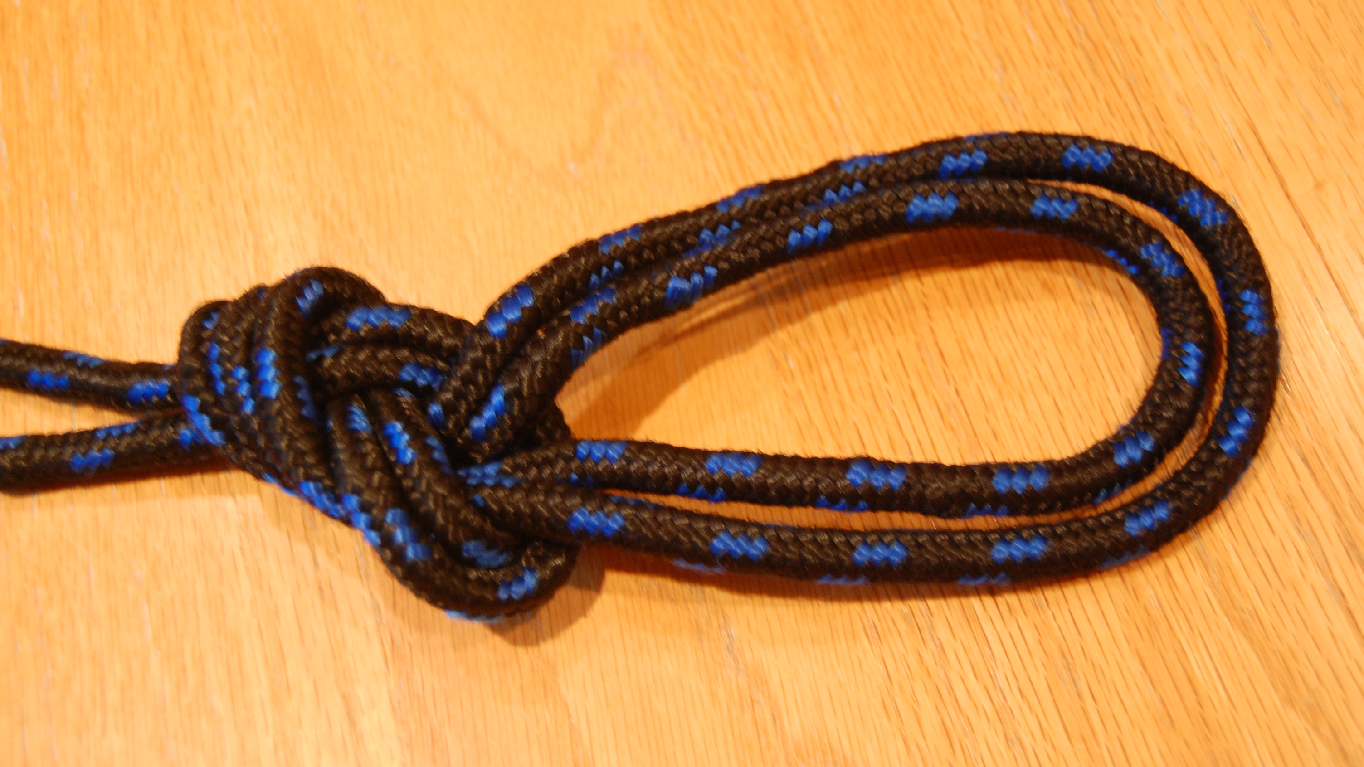
Double figure 8 loop
Double figure 8 loop: This knot forms a double bight and is more versatile than the single loop 8. It is used with multiple anchor points.

Slide 10
Terms used in rope work

Slide 11
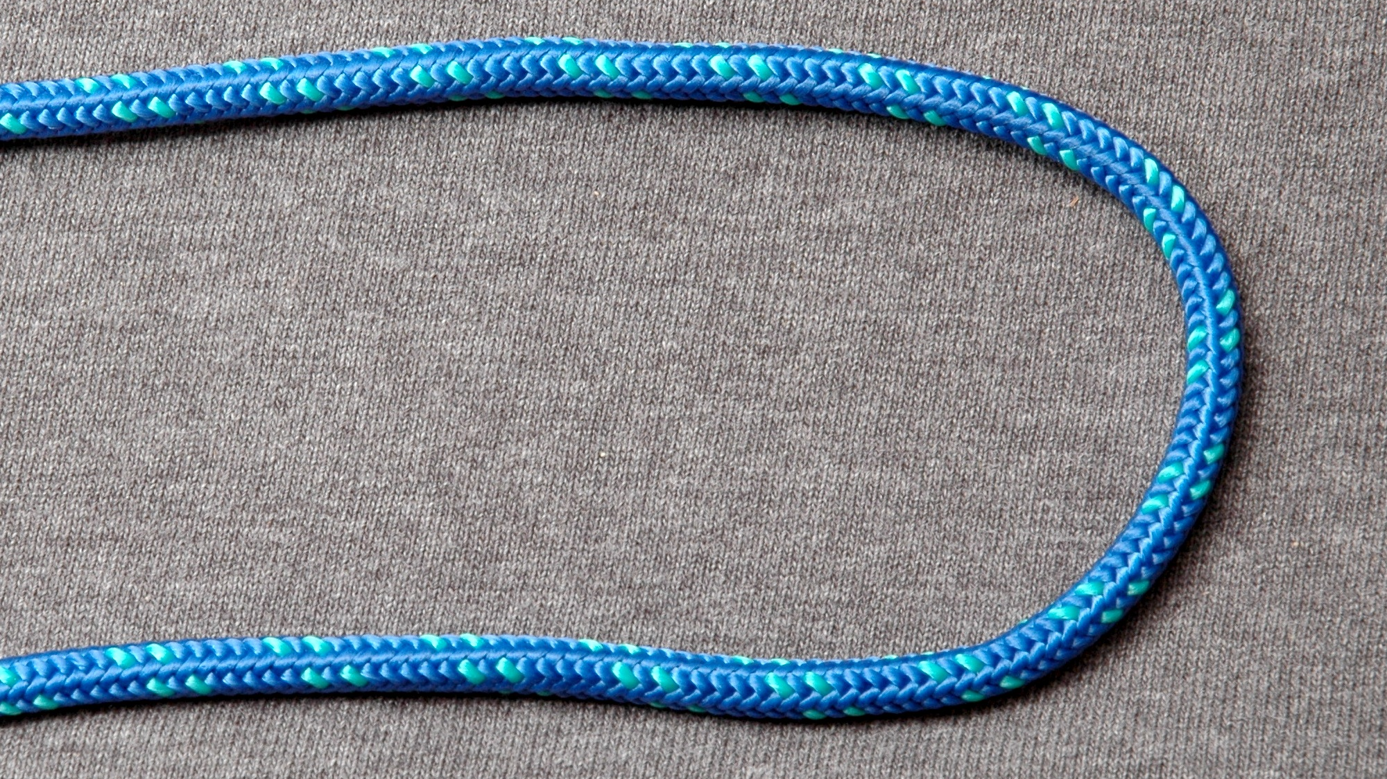
Bight
Bight: A simple bend in a rope; the rope does not cross itself.

Slide 12
Half hitch
Half hitch: A loop that runs around a rope in such a manner as to bind on itself.

Slide 13
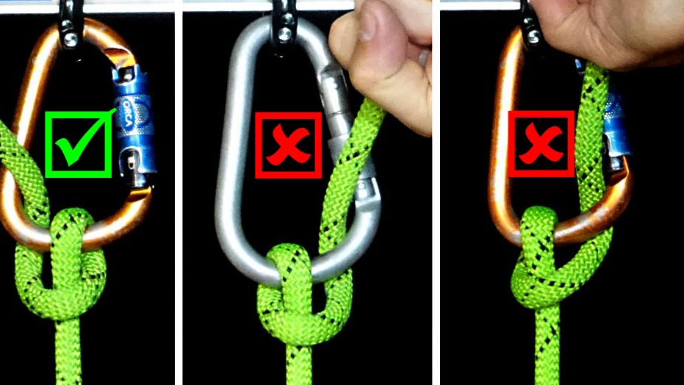
Hitch
Hitch: A configuration that is tied around and object.

Slide 14
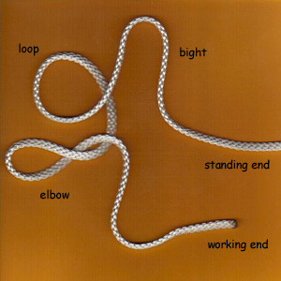
Loop
Loop: A simple bend in a rope that crosses itself.

Slide 15
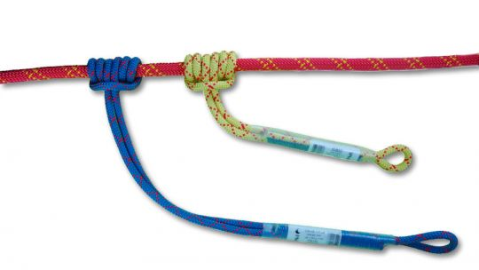
Pigtail
Pigtail: The short length of rope at the end of a knot or coil.

Slide 16
Round turn
Round turn: A bend in a rope that runs 360° around an object with both rope ends running in the same direction.

Slide 17
Running end
Running end: The free or working end of the rope.

Slide 18
Standing end
Standing end: The anchored end of a rope

Slide 19
Pre-equalized cord rigging
This method provides three pre-equalized attachment points and uses none of the rappel rope to construct the rigging.
It can be used with or without the rescue rope setup.
The anchor points can be in any configuration or distance apart. The pre­ equalizing cord allows for easy disconnecting of the rappel rope(s).

Slide 20
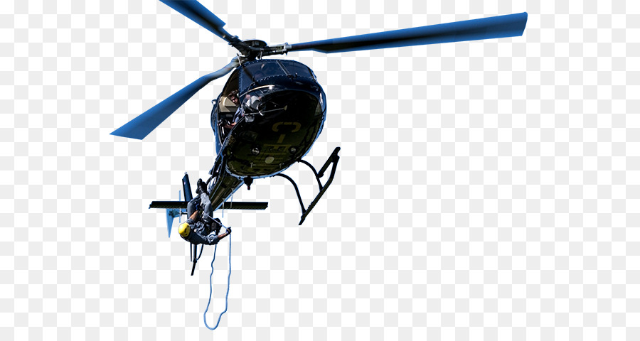
Rigging the system
Cut a piece of 1-inch tubular nylon or rappel rope to an approximate length of 20 feet, depending on the anchor point separations

Slide 21
Rigging the system
Tie the ends of the 1-inch nylon together using a water/tape knot to form a continuous loop. Leave 1 to 2 inches of pigtail. If using rappel rope, tie ends using a double fisherman's knot, leaving a minimum of 2 inches of pigtail

Slide 22
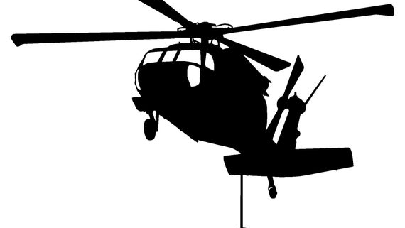
Rigging the system
Attach the loop to each of the three anchor points using a locking carabiner for each with the gate facing up and locked. Position the knot that secures the loop close to an anchor point.

Slide 23
Rigging the system
Pull the three rope sections between the anchor points and gather them together to form three bights. Ensure the bights all have equal tension when pulled in the direction of the rappel. Ensure the knot that secures the loop is still positioned close to an anchor point and not in the bights.

Slide 24
Rigging the system
Make a figure eight knot or overhand knot with the three bights and attach a large locking carabiner to this point. This is the attachment point for the rappel line.

Slide 25
Rigging the system

Slide 26
Rope Deployment Methods

Slide 27
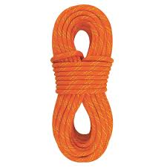
circular loop
circular loop, coil the rope in a round coil as it is being placed in a waterproof bag.
Make sure to coil from running end first, finish­ing at the standing end.
DO NOT tie any knots at the end of the rope or secure the rope to the bag in any fashion.

Slide 28
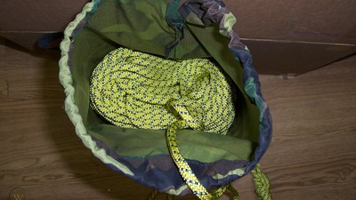
rope deployment bag
The rope deployment bag deploys the rope in an orderly manner.
The rope is back­ stacked into the bag in an S-type manner, starting with the running end and working to the standing end.
DO NOT tie or secure the rope to the deployment bag in any way.

Slide 29
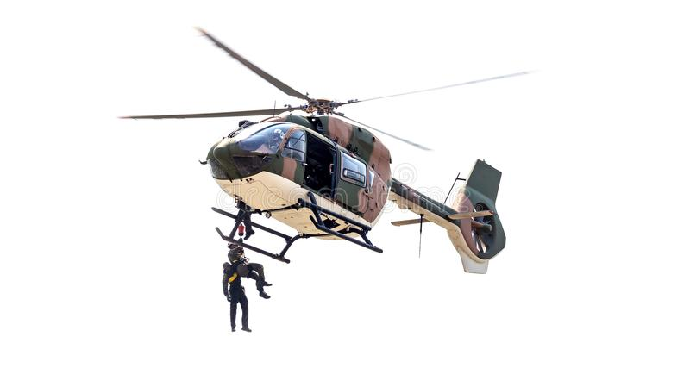
Attaching any object or weight to the running end of any rope is prohibited. Objects at­tached to a rope could prevent a roper from freeing himself from the rope in the event of an emergency.

Slide 30
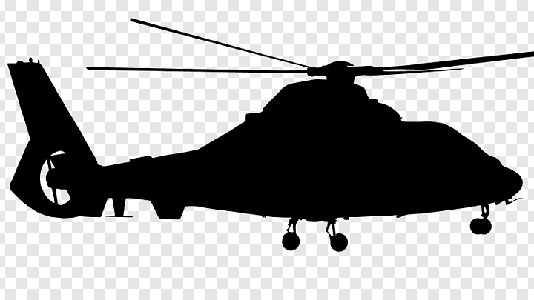
To counter the effects of rotor downwash, a mini­ mum of 15 to 20 feet of rope on the ground can act as a rope weight.

Slide 31
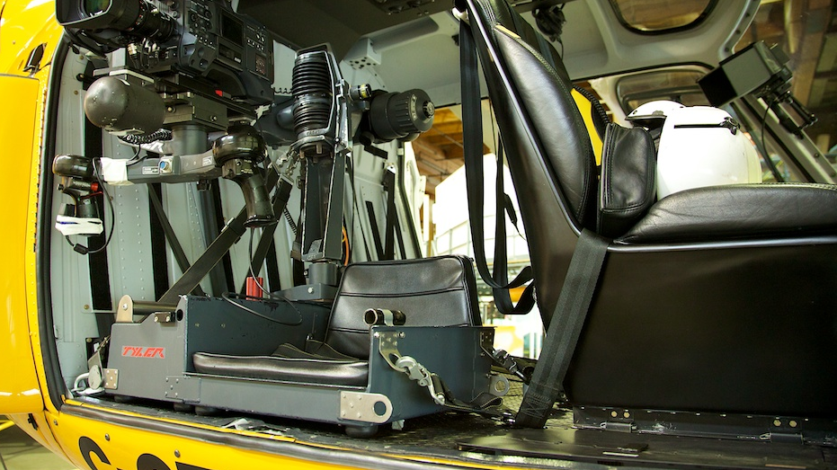
Rigging/Hook Up
No helicopter modifications are necessary for rappel rigging.
Two basic require­ments are mandatory when rigging for rappelling: redundancy of attachment points and adequate padding to ensure no damage to the ropes.

Slide 32
Rigging/Hook Up
The rope master is responsible for properly rigging the helicopter and he personally inspects all rap­pel rigging.

Slide 33
To rig the helicopter
Attach three steel locking carabiners to the three separate cargo tie down fittings.
With the running end of the two rappel lines departing the helicopter, attach each rappel line to the primary anchor point with a directional figure eight.

Slide 34
To rig the helicopter
Attach each rappel line to the secondary anchor point with a directional figure eight.
Attach each rappel line to the tertiary anchor point with a figure eight loop.

Slide 35
To rig the helicopter
Ensure
Ensure there is equal tension between the pri­ mary and secondary anchor points and the sec­ondary and tertiary anchor points.
Lock
Lock all carabiners.
Pad
Pad the edge of the cabin deck to cover sharp edges or metal burrs in order to prevent rappel line chaffing.

Slide 36
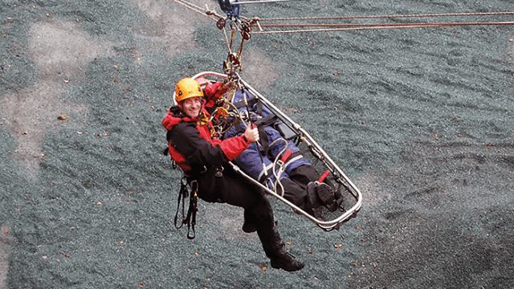
Warning
Only one roper sha be on a rappel rope at one time.
The load limitation of the cargo tie down rings precludes total weight in excess of 500 pounds to be applied to any single tie down ring.
It is ideal to send a roper from both the left and right skid at the same time. This helps maintain stability of the helicopter dur­ing rescue operations.

Slide 37
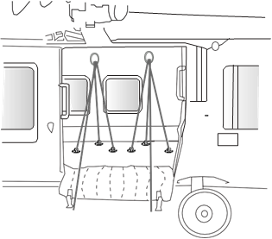
Single Door
The three anchor points are two center deck rings and one port side deck ring. Rigging the single door H-60

Slide 38
Double Door
Because of limited cabin space, only the overhead cargo rings are utilized for double door rigging.
Tie a directional figure eight 4 feet from the end of the standing end of the rope and attach to the overhead cargo ring (closest to the exit) using a locking carabiner.

Slide 39
Double Door
Tie a bowline or figure eight 2 feet from the primary anchor point and attach to the second­ary overhead cargo ring (inboard of exit) using a locking carabiner.
Pad and tape all edges coming in contact with the rope and ensure side door is locked open.

Slide 40
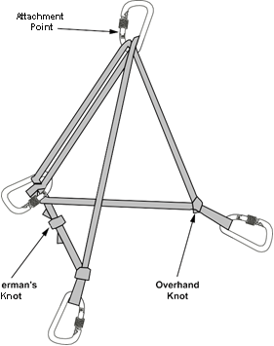
Double Door Self-Equalizing Setup
This method provides three self-equalized attach­ment points and uses none of the rappel rope to construct the rigging.

Slide 41
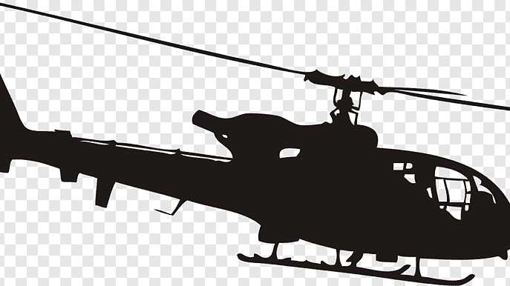
Pre-Equalized Cordelette
This method provides three pre-equalized attach­ment points and uses none of the rappel rope to construct the rigging.

Slide 42
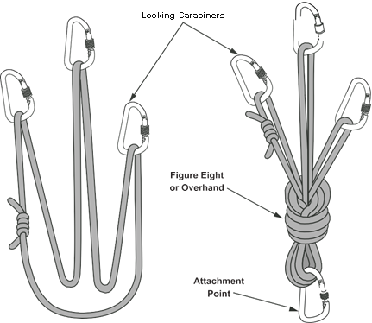
Pre-Equalized Cordelette

