Slide 1
THE RESCUE COMPANY 1

Slide 2
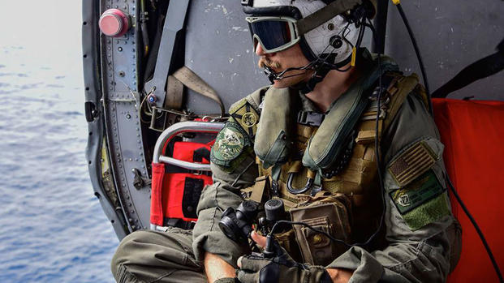
Helicopter CREW CHIEF & HOIST CHECKLIST

Slide 3
HELICOPTER SEARCH AND RESCUE CREW CHIEF
Responsible for assisting helicopter search and rescue (SAR)
Assist pilot with navigation, air rescue, aviation communications
supervising a qualified crew conducting air SAR

Slide 4
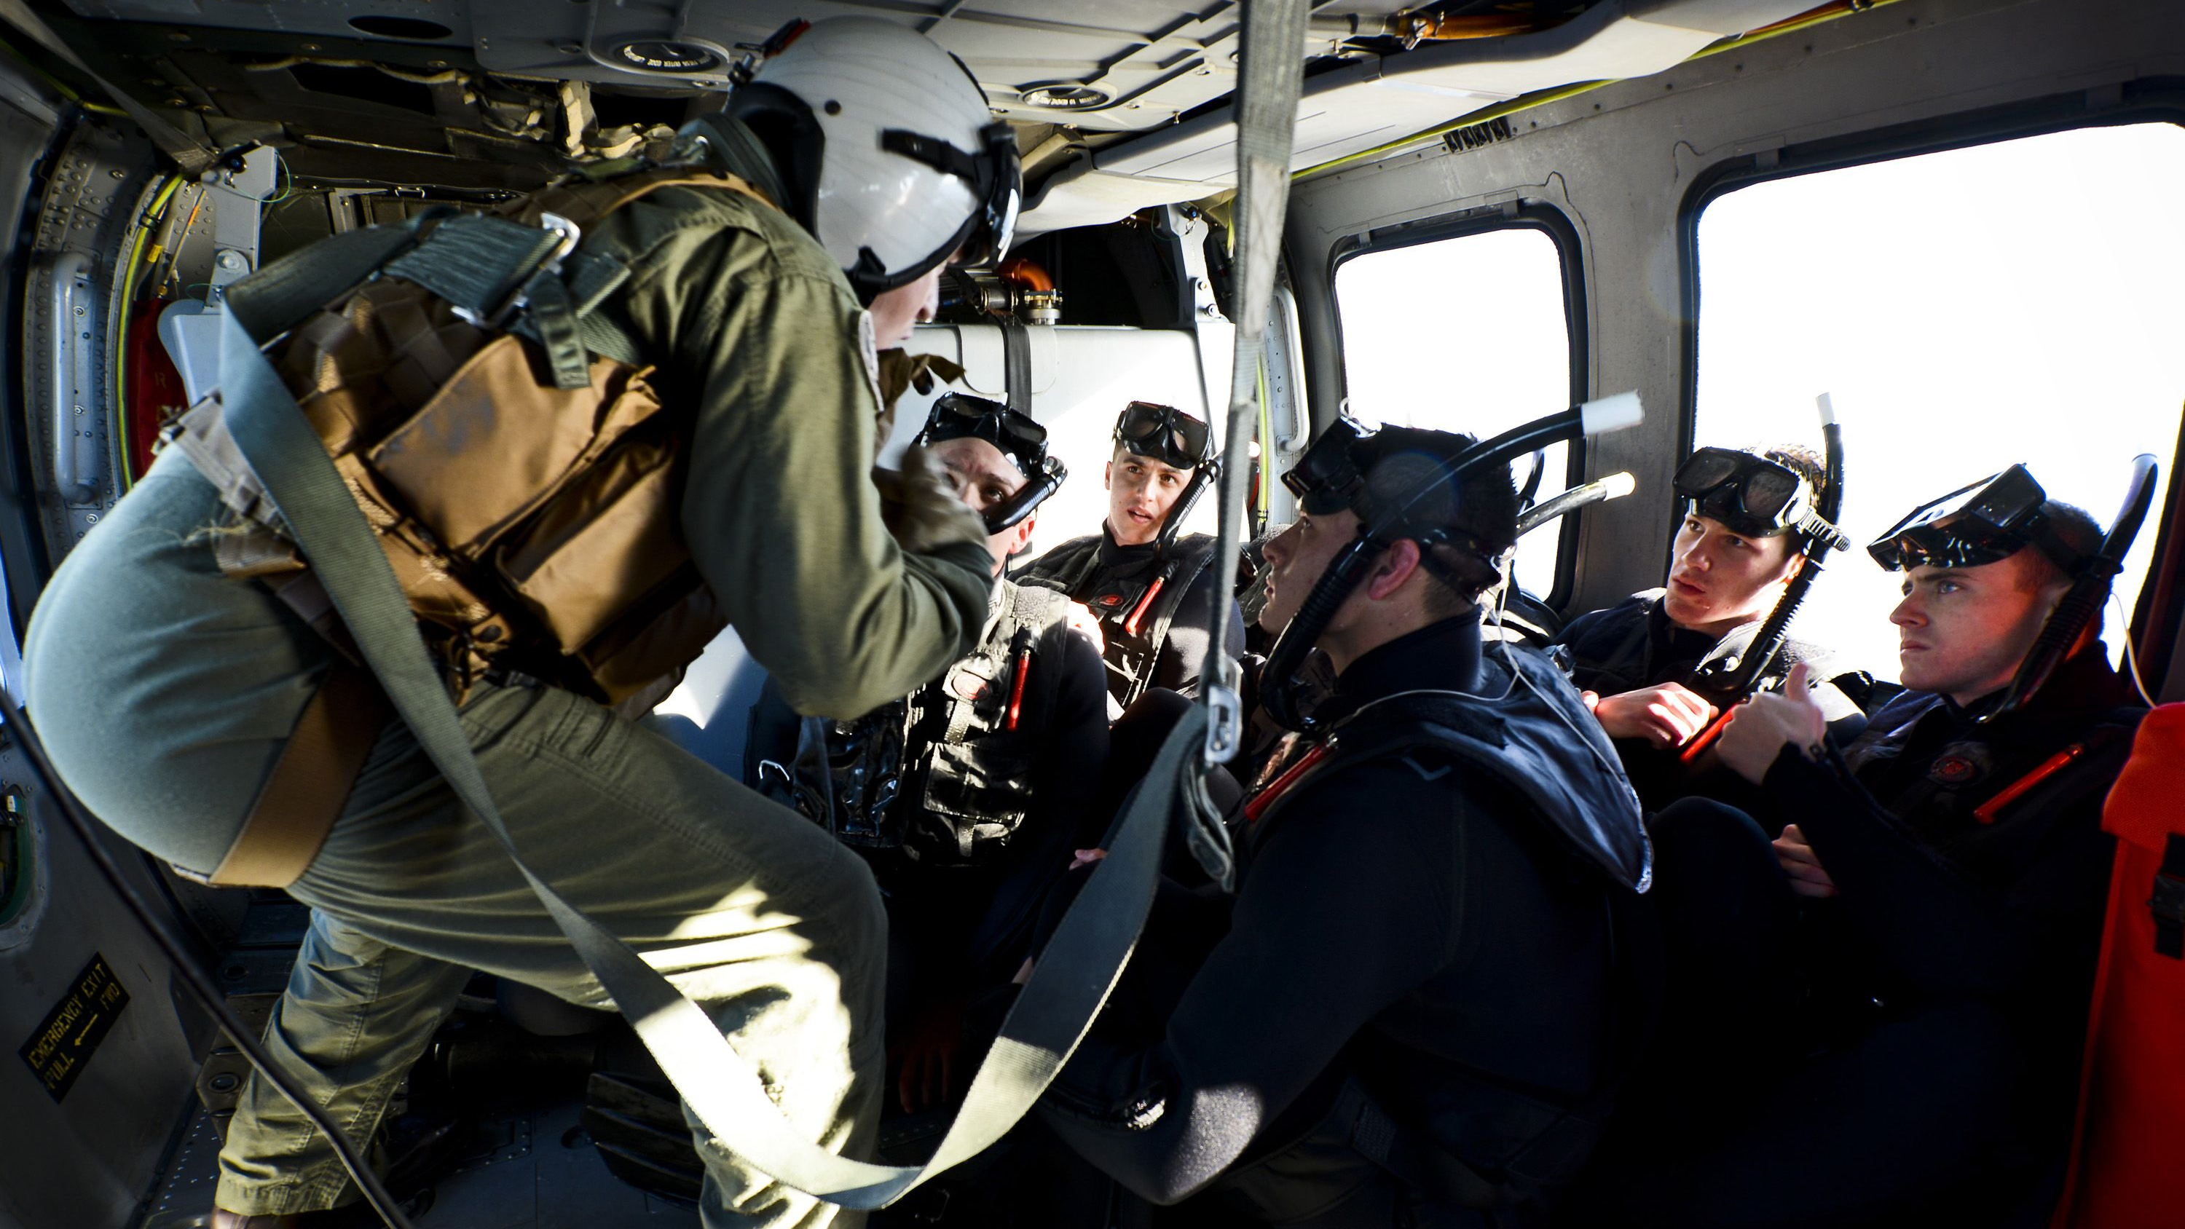
supervising qualified crew
supervising a qualified crew conducting air SAR utilizing a helicopter to:
locate lost, stranded, and/or abandoned individuals who may or may not be injured or in need of medical attention.
Conducting air rescue tasks from inside the helicopter (i.e., external load rigging, operation, and communication).

Slide 5
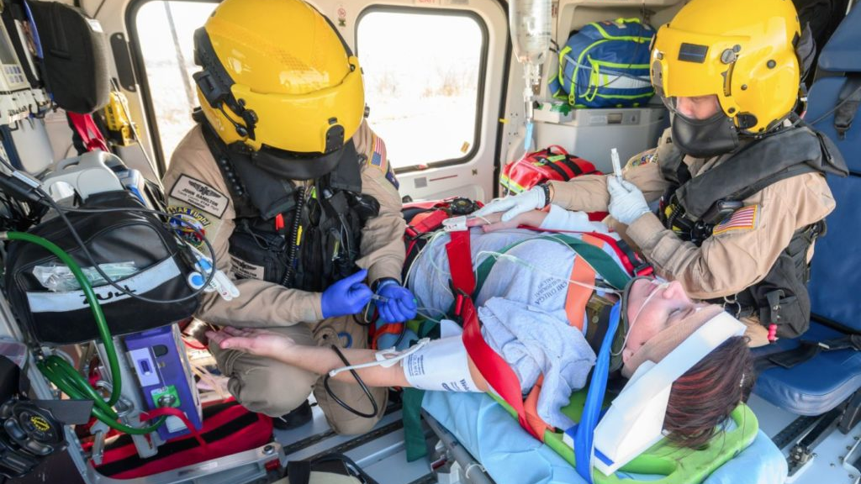
HELICOPTER SEARCH AND RESCUE CREW CHIEF
Basic Life Support (BLS) or Advance Life Support medical treatment may be performed if needed.

Slide 6
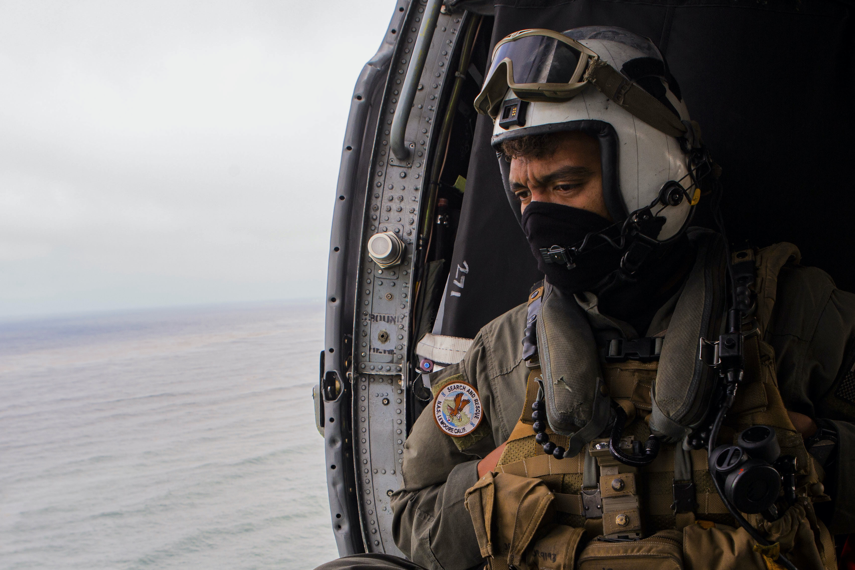
HELICOPTER SEARCH AND RESCUE CREW CHIEF
Air rescue ACLS and BLS may include but not limited to technical rescues utilizing hoist or short-haul techniques
Rescues in urban and rural areas, mountainous terrain, swift water, still water, or off­shore rescues and on-scene medical evacuations of disaster victims with life threatening injuries.
Air searches and rescues may be conducted day or night under visual flight rule (VFR) conditions.

Slide 7
HELICOPTER SEARCH AND RESCUE CREW CHIEF
This is a mid-level supervisory and tactical position within a helicopter rescue unit (single resource).

Slide 8
Fulfillment of requirement(s) or equivalent as stated in the following standards
OSHA 1910.120 and/or 1910.134(n Respiratory Protection
Training standards as required by the agency having jurisdiction (AHJ) related to Helicopter Rescue Operation.

Slide 9
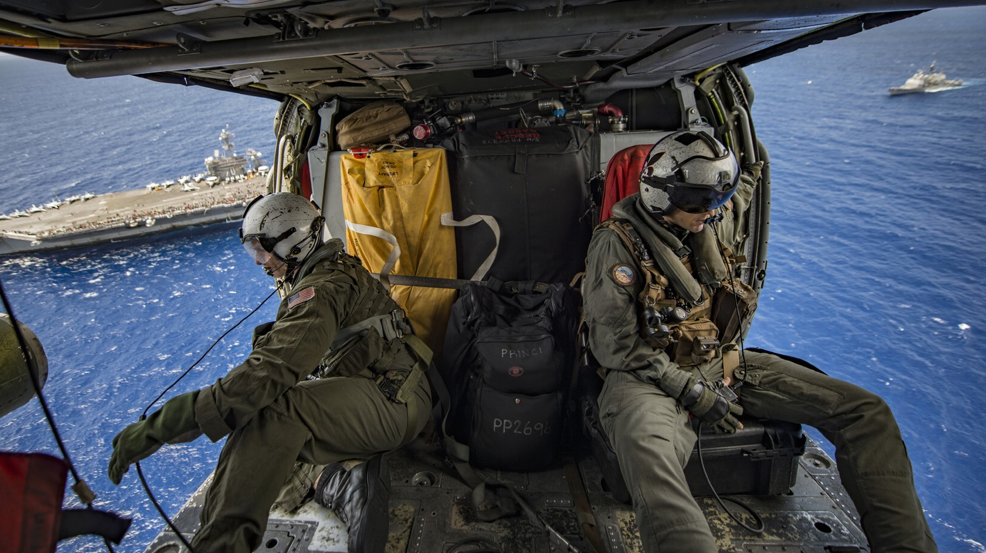
Completion of the following courses or equivalent
IS/ICS-100: Introduction to Incident Command System
IS/ICS-200: ICS for Single Resources and Initial Action Incidents
IS/ICS-700: National Incident Management System (NIMS), An Introduction
IS/ICS-800: National Response Framework (NRF), An Introduction

Slide 10
Completion of awareness-level training in the following topic
Has a working knowledge commensurate with the environment and the duties of the Helicopter SAR Technician (HSRT)

Slide 11
Completion of awareness-level training in the following topic
Technical rescuer
Job performance requirements
Rope rescue
Surface water rescue
Swift water/flood rescue
Urban search and rescue (US&R)
Land rescue

Slide 12
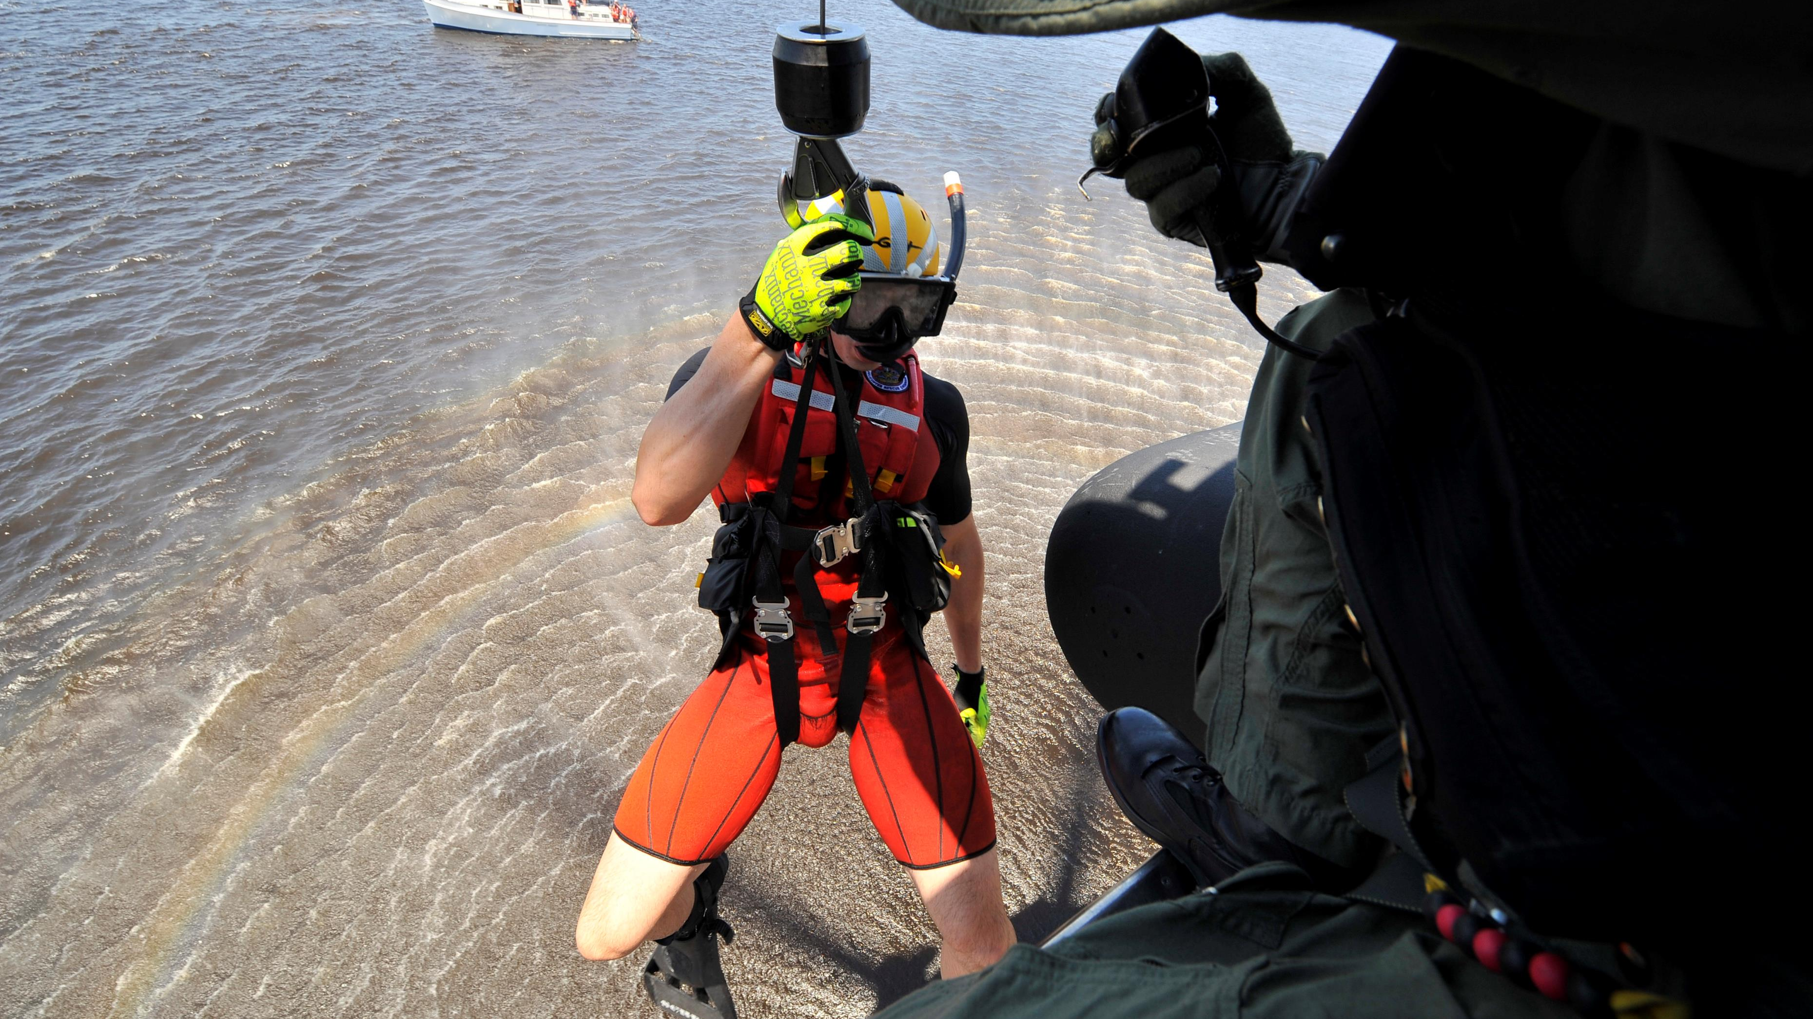
Completion of awareness-level training in the following topic
Mountain/technical rescue
Structural rescue
Disaster rescue
Still water rescue
Wilderness rescue

Slide 13
Completion of awareness-level training in the following topic
Has training commensurate with the environments in which they are operating
SAR-specific risk assessment
SAR-specific hazard mitigation, including multi-aircraft operations
SAR-specific personal protective equipment (PPE)

Slide 14
Completion of awareness-level training in the following topic
Use of related tools, devices, and equipment
Aviation Crew Resource Management (CRM)/Aeronautical Decision-Making (ADM)
Emergency Procedures, Aircraft Familiarization
Survival to include aircraft water immersion

Slide 15
Crew Chief Operational Training
Ability to assist pilot with navigation and general external load communications and emergency communications
Ability to perform general and internal and external load rescue rigging and operations.

Slide 16
Crew Chief Operational Training
Knowledge and training in preventive and Emergency Corrective Actions (ECAs)
Knowledge Emergency Procedures (EPs) for all reasonably expected emergencies, including external load rigging emergencies provided by their program (short haul, helicopter rappel, cable hoist, etc.)

Slide 17
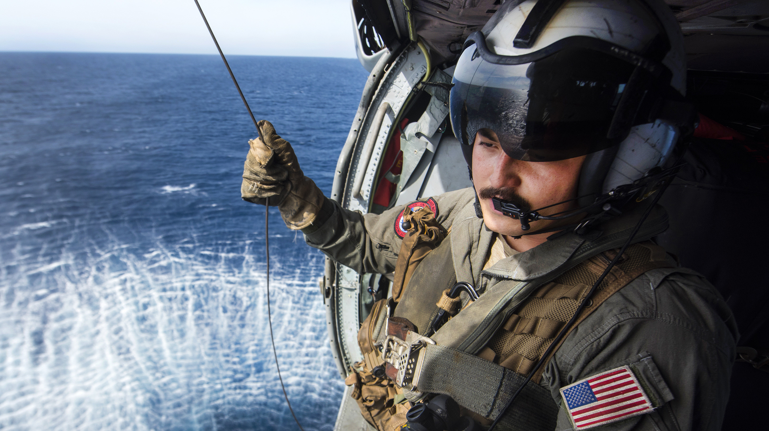
Crew Chief Functional Training in all general aviation rescue operations
Human external loads
Short haul
Hoist
Rappel
Still and moving water insertions

Slide 18
Crew Chief Functional Training in all general aviation rescue operations
Recon/surveillance
Confirmed area techniques
Night flight

Slide 19
Crew Chief Functional Training in ingress-egress
Hover ingress-egress
Toe in ingress-egress
Single skid landings

Slide 20
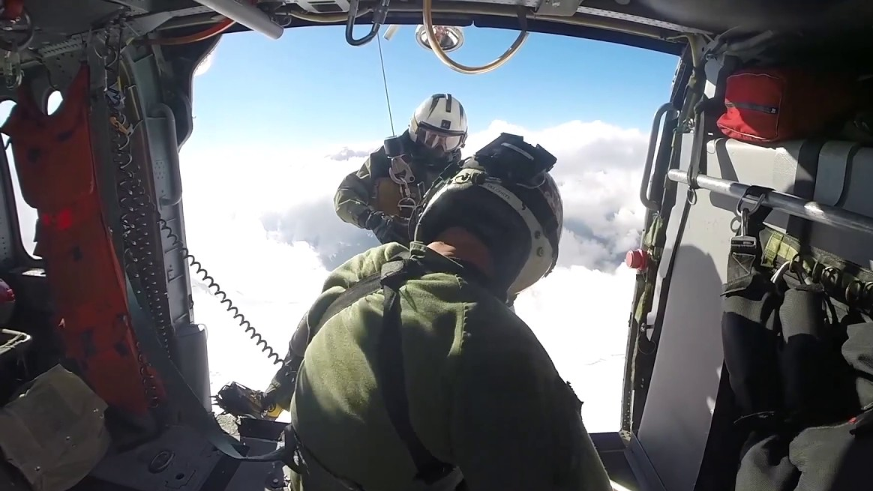
CREW CHIEF HOIST CHECKLIST

Slide 21
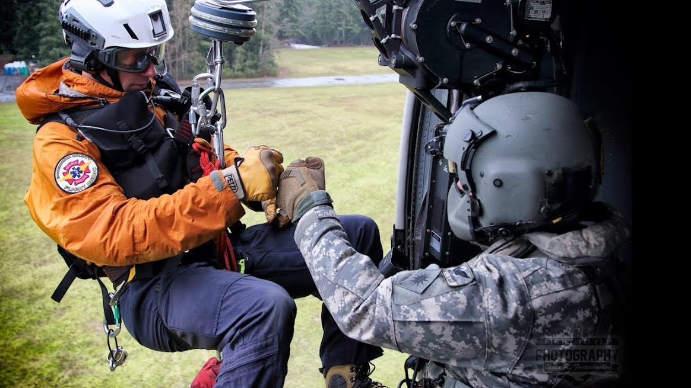
CREW CHIEF HOIST CHECKLIST
The Crew Chief will ensure that the aircraft is properly configured for SAR missions
Confirm the rappel bar is securely attached to the aircraft.
The "load release handle" is locked and safety pinned in position

Slide 22
CREW CHIEF HOIST CHECKLIST
Crew Chief will perform a safety inspection of all crewmembers ensuring proper PPE for the mission
Crew Chief will begin radio communication with ground units

Slide 23
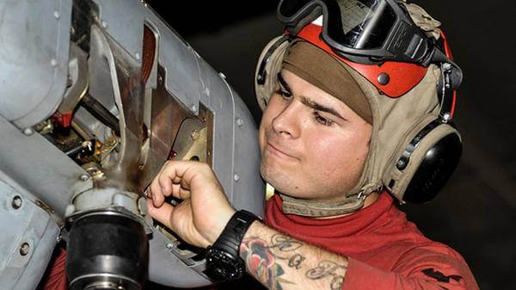
CREW CHIEF HOIST CHECKLIST
Crew Chief will complete pre-rescue safety inspection of the Helicopter Rescue Technician

Slide 24
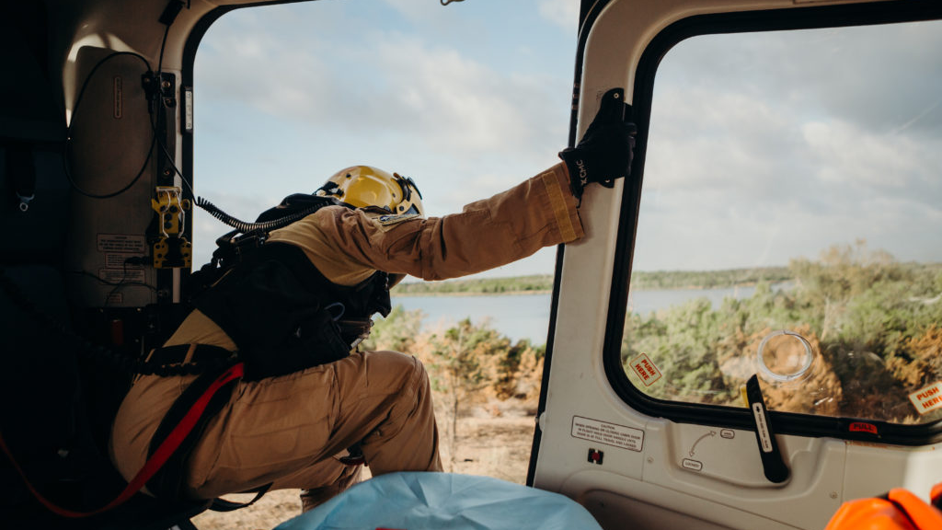
CABIN SECURED
Prior to calling cabin secure the Crew Chief will ensure that the HRS and all equipment are properly secured

Slide 25
DOOR OPEN AND LOCKED
The Crew Chief will move into position for rescue operations at the front of the right sliding door

Slide 26
Power
REQUEST HOIST POWER
LIGHT CHECK OK

Slide 27
Power
Crew Chief will deploy hoist cable to the Rescuer

Slide 28
CREW CHIEF RADIO TEST

Slide 29
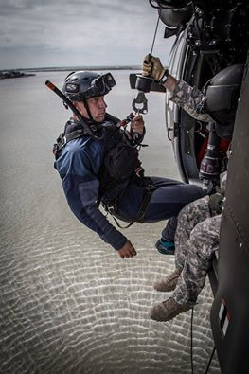
RESCUER READY
Crew Chief will boom rescuer into ready position
Will not lower HRS until Pilot gives the command

Slide 30
RESCUER IN POSITION

Slide 31
HOIST RUNNING
Crew Chief will provide Pilot with progress of HRS on hoist (e.g. HRS at 15 feet, 30 feet etc.)

Slide 32
CONFIRMING AIRSPEED/ ALTITUDE
Crew Chief will confirm proper position, altitude, speed

Slide 33
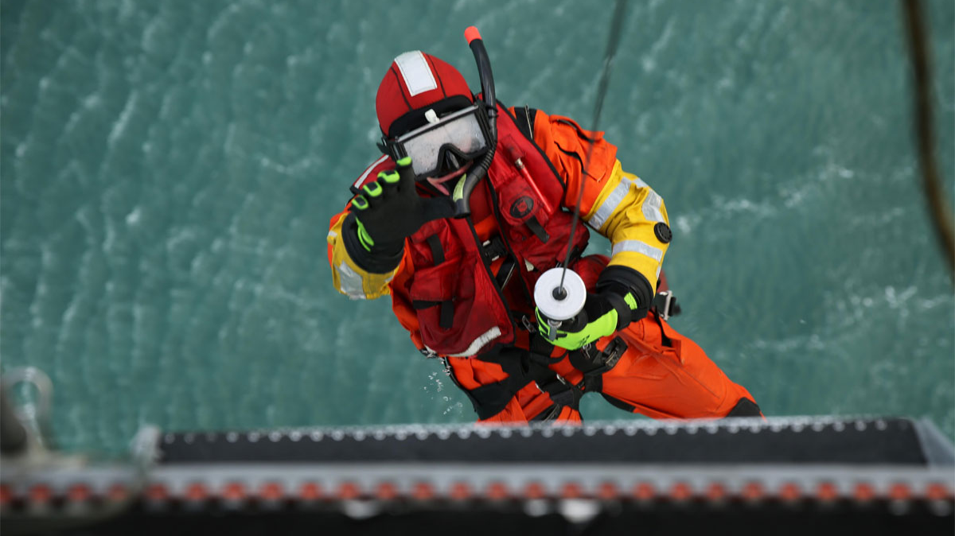
CHECKED
Crew Chief will then begin to give Pilot corrective commands to the target LZ

Slide 34
DECISION CHECKED
Crew Chief will make final movement commands as the rescuer nears the ground
FORWARD 10, 5, 4, 3, 2, 1 .. STOP FORWARD, HOLD POSITION
RESCUER ON GROUND
RESCUER DISCONNECTING HOOK FREE
HOIST RUNNING

Slide 35
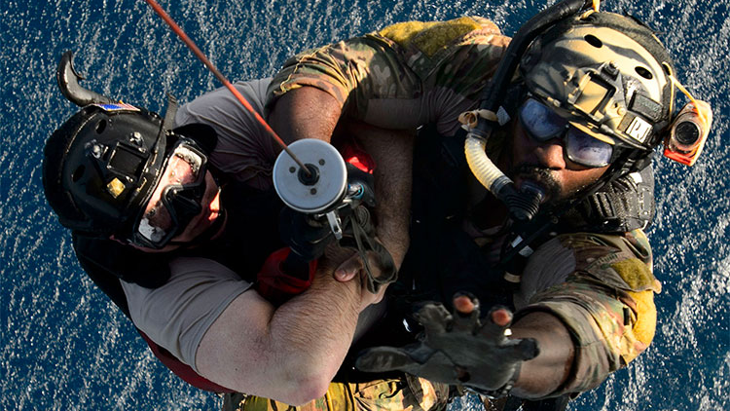
AXIS CLEAR
Crew Chief will provide commentary on progress of the hoist hook as it is retrieved and call clear when the hook can be retrieved without striking any obstacles

Slide 36
DECISION CHECKED
DECISION CHECKED
HOOK STOWED- BOOM IN
REQUEST HOIST POWER OFF
PENDANT IS OFF AND STOWED
DOOR CLOSED/ CABIN SECURE

Slide 37
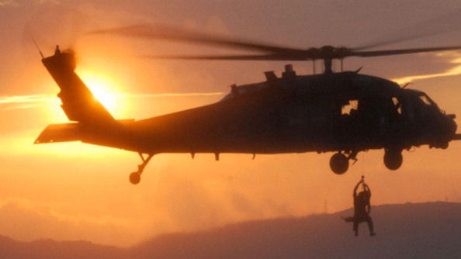
CREW CHIEF HOIST CHECKLIST 14 STEP LIST

Slide 38
14 STEP LIST
Operations briefing completed
Hoist operator attached and secure
All passengers attached and secure
(PFD) Donned

Slide 39
14 STEP LIST
All equipment attached and secure
No loose items in the cabin
Ensure necessary power
Ensure escape route identified

Slide 40
14 STEP LIST
Radio communication plan identified
Both doors open and secure
Power to the hoist

Slide 41
14 STEP LIST
I have a green light
Right side clear, tail is clear
Clear to lift

