Slide 1
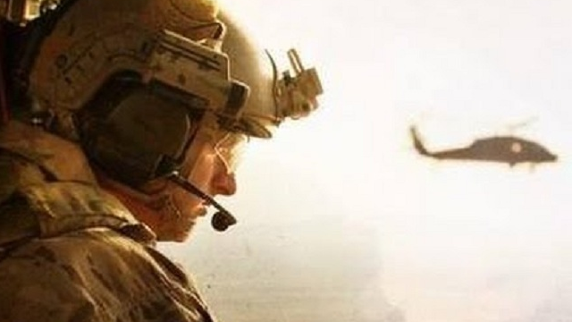
THE RESCUE COMPANY 1

Slide 2
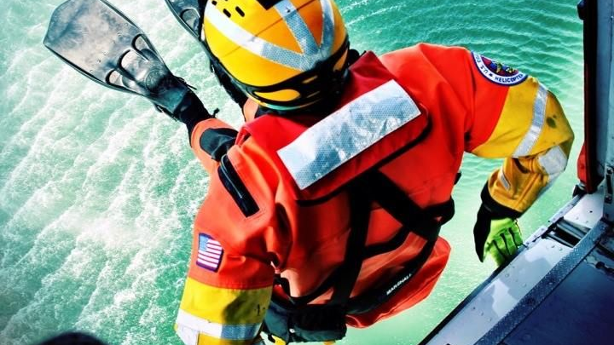
Helicopter rescue swimmer
Helicopter Rappel

Slide 3
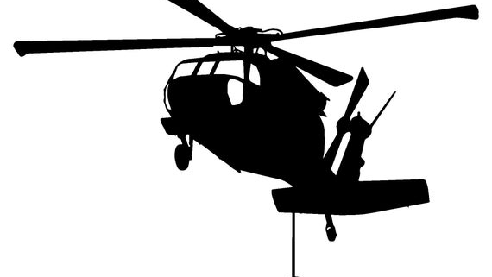
HISTORY
Early use of the helicopter rappel included military operations in combat.
The 11th Air Assault Division (U.S. Army) introduced the earliest combat use of helicopter rappelling in combination with troop ladders in 1964-1965.

Slide 4
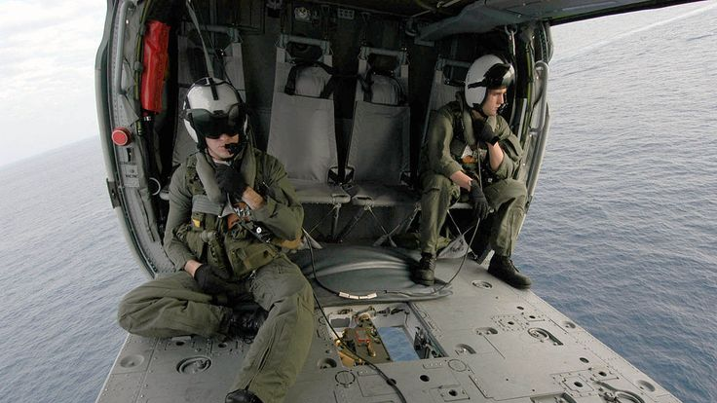
HISTORY
This was conducted in combat in December, 1965, near An Khe in Vietnam by the 1st Airborne Brigade of the 1st Cavalry Division (Airmobile ).

Slide 5
OPERATIONAL CONSIDERATIONS
Rescuer insertion can be accomplished via helicopter rappelling which offers reduced exposure time of the rescuer beneath the aircraft compared with a helicopter short-haul.

Slide 6
OPERATIONAL CONSIDERATIONS
Helicopter rappelling has inherent hazards and mishaps have occurred involving loss of descent control, with subjects striking the ground; a jammed descender caused by entanglement with clothing or hair; a rappel rope that does not reach the ground; and rappeller injury caused by striking the door threshold or skid when exiting the helicopter.

Slide 7

OPERATIONAL CONSIDERATIONS
The U.S. Navy currently employs the Sky Genie descender device and related lines in rappel operations with a separate attended belay line.

Slide 8
anchor point
An overhead rappel anchor point, which must be FM approved through a supplemental type certificate {STC) as an aircraft modification, provides the most convenient departure for the rappeller from the aircraft

Slide 9
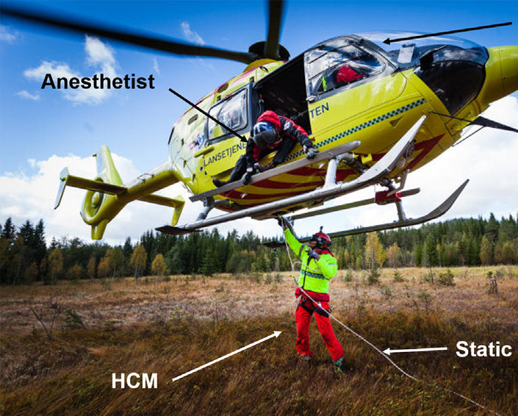
length
The length of a helicopter rappel varies by agency preference and by environmental considerations, which may include insertion into tall forest canopy. Rappels of 75 to 150 ft. (23 to 46 m) are most common.

Slide 10
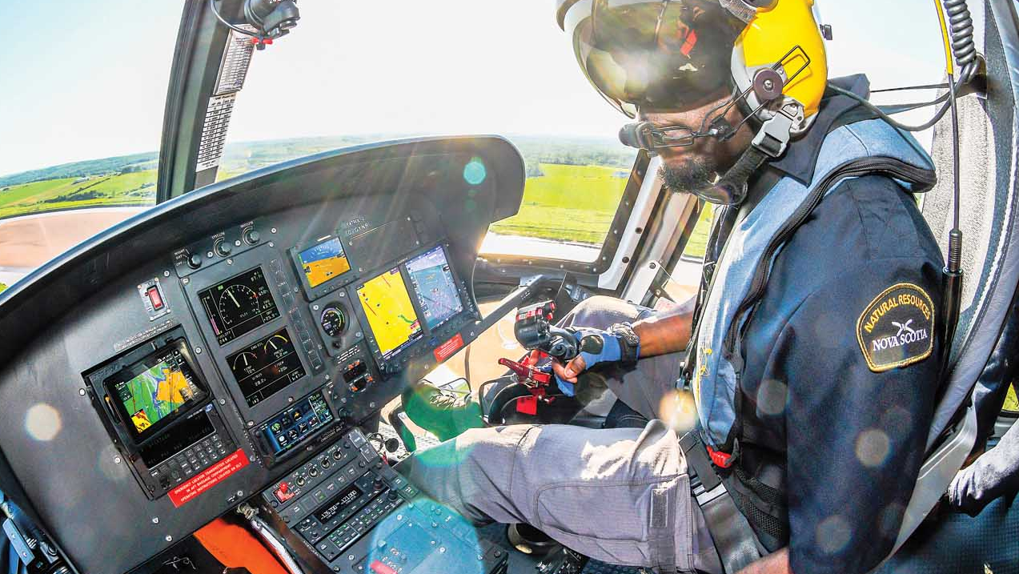
pilot
The aircraft commander's primary responsibility is the safe conduct of the flight.

Slide 11
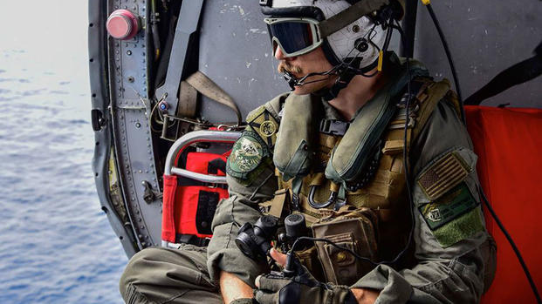
Crew Chief
The crew chief's primary responsibility during Helicopter Rope operation is to assist the pilot with terrain/obstacle clearance and to assist with maintaining the helicopter over the target area by passing voice instructions to the pilot.

Slide 12
Crew Coordination
Briefings
Internal Communications System

Slide 13
Briefings
Face-to-face briefings involve all rescue participants.
The rope master gives a detailed rescue mission brief to rescue participants
The aircrew should be present during the rescue mission brief.

Slide 14
Internal Communications System
Challenge and Reply
Radio Communications
Hand-and-arm Signals

Slide 15
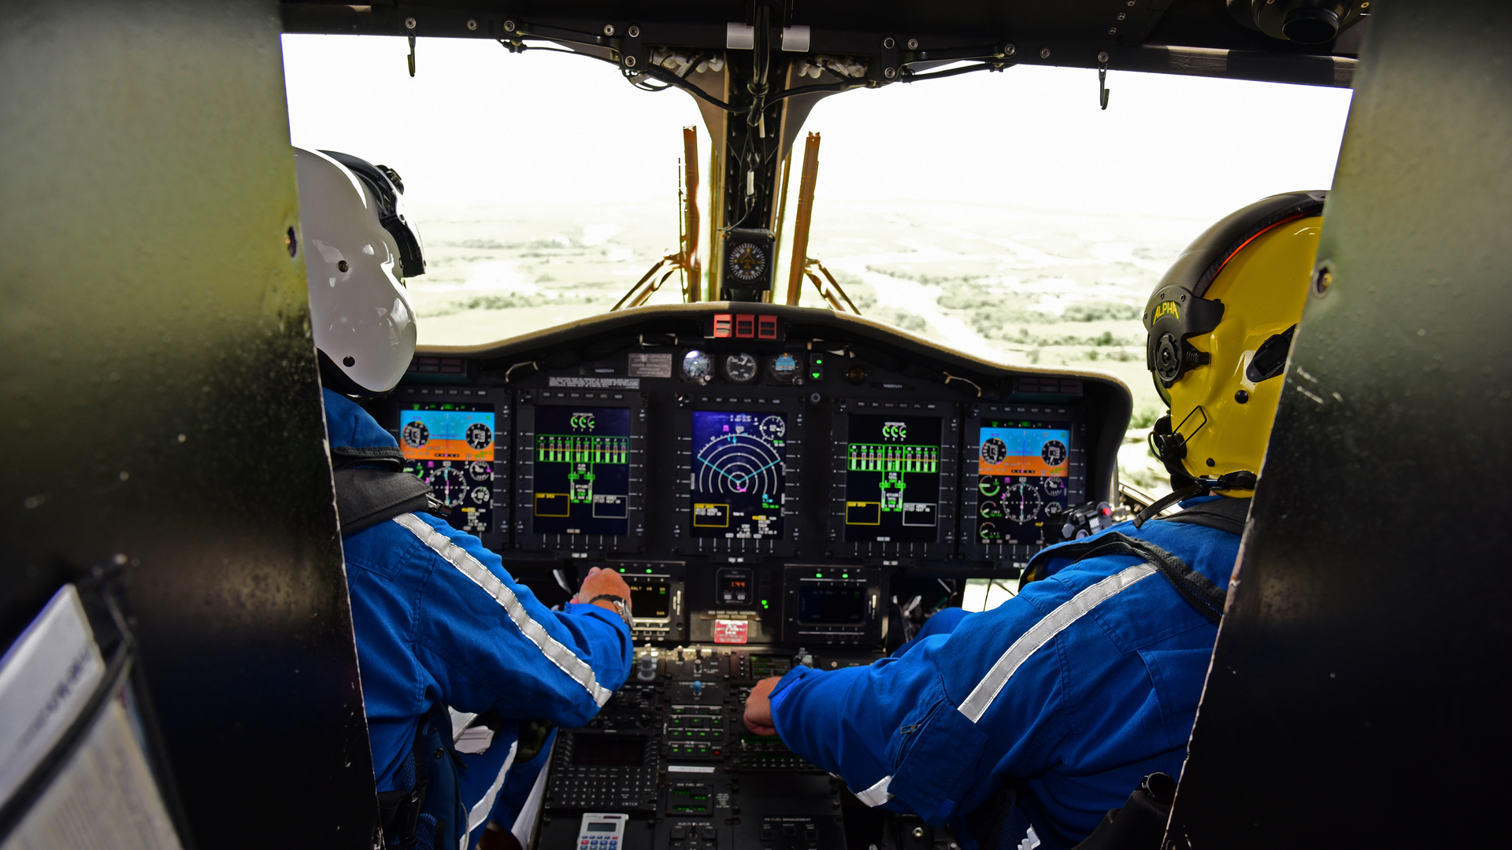
Challenge and Reply
The method of challenge and reply is mandatory for all helicopter rescue commands between the aircrew and the rope master.
Challenge and reply provides clarity to intercommunications and assurance to all rescue participants that commands have been passed and received.

Slide 16
Radio Communications
Operable radio communications must be main­tained between the helicopter and the safety officer, who is located in the drop zone.
If the Safety officer is aboard the helicopter, he uses the ICS.

Slide 17
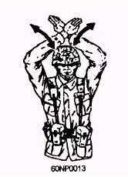
Hand-and-arm Signals
Ropers must rely on hand-and-arm signals and verbal commands from the rope master for communications.
Therefore, a clear understand­ing of all commands and hand-and-arm signals is mandatory by all rescue participants and aircrew

Slide 18
Environmental Factors
A minimum of 10 feet vertical clearance and 15 feet horizontal clearance from obstacles are mandatory while conducting a hover for rescue operations.
Care must be taken to select a drop/pickup zone that is relatively free of dust, snow, or other objects that could obscure the aircraft commander's vision.

Slide 19
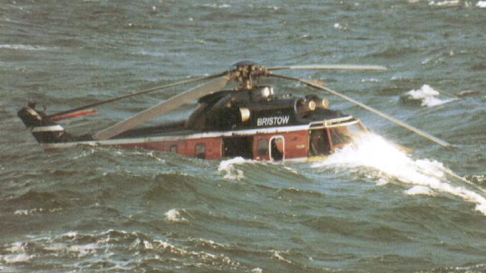
Environmental Factors
Rescue operations must be aborted if the air­craft commander is unable to detect a visible horizon or acquire visual reference points due to weather conditions (e.g., fog, haze) or other factors.
The aircraft commander must complete a proper weight and balance calculation to deter­ mine if environmental factors permit safe rescue operations.

Slide 20
Night safety Factors
Night operations can affect an aircraft command­er's ability to maintain a steady position over the target area.
They also challenge the rope master's ability to maintain control of ropers during the conduct of a rescue
During nighttime opera­tions, the aircrew wears night vision devices (NVDs) as directed by current policy.

Slide 21
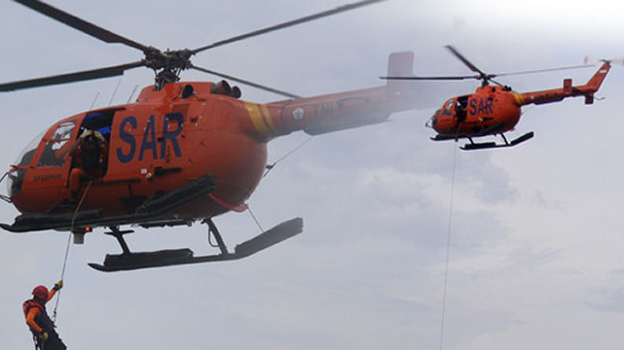
Helicopter safety Factors
Loose gear, padding, and rope ends that can create a tripping hazard to ropers as they move to their rope stations must be secured inside the helicopter.
When rescue operations involve open doors personnel inside the helicopter must be particularly cautious to avoid accidentally falling through the door.

Slide 22
Helicopter safety Factors
Whenever possible the hatch to the door remains closed until required for use.
A qualified rope master will be located at each rope station to ensure safety.

Slide 23
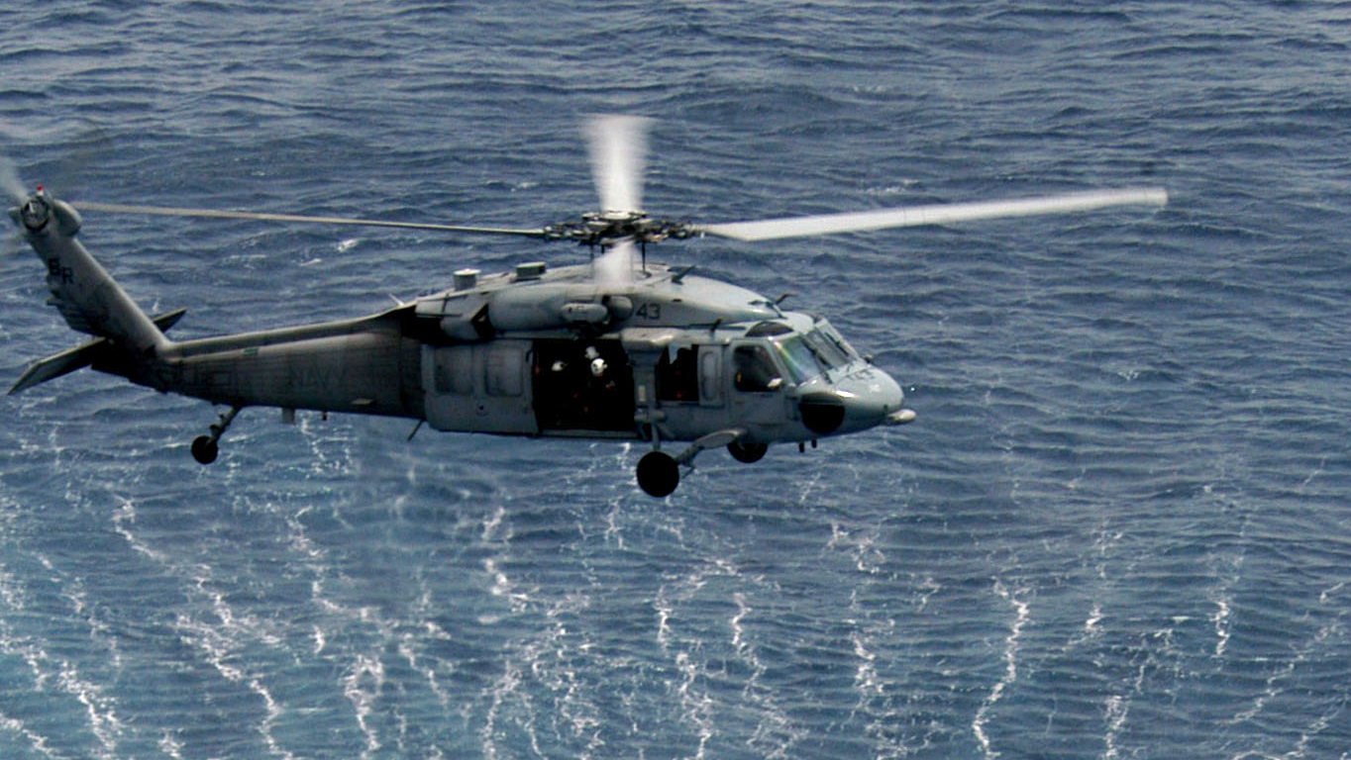
Rotor Downwash
Rotor downwash pushes ropers down the rope; therefore ropers must be prepared to apply additional braking.
Rotor downwash causes sand and small objects to be blown into the drop/pickup zone. Ropers must wear approved eye protection goggles to avoid eye injury from flying debris.
Long­ sleeve clothing is also required to avoid cuts, abrasions, and skin irritations.

Slide 24
Rotor Downwash
The size of the helicopter affects the rotor downwash (large helicopters have greater rotor downwash than small helicopters).
The weight of the helicopter increases the rotor downwash effect (the more weight the greater the rotor downwash ).

Slide 25
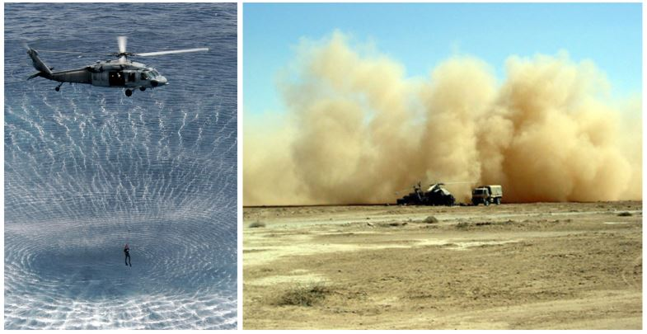
Hover Height
Rotor downwash can agitate a rope hanging from the helicopter and cause the rope to whip, creating a dangerous situation .
A slightly higher hover reduces the effect of rotor down­ wash on the ground and the rope.

Slide 26
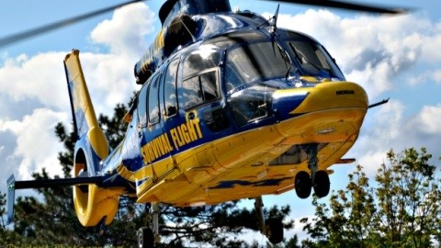
Hover Height
During wooded or mountain area rescue opera­tions, hover heights are restricted to the lowest possible height commensurate with rope length, obstacle clearance, visual cues, soil sta­bility, and rotor downwash .

Slide 27
Static Discharge
Static electricity is generated by a helicopter and is discharged from the aircraft by contact with the ground.
Therefore, personnel will not be in contact with the rope as it touches the ground due to the possibility that the rope may conduct static electricity.

Slide 28
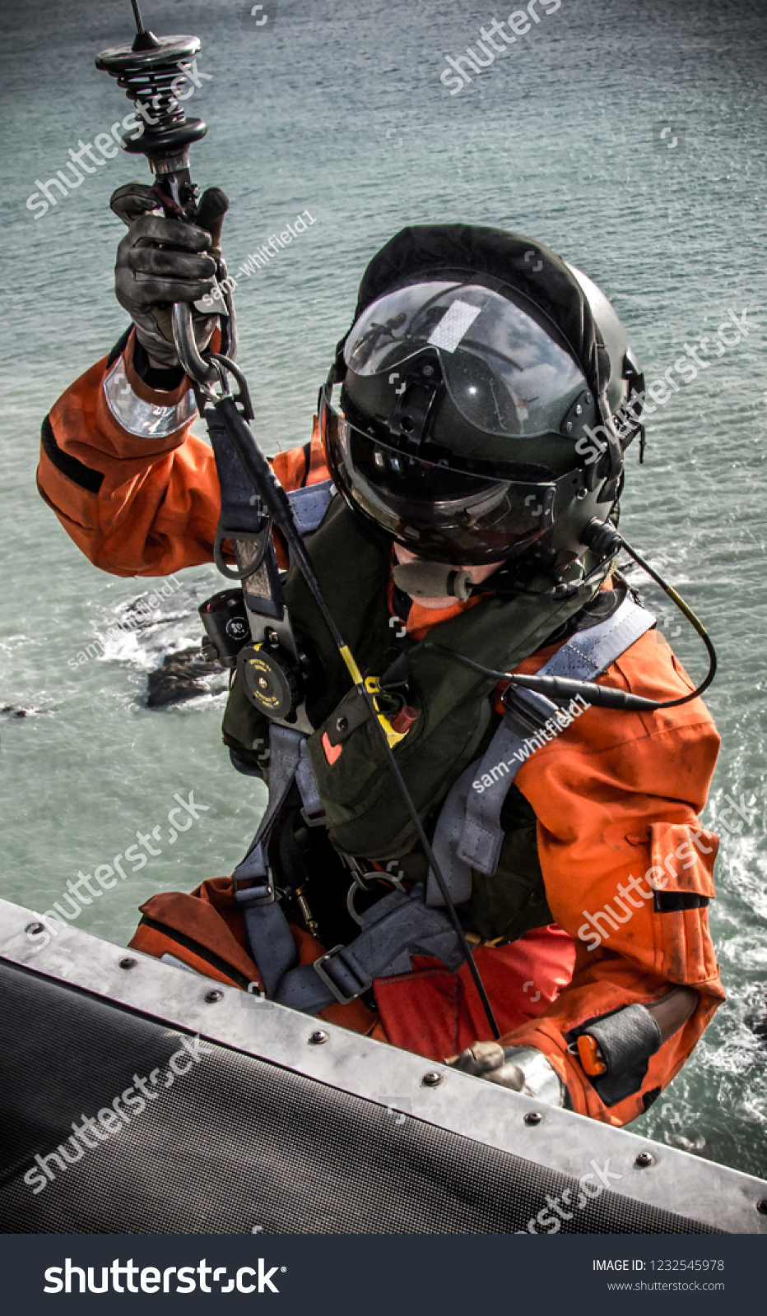
Static Discharge
Rescue operations will not commence until the rope has made contact with the ground.

Slide 29
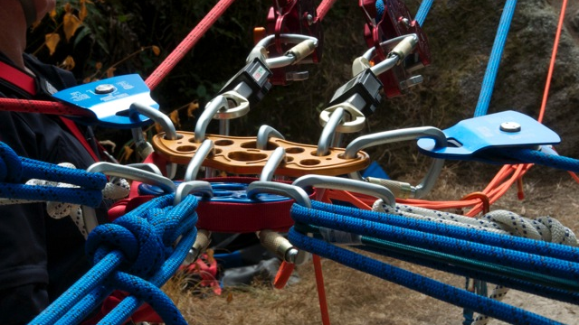
Static Discharge
Dry ropes are nonconductive and do not allow static electricity to be discharged through them.
However, ropers may experience a small harm­ less shock upon reaching the ground due to the body's ability to conduct an electrical charge. Ropes may become conductive if they are wet.

