Slide 1

The rescue company 1
Helicopter Swiftwater Rescue

Slide 2
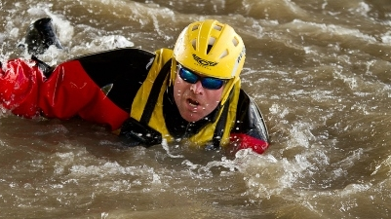
Rope Rescues

Slide 3
Throw Bags
One of the main determinants for selecting a throw bag is to ask yourself the following question.
"Will you take it with you at all times."
If you don't have it with you, you can't use it.

Slide 4

Packing the Throw Bag
The criteria for successfully re-packing a throw bag is that the rope is randomly stuffed into the bag. The operative term is "randomly."
When the rope is randomly stuffed, it comes out without becoming entangled when thrown.

Slide 5
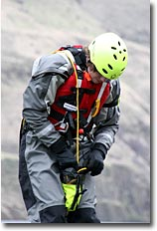
Packing the Throw Bag
First, open the end of the throw bag. Second, hold the bag open using the third, fourth and fifth fingers of each hand.
This frees up the first finger and thumb to stuff the rope.

Slide 6
Packing the Throw Bag
Place the rope over the shoulder.
The life jacket prevents the rope from slipping off the shoulder.
If done correctly, there may be a slight rope burn over the shoulder.
Grasp the rope with the thumb and first finger and stuff hand over hand the rope into the bag.

Slide 7
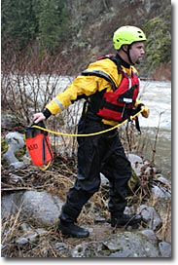
First Throw of a Throw Bag
There are three approaches to throwing a throw bag.
These are the underhand, sidearm an overhand approaches.
All can be use effectively.

Slide 8
First Throw of a Throw Bag
Underhand Throw
Generally, the farthest throws occur underhand.
When standing in knee deep or deeper water, the underhand throw becomes impractical and a side arm or overhand throw needs to be used.

Slide 9
First Throw of a Throw Bag
Sidearm Throw
A sidearm throw may be necessary, depending on your position, obstructions, etc, but accuracy may suffer.
Practice tossing your rescue bag ahead of time; don’t let an emergency catch you unprepared.

Slide 10
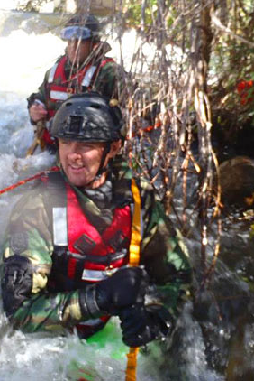
First Throw of a Throw Bag
Overhand Thrown
Overhand throws can be very powerful and are especially useful when you are sitting in a boat or standing in deep water or in tall grass.

Slide 11
First Throw of a Throw Bag
Overhand Thrown
In any case, smoothness and timing are what will help active good distance and accuracy.
Timing is key to hitting your target.

Slide 12
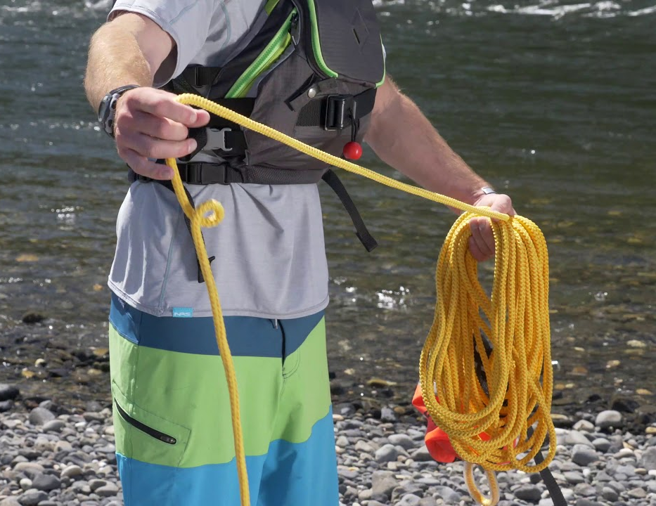
Second Throw
Retrieving the bag, stuffing it, or even filling the retrieved bag with water is not really an option

Slide 13
Second Throw
For the second throw, start coiling the throw bag rope end on shore.
Let the bag float downstream if necessary. Count the coils.
The length of each coil will depend on the person coiling.
Figure three to four feet per coil.

Slide 14
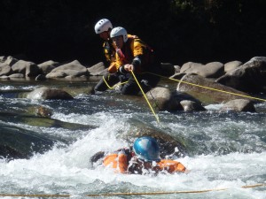
Second Throw
Counting the coils is important
if the victim is fifteen feet away, there needs to be at least five coils or fifteen feet of rope to reach the victim.
If not, the second throw will fall short

Slide 15
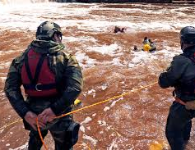
To make the second throw
Take the second coil and hold it in the non-throwing hand.
Step on the line. This prevents the line from slinking away from the rescuer into the river.
With the first coil in the throwing hand, throw it to the victim.

Slide 16
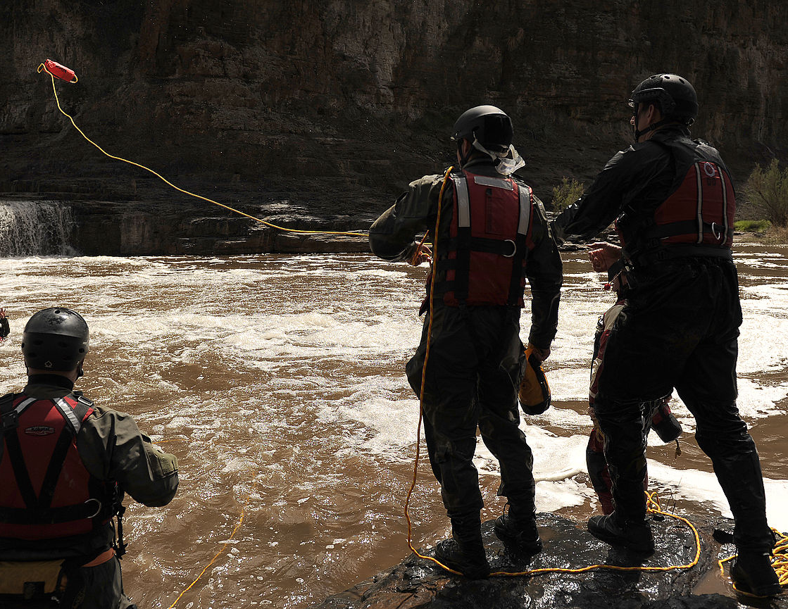
To make the second throw
At the same time gently release the second coil in a manner that doesn't place a drag on the first coil thrown.

Slide 17
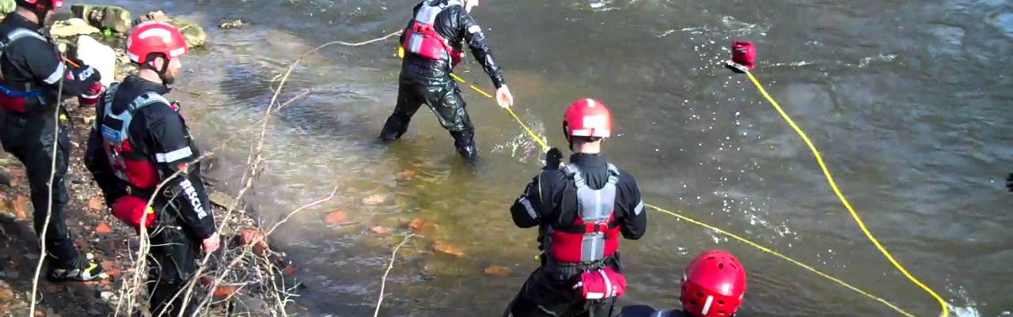
To make the second throw
This takes practice to perfect and most rescuers practice this skill in between rescue drills to perfect their proficiency at this skill.

Slide 18
Throw Bag Drill
Actually the throw bag drill is both a defensive swimming and throw bag throwing drill.
It is an excellent activity to familiarize participants with moving water and its potential dangers.

Slide 19
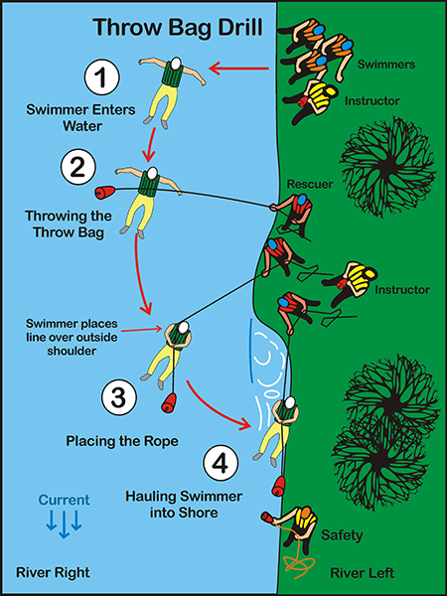
Throw Bag Drill

Slide 20
Throw Bag Drill instructor upstream
The upstream instructor supervises and instructs participants on the following key points.
The first key is the entry into water.
Depending on the site, the entry may involve wading or a Swiftwater entry dive.

Slide 21
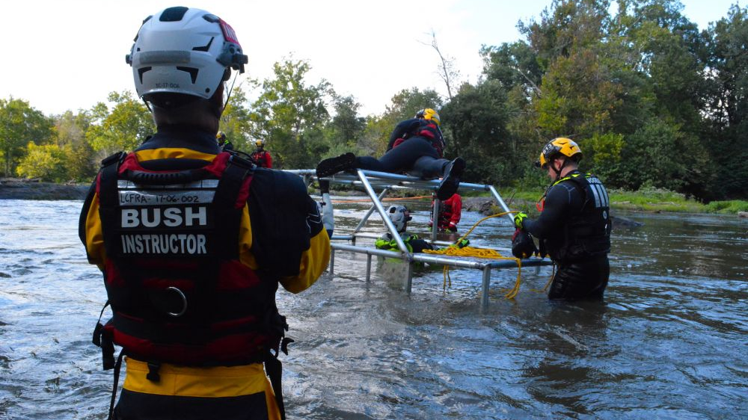
Throw Bag Drill instructor upstream
Next, swimmers may need to be prompted to swim to an appropriate distance away from shore.

Slide 22
Throw Bag Drill instructor upstream
Third, swimmers are reminded to keep their feet up and to use the defensive swimming position.
If properly instructed, a student or participant can assume the instructor's role at this station.

Slide 23
Throw Bag Drill second instructor
The second instructor supervises the throw bag River Right throwers.
This involves the throwing of throw bags and hauling the swimmer into shore.

Slide 24
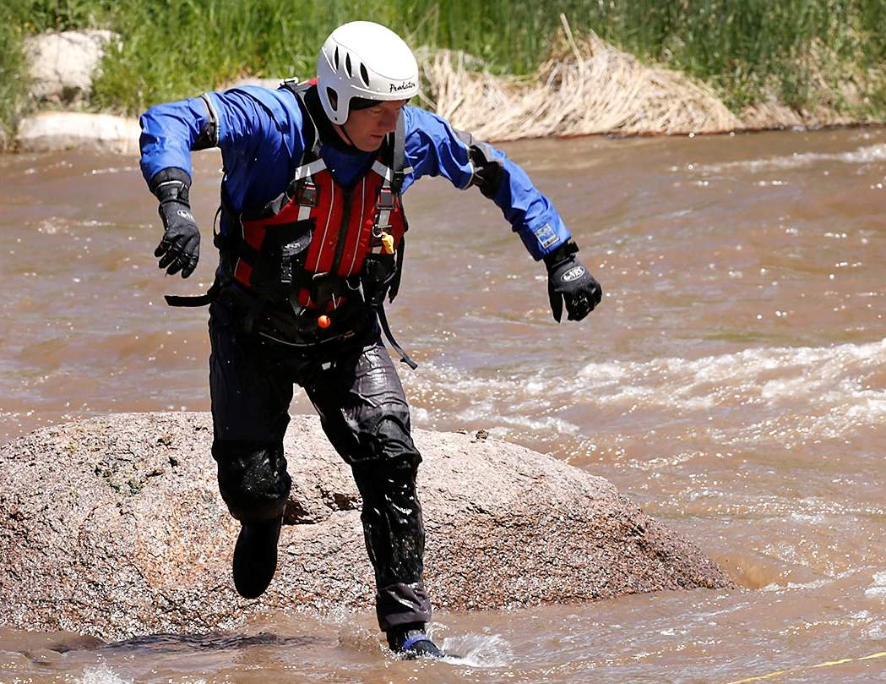
Throw Bag Drill second instructor
Normally, the instructor has a throw bag in hand in case it is needed on missed throws.
In addition, there needs to be good communication between the instructors in coordinating the swimmers and rescuers.

Slide 25
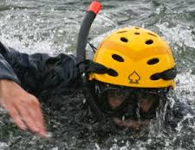
Throw Bag Drill
Downstream Safety
Downstream Safety
One or more downstream safeties should be located downstream to rescue any swimmers not rescued by the throw bag rescuers.

Slide 26
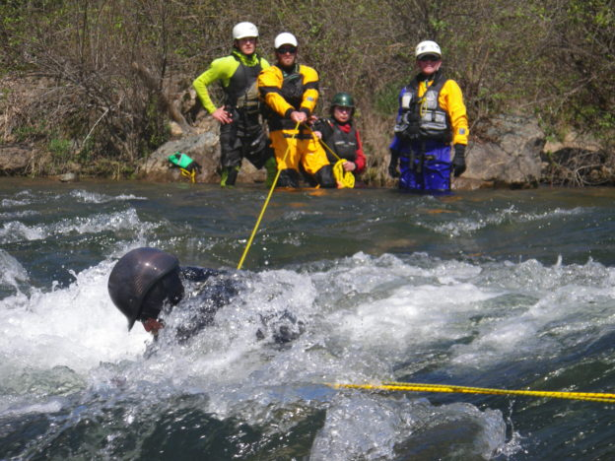
Throw Bag Drill
Downstream Safety
Remember, swimmers can always swim to shore if the rescuers miss them.

Slide 27
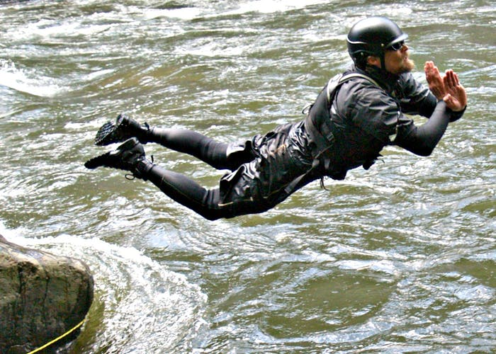
Scene #1
Swimmer Enters the Water
Depending on the site, swimmers can enter the water by wading or using a Swiftwater entry dive.

Slide 28
Scene #1
Swimmer Enters the Water
The Swiftwater entry dive is not really a dive, but a belly-flop with hands held outward to protect the face.
The instructor coordinates the entry with the other instructor and monitors the key points to swimmers.

Slide 29
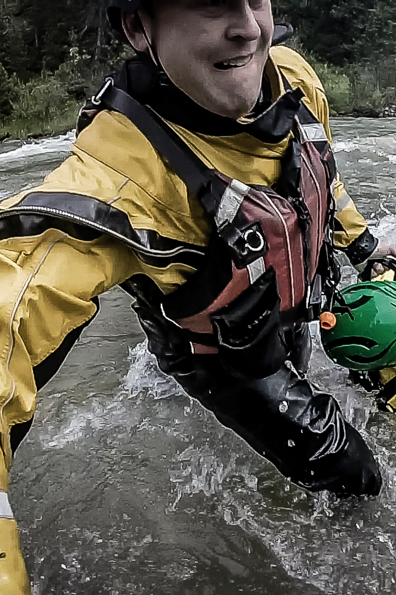
Scene #2:
Throwing the Throw Bag
Holding the throw bag in the throwing hand and grasping the loop in the other hand, the rescuer throws the throw bag to the victim.
Two keys to a good throw are the throw bag should be thrown over or past the swimmer
The line should land over the chest of the victim.

Slide 30
Scene #2
Throwing the Throw Bag
There are numerous variations to this drill.
There can be multiple swimmers and rescuers.
The swimmer can purposely miss the first throw requiring a second throw.

Slide 31
Scene #3
Placing the Rope
The swimmer grabs hold of the line and places it over the shoulder facing away from the rescuer.
The swimmers head is pointing toward the shore and the rescuer.
This creates a good ferry angle for the swimmer that aids in swinging the swimmer to shore.

Slide 32
Scene #3
Placing the Rope
The force of the water at an angle on the swimmer creates a ferry angle.
Some people find the placement of the rope over their outside shoulder objectionable since it can bite into their neck.
They may prefer using the shoulder facing the shore.

Slide 33
Scene #3
Placing the Rope
This is one of those instances where it most likely doesn't matter.
Either shoulder will normally work.
However, placing the rope over the outside shoulder is technically correct

Slide 34
Scene #4
Hauling Swimmer to Shore
The rescuer hauls in the victim to shore.
Ideally, there is a large eddy to haul the swimmer into.
Depending on circumstances, the rescuer can move laterally or inward on shore which increases the pendulum effect.

Slide 35
Scene #4
Hauling Swimmer to Shore
The different belays can be practiced, and if needed a backup be layer can be used.
Participants can be rotated through the different stations including downstream safety.

Slide 36
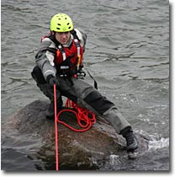
Belays
In a belay, the rope is bent around an object which transfers all or part of the load to the belay object.
Although the focus is on the rescuer's hip belays, rocks and trees can be used as belays.
The rope can be wrapped around a rock or tree. Be sure the rock or tree is substantial.

Slide 37
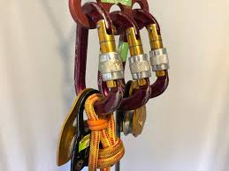
Belays
If needed, the rescuer can add a hip belay to a partial belay around a rock or tree.
In a hip belay, the rope goes around the butt of the rescuer.

Slide 38
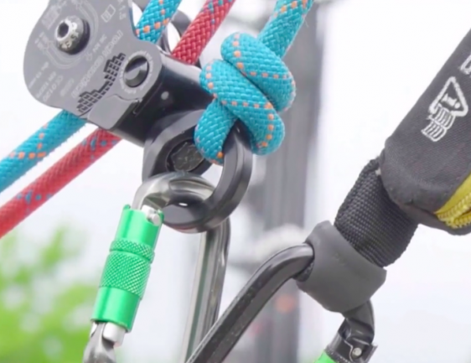
Belays
As a rule, the line extending to the victim is downstream and the unloaded end is on the upstream side of the rescuer.
This reduces the likelihood of the rescuer becoming entangled in the line if they must let go of the victim.

Slide 39
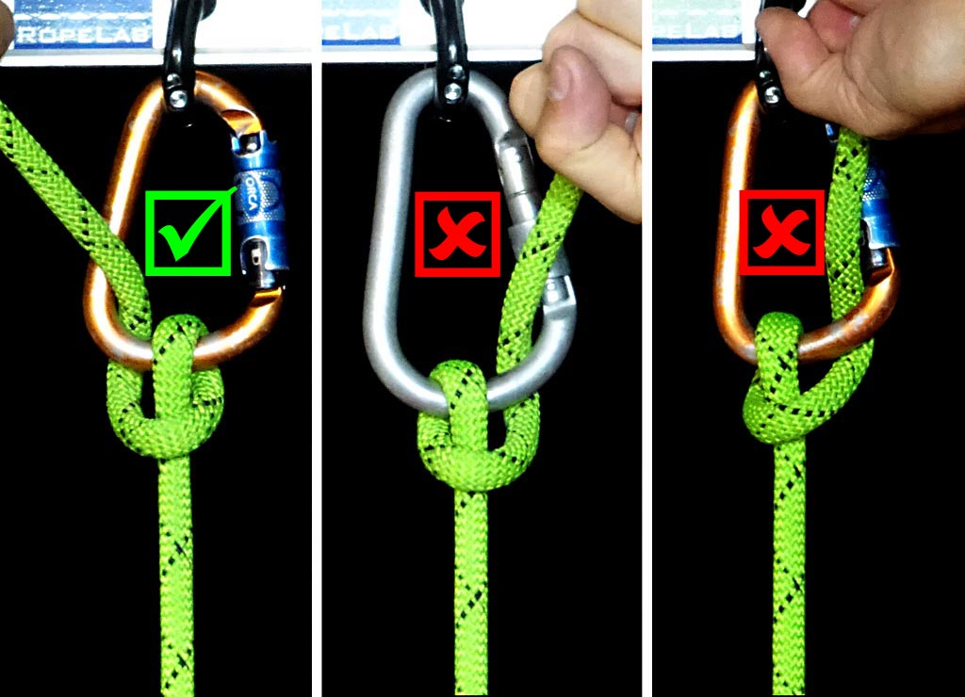
Belays
If the rescuer needs to increase resistance on the belay, he pushes the line over and down the leg in the crouch area with the upstream hand.

Slide 40
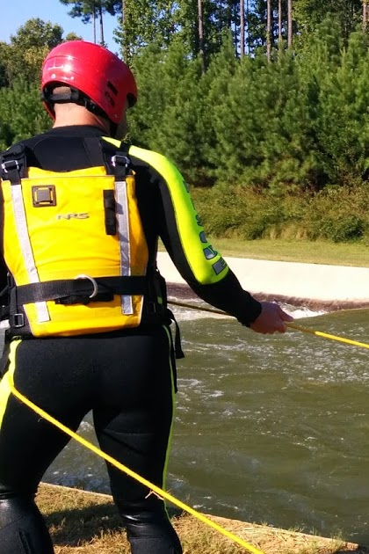
Standing Belay
In a standing belay, the rescuer belays the rope around the upper portion of her butt while standing.
The advantage of a standing belay is that it allows mobility.
The rescuer can move to a new location which can reduce the load and pendulum the swimmer to shore more easily.

Slide 41
Standing Belay
Another rescuer can backup the standing be layer if needed.
The backup belayer holds onto the life jacket shoulder straps of the belayer.

Slide 42
Standing Belay
The backup belayer emphasizes pulling down rather than pulling backwards.
If more belaying is needed, the standup belayer can reposition herself in a sitting belay.

Slide 43
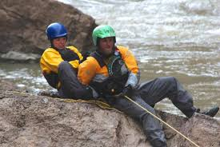
Sitting Belay
In a sitting belay, the rescuer belays the rope around the upper portion of her butt while in a sitting position.
The advantage of a sitting belay is that it offers more resistance with the ground and in general, it can carry more load.

Slide 44
Sitting Belay
Also, the belayer can use rocks and other objects to brace her feet.
The disadvantage is that the rescuer lacks mobility.
As with the standing belay, a backup be layer grasps the shoulder straps of the life jacket and emphasizes pulling downward.

Slide 45
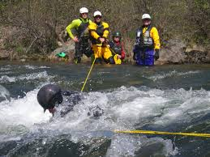
Increasing Pendulum Effect
Many rescue sites have sufficient room to allow the rescuer to take several steps backward toward the shore.
Taking several steps backward or laterally offers the rescuer several benefits.
First, it increases the ability of the rescuer to pendulum the victim to shore.

Slide 46
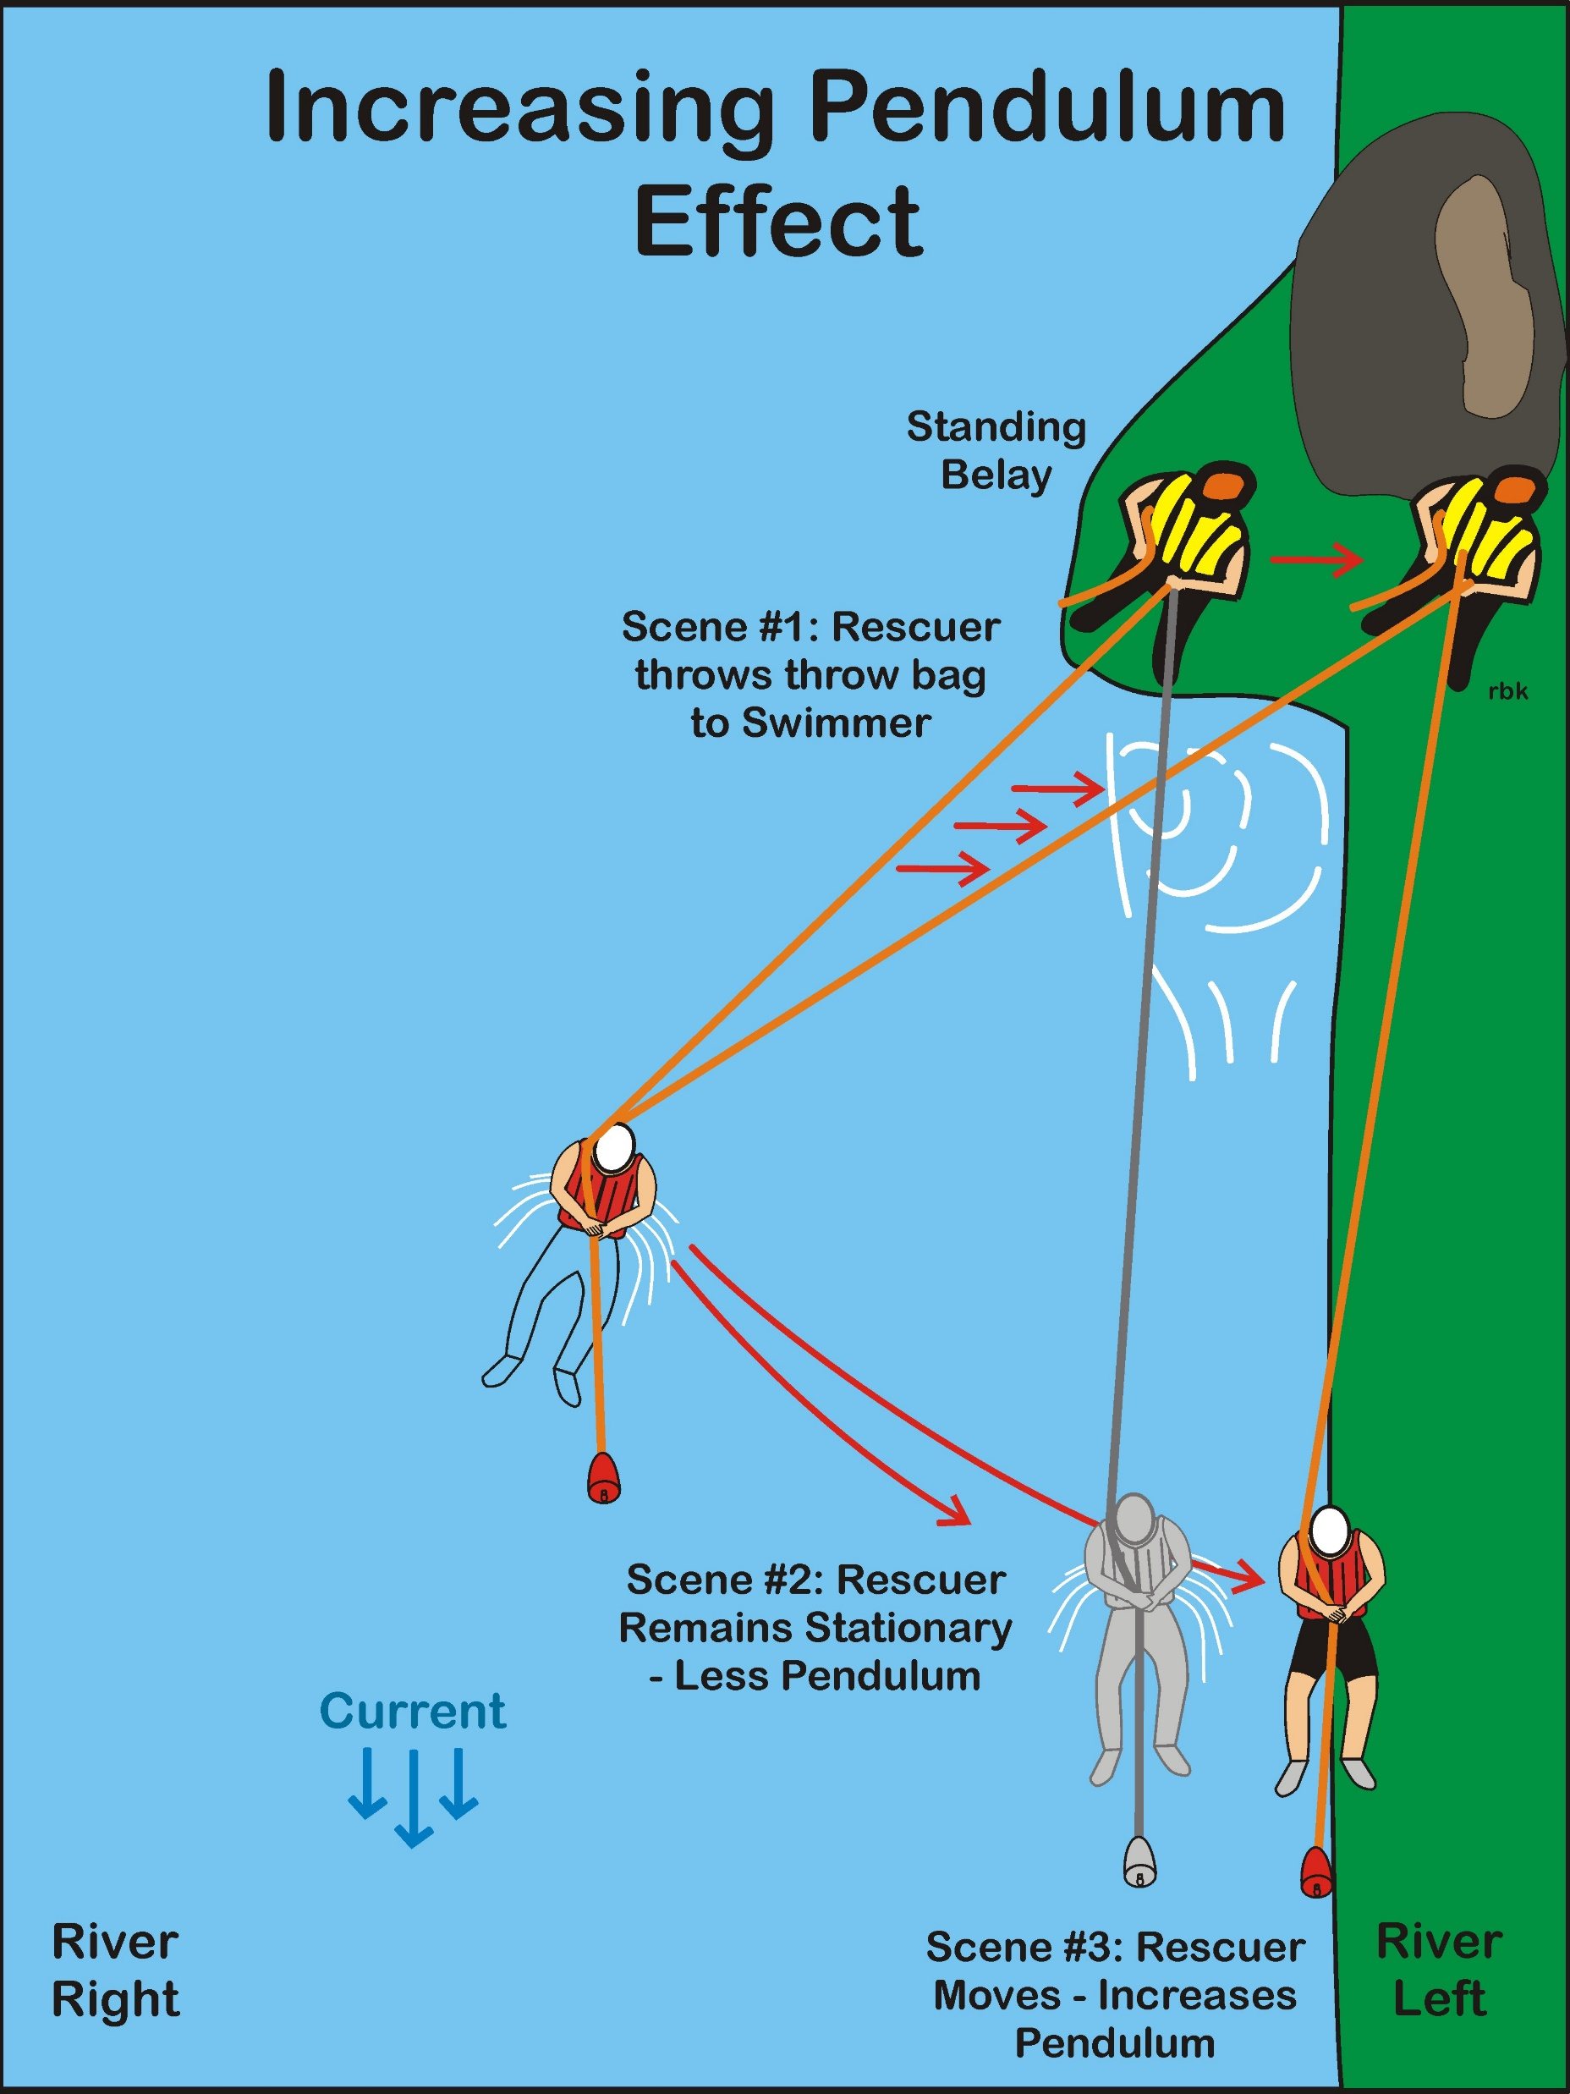

Slide 47
Increasing Pendulum Effect
Scene #2
In Scene #2 the line is parallel with the current and there is no pendulum effect left.
The victim is left dangling in the current.

Slide 48
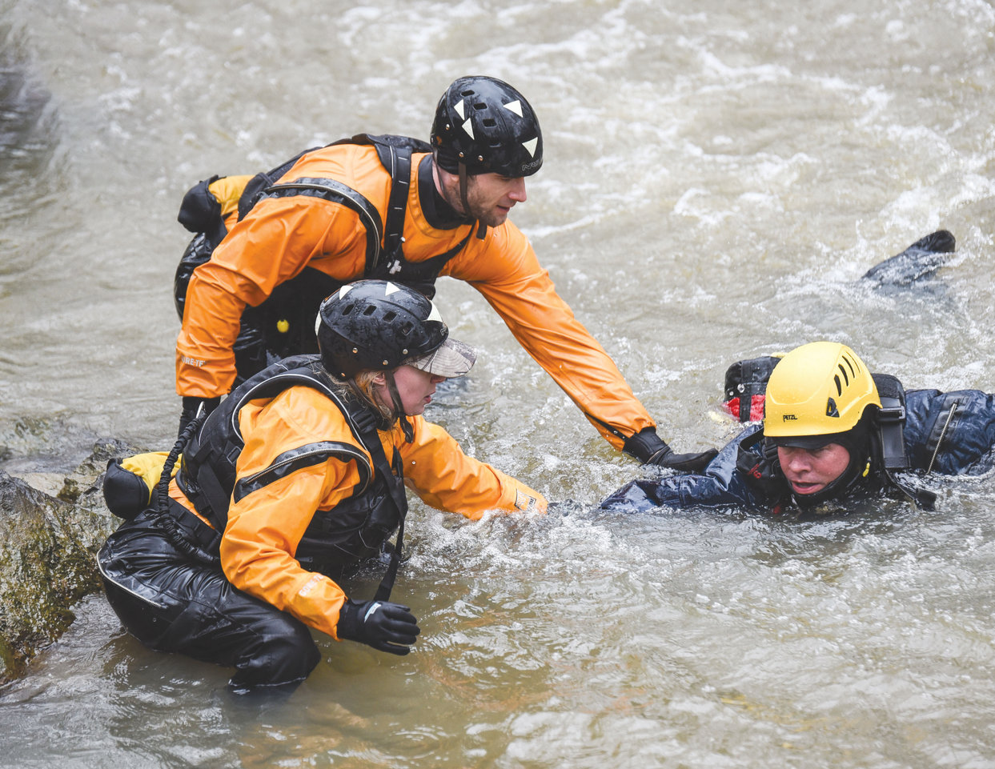
Increasing Pendulum Effect
Scene #2
In Scene #2, the total weight of the victim including the force of the water is borne by the rescuer.
Often this requires the rescuer to go into a sitting belay to counteract the weight of the victim.

Slide 49
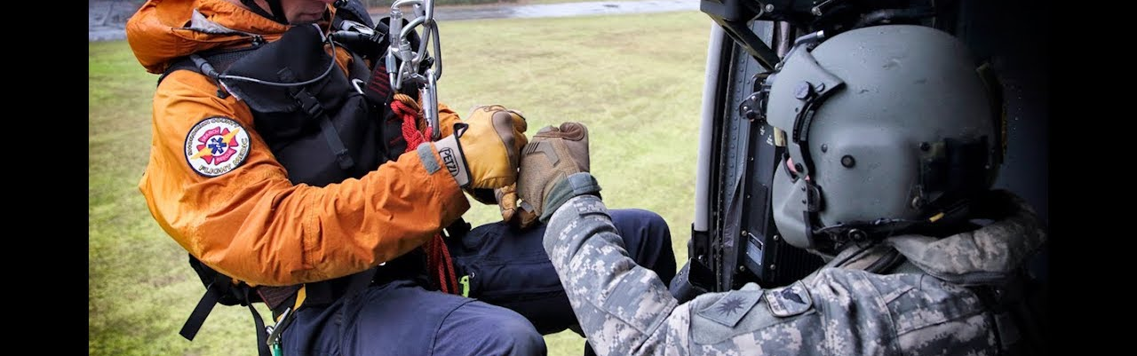
Increasing Pendulum Effect
Scene #2
By taking several steps backward on the shore, there is a greater angle between the line and the current which reduces the weight or force borne by the rescuer.

Slide 50
Increasing Pendulum Effect
Scene #2
In many rescues, the reduced weight or force on the rescuer allows the rescuer to remain in a standing belay.
It may avoid having to use a belay at all, and it allows the rescuer to simply haul the swimmer into shore

Slide 51
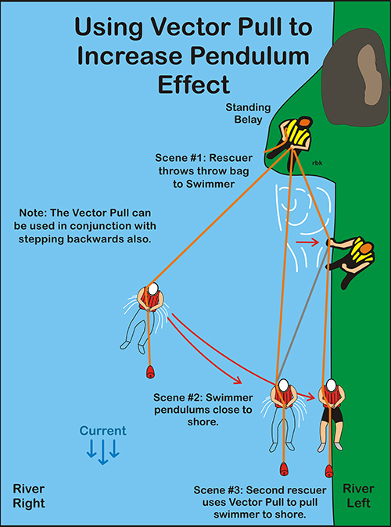

Slide 52
Increasing Pendulum Effect
Scene #3
In Scene #3, the rescuer can pendulum the victim to shore.
Note, there is still an angle in the system if needed.
Second, taking several steps backward, reduces the load on the rescuer.

