Slide 1
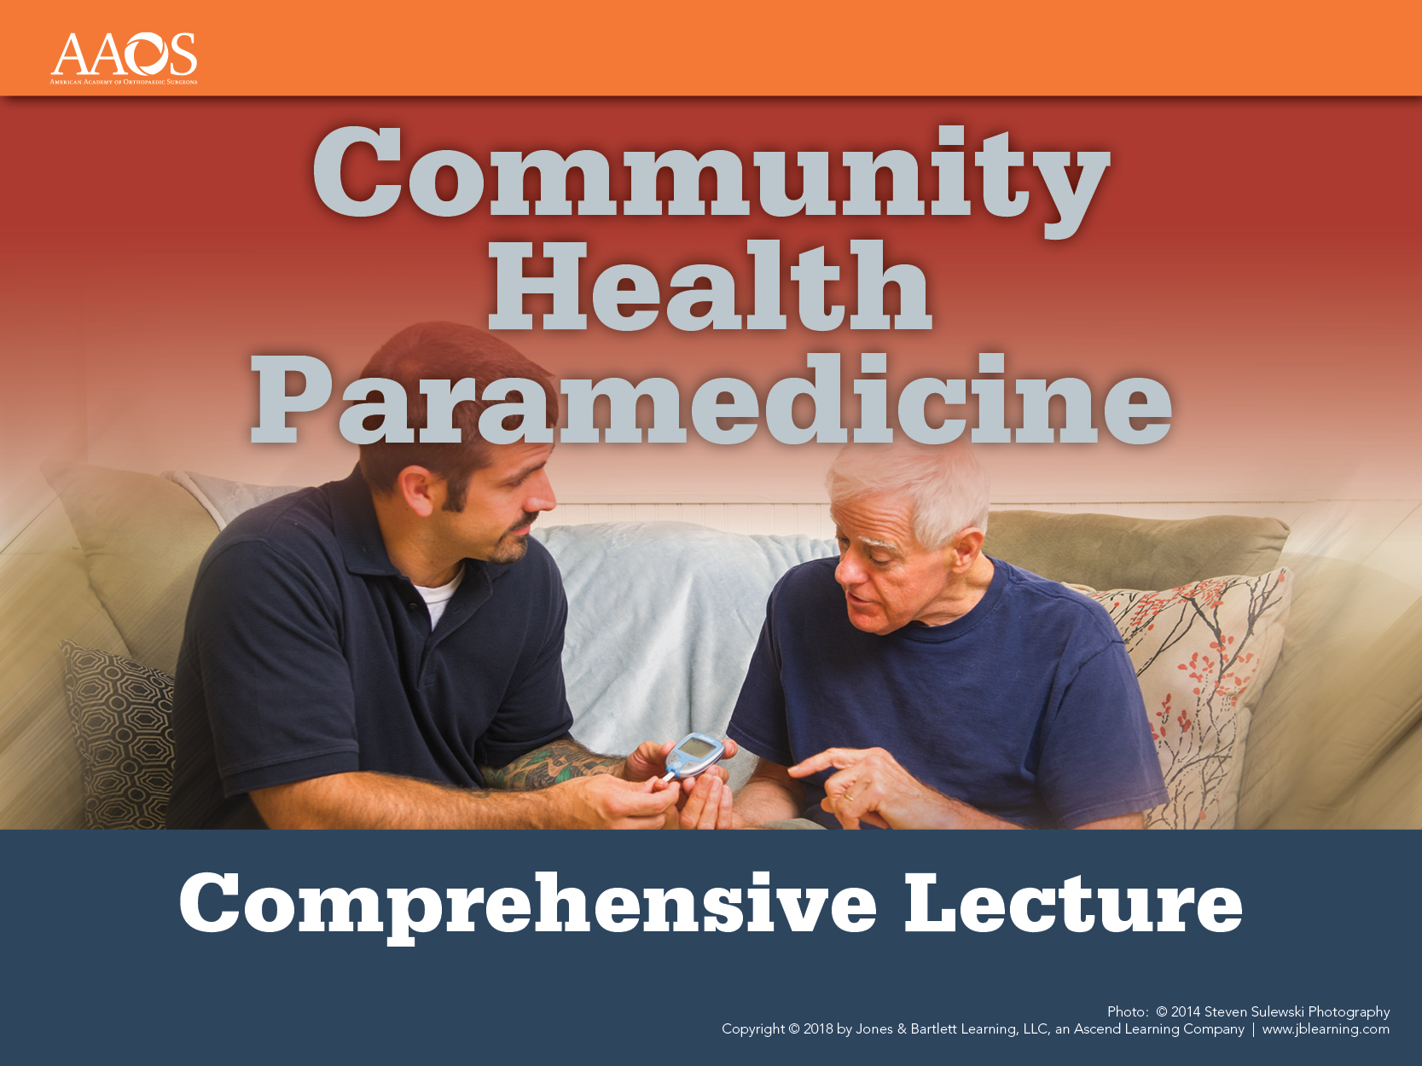
Notes:
Chapter 3: Professional Boundaries

Slide 2
Chapter 3
Professional
Boundaries
Notes:
Chapter 3: Professional Boundaries

Slide 3
Introduction (1 of 4)
Community paramedics compared to EMS
  EMS providers have patient interaction for less than 30 minutes.
  Community paramedic home visits are up to 60 minutes.
Notes:
Lecture Outline
I. Introduction
A. Community paramedic compared to EMS
1. On average, EMS providers have patient contact or interaction for less than 30 minutes.
2. A typical community paramedic home visit will be up to 60 minutes.

Slide 4
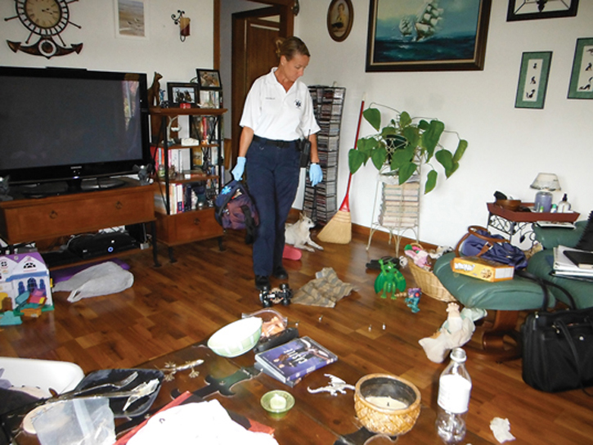
Introduction (2 of 4)
Community paramedic has more exposure to:
  The patient
  The patient’s living environment
  Potential hazards posed by the patient and environment
© Jones & Bartlett Learning
Notes:
Lecture Outline
3. Community paramedic will have more exposure to:
a. The patient
b. The patient’s living environments
c. Potential hazards posed by the patient and environment

Slide 5
Introduction (3 of 4)
Community paramedic establishes a long-term therapeutic relationship over multiple visits
Typical model:
  Community paramedic initially sees patient weekly
  Programs last 4 to 8 weeks
Notes:
Lecture Outline
4. The community paramedic establishes a long-term therapeutic relationship over multiple visits.
a. Typical model:
i. Community paramedic initially sees patient weekly
ii. Programs last 4 to 8 weeks

Slide 6
Introduction (4 of 4)
Change in interaction with patients makes it essential to review:
  Professional boundaries
  Personal safety
  Patient interactions
Notes:
Lecture Outline
5. This change in how community paramedics interact with patients makes it essential to review:
a. Professional boundaries
b. Personal safety
c. Patient interactions

Slide 7
Professional Boundaries (1 of 14)
Built on principles of trust, respect, and confidentiality
Borders within which the relationship occurs
Developed by community paramedic
Critical to success and safety of community paramedic and patient
Notes:
Lecture Outline
II. Professional Boundaries
A. Built on the principles of trust, respect, and confidentiality
1. Borders within which the therapeutic relationship between health care provider and patient occurs.
2. Developed by the community paramedic and maintained by community paramedic and patient
3. Critical for the success and safety of both community paramedic and patient

Slide 8
Professional Boundaries (2 of 14)
Boundaries sometimes represent a set of actions performed to ensure best interests of patient
  Example: Many patient encounters focus solely on the patient’s health issues.
As trust grows, the community paramedic and patient may agree to adjust these boundaries.
Notes:
Lecture Outline
4. Sometimes represent a set of actions performed to ensure the best interests of the patient.
Example: Many patient encounters will focus solely on the patient’s health issues.
5. Professional boundaries often dictate that the community paramedic not delve into personal aspects of the patient’s life.
a. As trust grows, the community paramedic and patient may mutually agree to adjust these boundaries.
b. Care must be taken to not move the boundaries beyond what is professionally acceptable.

Slide 9
Professional Boundaries (3 of 14)
A successful health care provider can gain, develop, and maintain a patient’s trust.
  Trust develops from shared experiences; successful interactions
  Result is more effective communication
    Example: Patient may not stay current with medications because family members are unwilling to go to the pharmacy
Notes:
Lecture Outline
6. A successful health care provider is able to gain, develop, and maintain a patient’s trust.
a. Trust develops from shared experiences and successful interactions.
b. Result is greater openness and more effective communication.
i. Example: Maybe the patient has difficulty staying current with medications because no family members is willing to take him or her to the pharmacy.
c. A patient’s willingness to share details gives the community paramedic greater insight into how to approach patient care holistically.
d. Patient has greater sense of security.

Slide 10
Professional Boundaries (4 of 14)
Continuum of the therapeutic relationship
  Interactions between the patient and health care provider
    Underinvolvement
    Overinvolvement
Notes:
Lecture Outline
7. When considering professional boundaries, it can be beneficial to think of the continuum of the therapeutic relationship.
a. Defined as the interactions between the patient and health care provider
i. Underinvolvement: patient is not receiving adequate attention from health care provider and patient’s health needs are not addressed
ii. Overinvolvement: health care provider is too involved

Slide 11
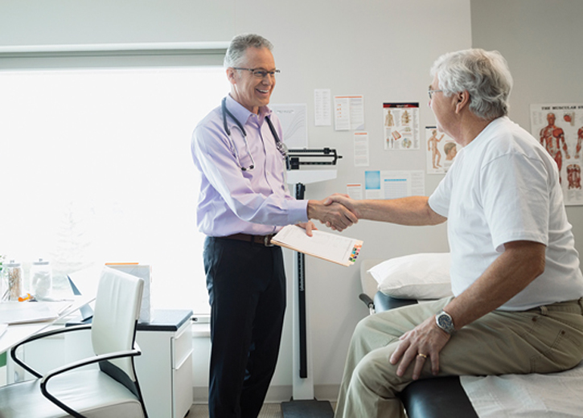
Professional Boundaries (5 of 14)
Physicians maintain boundaries while building trust
  Compassionate care without overinvolvement
  Professional distance and boundaries
© Hero Images/Getty
Notes:
Lecture Outline
8. This balance between maintaining professional boundaries but also building trust and confidence is also faced by physicians.
a. Strive for compassionate and empathetic care without overinvolvement
b. Achieve this by maintaining a professional distance and boundaries while providing care

Slide 12
Professional Boundaries (6 of 14)
Within the patients’ homes, the community paramedic must:
  Establish trust
  Keep a professional distance
  Maintain open lines of communication
Notes:
Lecture Outline
9. Within the boundaries of the patients’ homes, community paramedics must:
a. Establish trust
b. Keep a professional distance
c. Maintain open lines of communication

Slide 13
Professional Boundaries (7 of 14)
Role of community paramedic in maintaining professional boundaries
  As a professional, the community paramedic must:
    Act in the best interests of the patient
    Be responsible for managing boundary issues
Notes:
Lecture Outline
B. Role of the community paramedic in maintaining professional boundaries
1. As the professional, the community paramedic must:
a. Act in the best interests of the patient
b. Be responsible for managing any boundary issues
2. Community paramedic must maintain the boundaries because:
a. Some patients may have challenges with setting boundaries and protecting themselves if boundaries are breached, especially patients with chronic illness or disability.
b. Some patients may breach a boundary.

Slide 14
Professional Boundaries (8 of 14)
When boundaries are understood, both parties are protected physically and mentally
Clearly defined limits on:
  Physical contact
  Emotional attachment
  Privacy
Notes:
Lecture Outline
3. When both the community paramedic and the patient understand and respect professional boundaries, both are protected physically and mentally.
a. There are clearly defined limits on:
i. Physical contact
ii. Emotional attachment
iii. Privacy

Slide 15
Professional Boundaries (9 of 14)
Compassion fatigue
  Health care provider becomes overwhelmed by patient’s problems, sadness, or grief
  Signs of compassion fatigue:
    Anger/anxiety when seeing patient’s name
    Frustration/anger when interacting with patient
    Strong desire to avoid contact with patient
Notes:
Lecture Outline
5. Compassion fatigue
a. Occurs when the health care provider becomes overwhelmed by a patient’s problems, sadness, or grief.
b. Signs of compassion fatigue:
i. A sense of anger or anxiety when the patient’s name appears on the list of home visits
ii. Frustration and a short temper when interacting with the patient during home visits
iii. A strong desire to avoid any contact with the patient or answer any of the patient’s calls

Slide 16
Professional Boundaries (10 of 14)
Common challenges
  Appropriate level of self-disclosure
  Visiting patients while off duty
  Living in a small community
  Giving or receiving significant gifts
Notes:
Lecture Outline
C. Common challenges in maintaining professional boundaries
1. Common areas where setting professional boundaries can be challenging:
a. Offering an appropriate level of self-disclosure (eg, sharing information that could endanger community paramedic or community paramedic’s family)
b. Visiting patients while off duty
c. Living in a small community
d. Giving or receiving significant gifts (eg, a patient could expect favors and special treatment in return for gifts)

Slide 17
Professional Boundaries (11 of 14)
Common challenges (cont’d)
  Managing dual or overlapping relationships
    Becoming friends
    Maintaining established conventions
    Engaging in physical contact
Notes:
Lecture Outline
e. Managing dual and overlapping relationships
i. Becoming friends (eg, patient tries to leverage the previous relationship to influence care; temptation on part of provider to provide above standard of care)
ii. Maintaining established conventions
iii. Engaging in physical contact

Slide 18
Professional Boundaries (12 of 14)
Common dilemmas
  Questions to ask yourself
    Is this in my patient’s best interest?
    How will this impact the service that I am providing?
    How would this be viewed by the patient’s family, significant other, or physician?
    Am I comfortable documenting this decision or behavior?
Notes:
Lecture Outline
D. Common dilemmas in maintaining professional boundaries
1. If boundaries are being crossed, ask yourself the following questions:
Is this is my patient’s best interest?
Whose needs are being served?
How will this have an impact on the service that I am providing?
Should I make note of my concerns or consult with a colleague or supervisor?
How would this be viewed by the patient’s family, significant other, or physician?
How would I feel telling a colleague or the patient’s physician about this?
Am I treating this patient differently? (For example, appointment lengths, time of appointments, extent of personal disclosures)
Does the patient mean anything “special” to me?
Am I taking advantage of the patient?
Does this action benefit me or my agency rather than my patient?
Am I comfortable in documenting this decision or behavior in the patient file?

Slide 19
Professional Boundaries (13 of 14)
Warning signs of violations
  Romantic or sexual thoughts
  Spending free time with patient
  Discussing work concerns with the patient
  Making special exceptions for a patient
  Feedback from others about your behavior
  Showing favoritism
Notes:
Lecture Outline
E. Warning signs of professional boundary violations
1. Warning signs that indicate that a professional boundary has been crossed or is about to be crossed include the following:
a. Frequently thinking of the patient when away from work, including romantic or sexual thoughts
Seeking social contact or spending free time with the patient
Feeling a sense of excitement or longing related to the patient
Sharing personal information or discussing work concerns, including talking about coworkers, with the patient
e. Feeling so strongly about the patient’s goals that you disregard colleagues’ comments or the wishes of the patient or his or her family, or believing you are the only one who can understand or help achieve the patient’s goals
f. Feeling responsible for the patient’s limited progress
g. Noticing more physical touching than is appropriate or required for the situation
h. Mentioning sexual content in conversations with the patient
i. Making special exceptions for your patient because the patient is appealing, impressive, or well connected
j. Receiving feedback from others that your behavior with the patient is overly familiar or intrusive
l. Keeping secrets with or for a patient
l. Showing favoritism
m. Meeting a patient in a setting that is not conducive to providing patient care

Slide 20
Professional Boundaries (14 of 14)
Potential consequences
  Uncomfortable situations
  Claims of harassment or litigation
  Community paramedic’s safety in jeopardy
    Example: Community paramedic using terms “babe” or “honey” may lead the patient to think physical contact is okay.
Notes:
Lecture Outline
F. Potential consequences of blurry boundaries
1. At the very least, blurred boundaries can create uncomfortable situations for the patient or the community paramedic.
2. The most severe consequences can include:
a. Claims of harassment with litigation pursuant to those claims
b. Situations in which the community paramedic’s safety is in jeopardy
i. Example: A community paramedic using the terms “babe” or “honey” may lead the patient to believe that initiating physical contact is okay.

Slide 21
Personal Safety
Stages of a home visit
  Before
  During
  After
Notes:
Lecture Outline
III. Personal Safety
A. Stages of a home visit
1. The community paramedic must prepare for a home visit by anticipating all the stages of the home visit:
a. Before
b. During
c. After

Slide 22
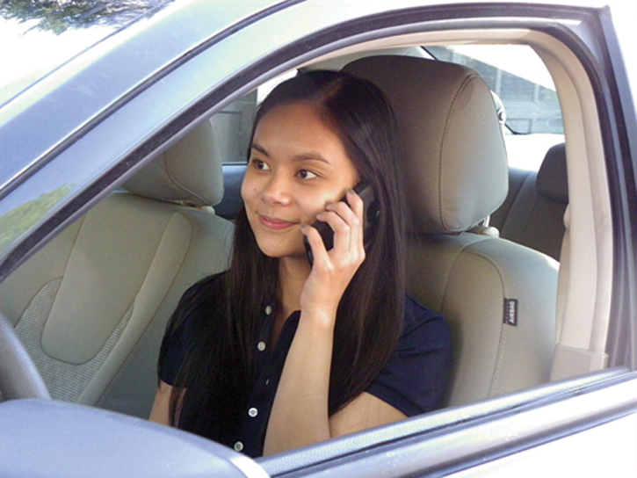
Before the Home Visit (1 of 7)
Let your supervisor and colleagues know your schedule.
Use dispatch to track your location.
© Jones & Bartlett Learning.
Notes:
Lecture Outline
B. Before the home visit
1. Let your supervisor and colleagues know your schedule
2. Use dispatch to track your location (ie, radio or call in)
a. Arrival on scene
b. Departure from scene

Slide 23
Before the Home Visit (2 of 7)
Know where you are going.
Contact the patient so he or she is prepared.
In the vehicle
  Ensure car is in good working order.
  Check the backseat and beneath vehicle.
  Keep valuables in trunk.
Notes:
Lecture Outline
3. Keep information about the patient up-to-date.
4. If unfamiliar with the patient or the location of the patient’s home, ask another staff member.
5. Know where you are going before you get into your vehicle.
6. Contact your patient before your visit so the patient is prepared for your arrival.
7. In the vehicle
a. Ensure your vehicle is in good working order.
b. Before entering the vehicle, check the backseat and scan beneath the vehicle.
c. Keep your doors locked at all times and the windows up.
d. Keep all valuables (eg, smartphones, laptops, and purses) out of sight. These items should be locked in the trunk before you leave the agency.

Slide 24

Before the Home Visit (3 of 7)
In the vehicle (cont’d)
  Choose a well-lit parking space.
  Do not park in patient’s driveway or on dead-end street.
© elwynn/Shutterstock
Notes:
Lecture Outline
e. To protect your tires and vehicle, avoid driving over garbage, potholes, and broken glass. Slow down when approaching speed bumps.
f. Park your vehicle where you can see it. Choose a parking space that is well lit or that offers the safest walking route.
g. Do not park in the patient’s driveway or on a dead-end street. Park in the direction that you will want to go when leaving the home.

Slide 25
Before the Home Visit (4 of 7)
In the community
  Be alert and observant.
  Be aware of your surroundings.
  Carry a cell phone/smartphone/portable radio.
  Visit unfamiliar locations early in the day.
  Introduce yourself to business and institutions.
  Call the office at scheduled check-in times.
Notes:
Lecture Outline
8. In the community
a. When you are traveling to your appointment, be alert and observant. Be aware of your surroundings (ie, do not wear headphones, text, and make phone calls).
b. Carry a cell phone, smartphone, or portable radio, if available.
c. When making initial visits to unfamiliar locations, arrange your schedule so that you can make these visits early in the day.
d. Introduce yourself to local businesses and institutions.
e. Call the office at scheduled check-in times.

Slide 26
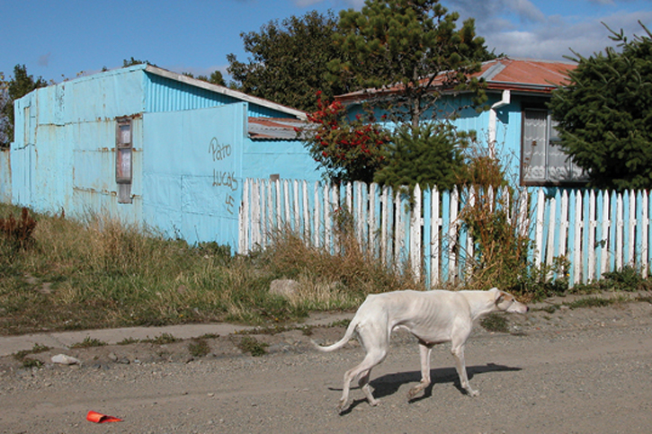
Before the Home Visit (5 of 7)
Approaching the home
  Trust your instincts.
  Leave immediately if you feel uncomfortable.
  Look for hazards before parking.
© zofia/iStock/Getty
Notes:
Lecture Outline
9. Approaching the home
a. When approaching the home, trust your instincts.
b. If you feel uncomfortable, leave immediately.
c. Before parking your vehicle, drive around the area and look for potential hazards (eg, poor lighting, limited visibility, unsecured animals, people yelling, fighting, drinking, or loitering).

Slide 27
Before the Home Visit (6 of 7)
Approaching the home (cont’d)
  If the address is incorrect, call dispatch or your agency.
  If followed on foot, enter closest public building
  If followed by car, walk in the opposite direction
  If people are loitering, walk across the street
  If confronted verbally, be professional
Notes:
Lecture Outline
d. If the address you have is incorrect, call dispatch or your agency.
e. If you suspect that you are being followed on foot, enter the closest public building and call for help.
f. If a car is following you while you are on foot, turn around and walk in the opposite direction past the car.
g. If people are loitering on the street or sidewalk, give yourself as much room as possible and walk around them or cross the street. Walk with confidence and purpose.
h. If you are confronted verbally, maintain a professional demeanor. Do not attempt to answer verbal challenges.

Slide 28
Before the Home Visit (7 of 7)
Approaching the home (cont’d)
  Wear clothes and shoes that are easy to run in.
  Lock valuables in the trunk of your vehicle.
  Keep your keys securely on you.
  Use an empty elevator if possible; press buttons yourself.
Notes:
Lecture Outline
Wear shoes and clothing that are easy to move and run in, should you need to escape a situation.
j. Valuables such as a purse should not be carried in the field; they should be locked in the trunk of the vehicle.
k. Keep your keys securely on you.
l. If you must use an elevator, use an empty one if possible. Press any necessary buttons yourself.

Slide 29
During the Home Visit (1 of 2)
During the home visit
  Note “No trespassing” and “Beware of dog” signs.
  If you hear yelling from the door, leave immediately.
  If you are unfamiliar with the person who answers the door, find out who he or she is.
Notes:
Lecture Outline
C. During the home visit
1. At the home, take note of signs such as “No trespassing” or “Beware of dog.” Such signs may be indicators of the homeowners’ attitude toward strangers.
2. Before knocking on the door, pause and listen. If you hear unsafe activity such as yelling, leave immediately.
3. If you are unfamiliar with the person who answers the door, before entering the home, find out who the person is and why he or she is at the home during your visit.

Slide 30
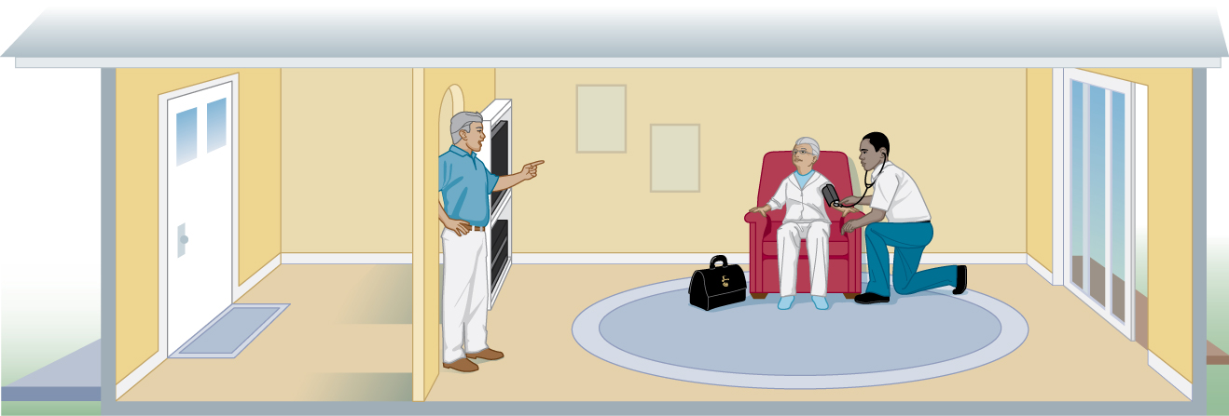
During the Home Visit (2 of 2)
During the home visit (cont’d)
  Note your entry and exit points.
  Maintain situational awareness.
  Utilize sharps techniques and aseptic practices.
© Jones & Bartlett Learning
Notes:
Lecture Outline
4. As you approach the patient, note your entry and exit points and make sure you have a clear path of escape.
5. Maintain situational awareness as you work with the patient. This can be achieved by noting any changes in body language that may indicate a change in the patient’s mood.
6. You will need to practice universal precautions. Utilize sharps techniques and aseptic practices. Always wear appropriate personal protective equipment.

Slide 31
After the Home Visit
Additional steps to maintain personal safety
  Wash your hands.
  Disinfect the equipment.
  Document the patient encounter.
    Report uncomfortable and unsafe situations.
Notes:
Lecture Outline
D. After the home visit
1. After the home visit is completed, there are additional steps you can take to maintain your personal safety.
a. Wash your hands.
b. Disinfect your equipment to ensure that you do not contaminate yourself or your next patient.
c. Document the patient encounter. This protects you legally. Document any uncomfortable or unsafe situations and report such incidents to your supervisor.

Slide 32
Personal Safety Plan (1 of 5)
A personal safety plan
  Tool that allows the community paramedic to:
    Assess the situation
    Preplan ways to ensure personal safety
Notes:
Lecture Outline
IV. Personal Safety Plan
A. Components of a personal safety plan
1. A personal safety plan is a tool that allows the community paramedic to:
a. Assess the situation
b. Preplan ways to ensure personal safety during patient encounters

Slide 33
Personal Safety Plan (2 of 5)
Components of a personal safety plan
  Previsit procedures
    Familiarizing yourself with the neighborhood; identifying entry and exit points
  During the visit procedures
    Keeping your back to the wall, wearing appropriate PPE
  Postvisit procedures
    Decontamination and documentation procedures
Notes:
Lecture Outline
2. Common components of a personal safety plan may include (but are not limited to):
Previsit procedures
i. This section outlines the steps you will take before entering the patient’s home to ensure your safety (eg, familiarizing yourself with the neighborhood; identifying, from your view of the home’s exterior, entry and exit points; reviewing the patient’s demographic information)
During the visit procedures
i. This section outlines what you will be doing during the home visit (eg, not allowing the patient or a family member to position themselves behind you, keeping your back to the wall to ensure no one is able to approach you from behind, and wearing appropriate personal protective equipment).
Postvisit procedures
i. This section outlines what you will be doing after the visit. It can include your decontamination procedures, documentation procedures, and scheduling of further appointments.

Slide 34
Personal Safety Plan (3 of 5)
Components of a personal safety plan (cont’d)
  Communication procedures
    Ensuring dispatch always knows your location; how and when to contact dispatch
  Personal disclosure procedures
    Deciding how much personal information you will disclose to your patients
Notes:
Lecture Outline
Communication procedures
i. This section includes the procedures you will follow to communicate with your patient and with your agency.
ii. How will you ensure that dispatch knows your location at all times?
iii. Will you radio in or will you have access to a cell phone?
iv. How and when will you contact dispatch?
v. How and when will you contact law enforcement or backup if you need it?
Personal disclosure procedures
i. Before the home visit, determine how much personal information you will disclose to your patients.
ii. If you have already determined that you will not share certain information, such as details about your family, it is easier to stick to that plan when the situation arises than to decide in the moment whether you should share that information when the patient asks about you.

Slide 35
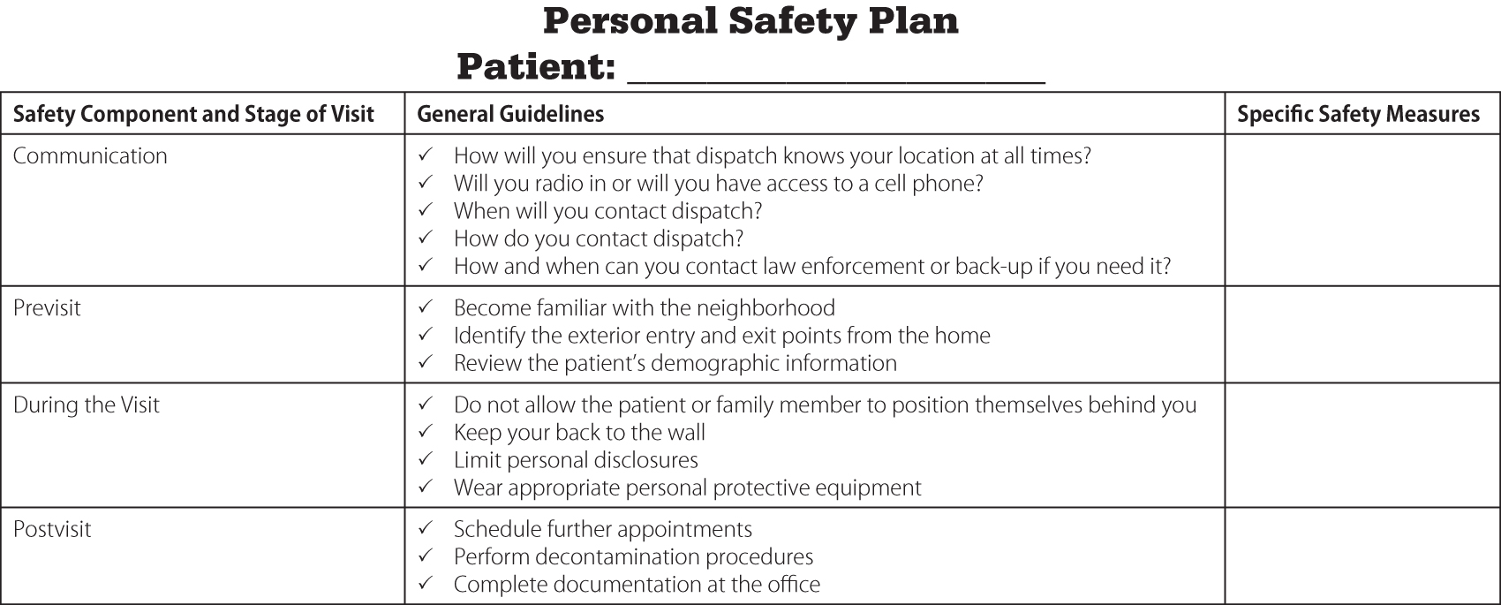
Personal Safety Plan (4 of 5)
Developing a personal safety plan
  Outline each component and how you will address it
© Jones & Bartlett Learning
Notes:
Lecture Outline
B. Developing the personal safety plan
1. Developing a personal safety plan can be as simple as creating a document or table on your computer and outlining each component and how you will address it.

Slide 36
Personal Safety Plan (5 of 5)
Developing a personal safety plan (cont’d)
  Plan should be comprehensive but simple
  Talk to your supervisor.
  Adjust your plan for specific patient situations.
  Be flexible with your plan.
Notes:
Lecture Outline
a. Your personal safety plan should be comprehensive but simple.
b. Meet with your supervisor about developing the personal safety plan. He or she can help you think through appropriate actions that will protect you while following agency protocols and procedures.
c. You may have to adjust your personal safety plan based on specific patient situations (eg, one patient may live on a dead-end road; another may live several floors up in a high-rise apartment building).
d. You will need to be flexible with your personal safety plan.

